Slide 1

Numbers 1:20-46
Reading by
Gary Tapp
True Words Baptist Church | 1377 S. 20th St. Louisville, KY | TrueWordsBaptist.org

Slide 2
Numbers 1:20-46 And the children of Reuben, Israel's eldest son, by their generations, after their families, by the house of their fathers, according to the number of the names, by their polls, every male from twenty years old and upward, all that were able to go forth to war; 21 Those that were numbered of them, even of the tribe of Reuben, were forty and six thousand and five hundred. 22 Of the children of Simeon, by their generations, after their families, by the house of their fathers, those that were numbered of them, according to the number of the names, by their polls, every male from twenty years old and upward, all that were able to go forth to war; 23 Those that were numbered of them, even of the tribe of Simeon, were fifty and nine thousand and three hundred. 24 Of the children of Gad, by their generations, after their families, by the house of their fathers, according to the number of the names, from twenty years old and upward, all that were able to go forth to war; 25 Those that were numbered of them, even of the tribe of Gad, were forty and five thousand six hundred and fifty. 26 Of the children of Judah, by their generations, after their families, by the house of their fathers, according to the number of the names, from twenty years old and upward, all that were able to go forth to war; 27 Those that were numbered of them, even of the tribe of Judah, were threescore and fourteen thousand and six hundred. 28 Of the children of Issachar, by their generations, after their families, by the house of their fathers, according to the number of the names, from twenty years old and upward, all that were able to go forth to war; 29 Those that were numbered of them, even of the tribe of Issachar, were fifty and four thousand and four hundred.

Slide 3
Numbers 1:30-46 Of the children of Zebulun, by their generations, after their families, by the house of their fathers, according to the number of the names, from twenty years old and upward, all that were able to go forth to war; 31 Those that were numbered of them, even of the tribe of Zebulun, were fifty and seven thousand and four hundred. 32 Of the children of Joseph, namely, of the children of Ephraim, by their generations, after their families, by the house of their fathers, according to the number of the names, from twenty years old and upward, all that were able to go forth to war; 33 Those that were numbered of them, even of the tribe of Ephraim, were forty thousand and five hundred. 34 Of the children of Manasseh, by their generations, after their families, by the house of their fathers, according to the number of the names, from twenty years old and upward, all that were able to go forth to war; 35 Those that were numbered of them, even of the tribe of Manasseh, were thirty and two thousand and two hundred. 36 Of the children of Benjamin, by their generations, after their families, by the house of their fathers, according to the number of the names, from twenty years old and upward, all that were able to go forth to war; 37 Those that were numbered of them, even of the tribe of Benjamin, were thirty and five thousand and four hundred. 38 Of the children of Dan, by their generations, after their families, by the house of their fathers, according to the number of the names, from twenty years old and upward, all that were able to go forth to war; 39 Those that were numbered of them, even of the tribe of Dan, were threescore and two thousand and seven hundred.

Slide 4
Numbers 1:40-46 Of the children of Asher, by their generations, after their families, by the house of their fathers, according to the number of the names, from twenty years old and upward, all that were able to go forth to war; 41 Those that were numbered of them, even of the tribe of Asher, were forty and one thousand and five hundred. 42 Of the children of Naphtali, throughout their generations, after their families, by the house of their fathers, according to the number of the names, from twenty years old and upward, all that were able to go forth to war; 43 Those that were numbered of them, even of the tribe of Naphtali, were fifty and three thousand and four hundred. 44 These are those that were numbered, which Moses and Aaron numbered, and the princes of Israel, being twelve men: each one was for the house of his fathers. 45 So were all those that were numbered of the children of Israel, by the house of their fathers, from twenty years old and upward, all that were able to go forth to war in Israel; 46 Even all they that were numbered were six hundred thousand and three thousand and five hundred and fifty.

Slide 5
Tribe by Tribe Military Roll Call: Numbers 1:20-46 Explained
True Words Baptist Church | 1377 S. 20th St. Louisville, KY | TrueWordsBaptist.org

Slide 6
Numbers 1:20–21 And the children of Reuben, Israel's eldest son, by their generations, after their families, by the house of their fathers, according to the number of the names, by their polls, every male from twenty years old and upward, all that were able to go forth to war; 21 Those that were numbered of them, even of the tribe of Reuben, were forty and six thousand and five hundred.

Slide 7
Numbers 1:22-23 Of the children of Simeon, by their generations, after their families, by the house of their fathers, those that were numbered of them, according to the number of the names, by their polls, every male from twenty years old and upward, all that were able to go forth to war; 23 Those that were numbered of them, even of the tribe of Simeon, were fifty and nine thousand and three hundred.

Slide 8
Numbers 1:24-25 Of the children of Gad, by their generations, after their families, by the house of their fathers, according to the number of the names, from twenty years old and upward, all that were able to go forth to war; 25 Those that were numbered of them, even of the tribe of Gad, were forty and five thousand six hundred and fifty.

Slide 9
Numbers 1:26-27 Of the children of Judah, by their generations, after their families, by the house of their fathers, according to the number of the names, from twenty years old and upward, all that were able to go forth to war; 27 Those that were numbered of them, even of the tribe of Judah, were threescore and fourteen thousand and six hundred.

Slide 10
Numbers 1:28-29 Of the children of Issachar, by their generations, after their families, by the house of their fathers, according to the number of the names, from twenty years old and upward, all that were able to go forth to war; 29 Those that were numbered of them, even of the tribe of Issachar, were fifty and four thousand and four hundred.

Slide 11
Numbers 1:30-31 Of the children of Zebulun, by their generations, after their families, by the house of their fathers, according to the number of the names, from twenty years old and upward, all that were able to go forth to war; 31 Those that were numbered of them, even of the tribe of Zebulun, were fifty and seven thousand and four hundred.

Slide 12
Numbers 1:32-33 Of the children of Joseph, namely, of the children of Ephraim, by their generations, after their families, by the house of their fathers, according to the number of the names, from twenty years old and upward, all that were able to go forth to war; 33 Those that were numbered of them, even of the tribe of Ephraim, were forty thousand and five hundred.

Slide 13
Numbers 1:34-35 Of the children of Manasseh, by their generations, after their families, by the house of their fathers, according to the number of the names, from twenty years old and upward, all that were able to go forth to war; 35 Those that were numbered of them, even of the tribe of Manasseh, were thirty and two thousand and two hundred.

Slide 14
Numbers 1:36-37 Of the children of Benjamin, by their generations, after their families, by the house of their fathers, according to the number of the names, from twenty years old and upward, all that were able to go forth to war; 37 Those that were numbered of them, even of the tribe of Benjamin, were thirty and five thousand and four hundred.

Slide 15
Numbers 1:38-39 Of the children of Dan, by their generations, after their families, by the house of their fathers, according to the number of the names, from twenty years old and upward, all that were able to go forth to war; 39 Those that were numbered of them, even of the tribe of Dan, were threescore and two thousand and seven hundred.

Slide 16
Numbers 1:40-41 Of the children of Asher, by their generations, after their families, by the house of their fathers, according to the number of the names, from twenty years old and upward, all that were able to go forth to war; 41 Those that were numbered of them, even of the tribe of Asher, were forty and one thousand and five hundred.

Slide 17
Numbers 1:42-43 Of the children of Naphtali, throughout their generations, after their families, by the house of their fathers, according to the number of the names, from twenty years old and upward, all that were able to go forth to war; 43 Those that were numbered of them, even of the tribe of Naphtali, were fifty and three thousand and four hundred.

Slide 18
Numbers 1:44-46 These are those that were numbered, which Moses and Aaron numbered, and the princes of Israel, being twelve men: each one was for the house of his fathers. 45 So were all those that were numbered of the children of Israel, by the house of their fathers, from twenty years old and upward, all that were able to go forth to war in Israel; 46 Even all they that were numbered were six hundred thousand and three thousand and five hundred and fifty.

Slide 19
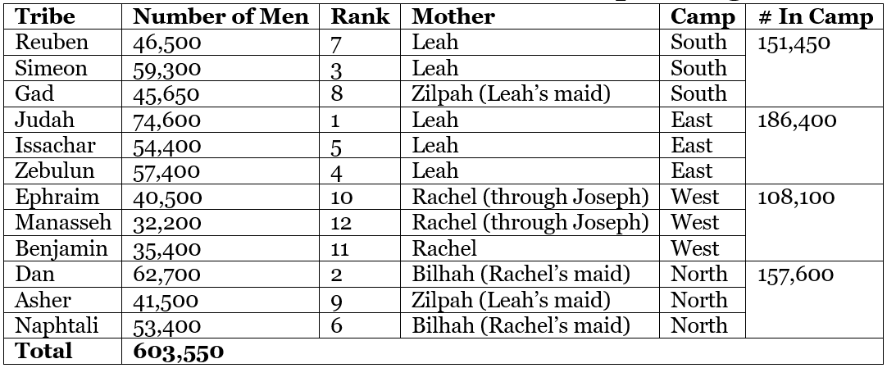

Slide 20
1. God Knows You by Name
2. God Values Order.
3. God Uses All Types of People.
4. Strength Comes from God's Blessing, Not Human Ability.
5. God Prepares His People for Future Battles.

