Slide 1

Romans 11:16-26
Sunday Morning
Joshua Tapp
True Words Baptist Church | 1377 S. 20th St. Louisville, KY | TrueWordsBaptist.org

Slide 2
Romans 11:16-21 For if the firstfruit be holy, the lump is also holy: and if the root be holy, so are the branches. 17 And if some of the branches be broken off, and thou, being a wild olive tree, wert graffed in among them, and with them partakest of the root and fatness of the olive tree; 18 Boast not against the branches. But if thou boast, thou bearest not the root, but the root thee. 19 Thou wilt say then, The branches were broken off, that I might be graffed in. 20 Well; because of unbelief they were broken off, and thou standest by faith. Be not highminded, but fear: 21 For if God spared not the natural branches, take heed lest he also spare not thee.

Slide 3
Romans 11:22-26 Behold therefore the goodness and severity of God: on them which fell, severity; but toward thee, goodness, if thou continue in his goodness: otherwise thou also shalt be cut off. 23 And they also, if they abide not still in unbelief, shall be graffed in: for God is able to graff them in again. 24 For if thou wert cut out of the olive tree which is wild by nature, and wert graffed contrary to nature into a good olive tree: how much more shall these, which be the natural branches, be graffed into their own olive tree? 25 For I would not, brethren, that ye should be ignorant of this mystery, lest ye should be wise in your own conceits; that blindness in part is happened to Israel, until the fulness of the Gentiles be come in. 26 And so all Israel shall be saved: as it is written, There shall come out of Sion the Deliverer, and shall turn away ungodliness from Jacob:

Slide 4
Never Replaced:
The Unbroken
Line of Believers
True Words Baptist Church | 1377 S. 20th St. Louisville, KY | TrueWordsBaptist.org

Slide 5
Romans 11:20-23 Well; because of unbelief they were broken off, and thou standest by faith. Be not highminded, but fear: 21 For if God spared not the natural branches, take heed lest he also spare not thee. 22 Behold therefore the goodness and severity of God: on them which fell, severity; but toward thee, goodness, if thou continue in his goodness: otherwise thou also shalt be cut off. 23 And they also, if they abide not still in unbelief, shall be graffed in: for God is able to graff them in again.

Slide 6
Romans 11:23 And they also, if they abide not still in unbelief, shall be graffed in: for God is able to graff them in again.

Slide 7
Romans 11:24 For if thou wert cut out of the olive tree which is wild by nature, and wert graffed contrary to nature into a good olive tree: how much more shall these, which be the natural branches, be graffed into their own olive tree?

Slide 8
Hebrews 11:4 By faith Abel offered unto God a more excellent sacrifice than Cain, by which he obtained witness that he was righteous, God testifying of his gifts: and by it he being dead yet speaketh.

Slide 9
Romans 11:1-2 I say then, Hath God cast away his people? God forbid. For I also am an Israelite, of the seed of Abraham, of the tribe of Benjamin. 2 God hath not cast away his people which he foreknew. Wot ye not what the scripture saith of Elias? how he maketh intercession to God against Israel, saying,

Slide 10
Romans 11:4 But what saith the answer of God unto him? I have reserved to myself seven thousand men, who have not bowed the knee to the image of Baal.

Slide 11
Romans 11:28–29 As concerning the gospel, they are enemies for your sakes: but as touching the election, they are beloved for the fathers’ sakes. For the gifts and calling of God are without repentance.

Slide 12
Romans 11:32 For God hath concluded them all in unbelief, that he might have mercy upon all.

Slide 13
Genesis 15:6 And he believed in the LORD; and he counted it to him for righteousness.

Slide 14
Ephesians 2:14-16 For he is our peace, who hath made both one, and hath broken down the middle wall of partition between us; 15 Having abolished in his flesh the enmity, even the law of commandments contained in ordinances; for to make in himself of twain one new man, so making peace; 16 And that he might reconcile both unto God in one body by the cross, having slain the enmity thereby:

Slide 15
Hebrews 8:13 In that he saith, A new covenant, he hath made the first old. Now that which decayeth and waxeth old is ready to vanish away.

Slide 16
Matthew 5:17 Think not that I am come to destroy the law, or the prophets: I am not come to destroy, but to fulfil.

Slide 17
Hebrews 8:10 For this is the covenant that I will make with the house of Israel after those days, saith the Lord; I will put my laws into their mind, and write them in their hearts: and I will be to them a God, and they shall be to me a people:

Slide 18
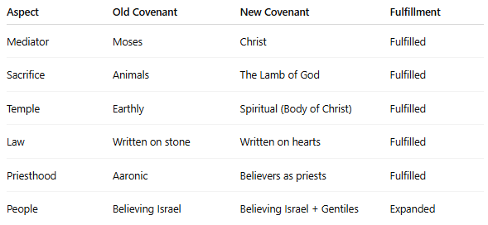

Slide 19
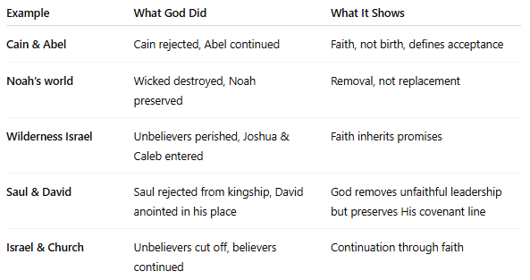

Slide 20
Galatians 3:28-29 There is neither Jew nor Greek, there is neither bond nor free, there is neither male nor female: for ye are all one in Christ Jesus. 29 And if ye be Christ's, then are ye Abraham's seed, and heirs according to the promise.

Slide 21
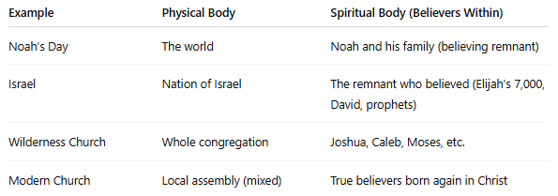

Slide 22
Romans 10:21 But to Israel he saith, All day long I have stretched forth my hands unto a disobedient and gainsaying people.

Slide 23
Romans 11:33 O the depth of the riches both of the wisdom and knowledge of God! how unsearchable are his judgments, and his ways past finding out!

