Slide 1

Sunday School
Matthew 8:23-34
Nathan Holmes
True Words Baptist Church – 1377 S. 20th St. Louisville, KY – TrueWordsBaptist.org

Slide 2
Matthew 8:23-26 And when he was entered into a ship, his disciples followed him. 24 And, behold, there arose a great tempest in the sea, insomuch that the ship was covered with the waves: but he was asleep. 25 And his disciples came to him, and awoke him, saying, Lord, save us: we perish. 26 And he saith unto them, Why are ye fearful, O ye of little faith? Then he arose, and rebuked the winds and the sea; and there was a great calm.

Slide 3
Title of the Lesson
From Tempest to Triumph
True Words Baptist Church – 1377 S. 20th St. Louisville, KY – TrueWordsBaptist.org

Slide 4
Matthew 8:23
And when he was entered into a ship, his disciples followed him.

Slide 5
Luke 8:22 Now it came to pass on a certain day, that he went into a ship with his disciples: and he said unto them, Let us go over unto the other side of the lake. And they launched forth.

Slide 6
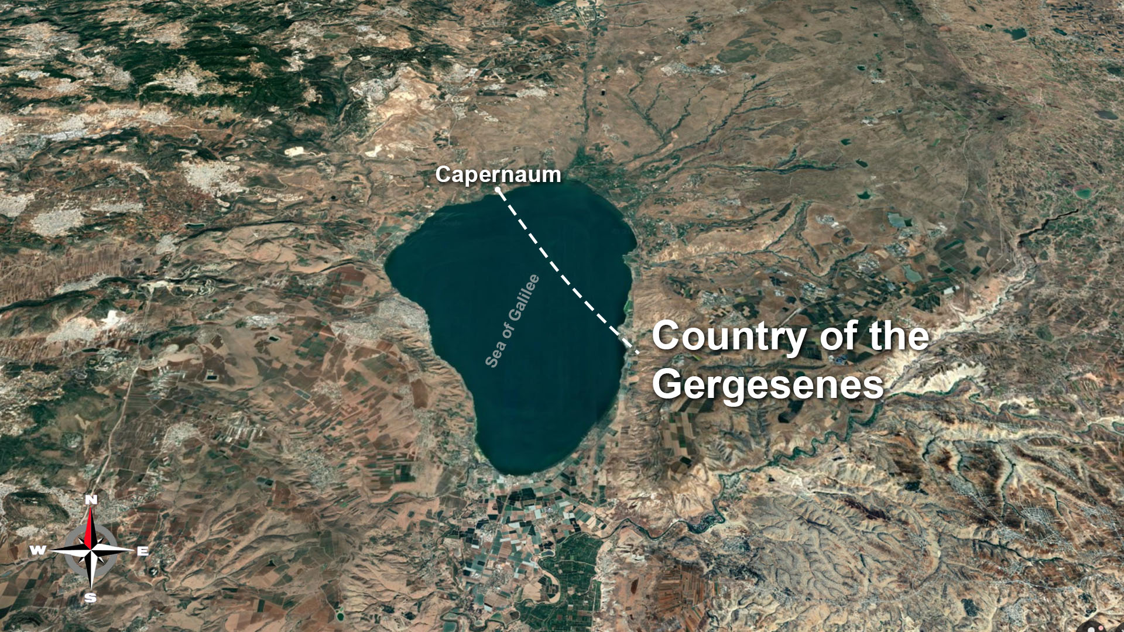

Slide 7
Matthew 8:24 And, behold, there arose a great tempest in the sea, insomuch that the ship was covered with the waves…

Slide 8
Proverbs 8:29 When he gave to the sea his decree, that the waters should not pass his commandment: when he appointed the foundations of the earth:

Slide 9
Ecclesiastes 3:1-8 To every thing there is a season, and a time to every purpose under the heaven: 2 A time to be born, and a time to die; a time to plant, and a time to pluck up that which is planted; 3 A time to kill, and a time to heal; a time to break down, and a time to build up; 4 A time to weep, and a time to laugh; a time to mourn, and a time to dance;

Slide 10
5 A time to cast away stones, and a time to gather stones together; a time to embrace, and a time to refrain from embracing; 6 A time to get, and a time to lose; a time to keep, and a time to cast away; 7 A time to rend, and a time to sew; a time to keep silence, and a time to speak; 8 A time to love, and a time to hate; a time of war, and a time of peace.

Slide 11
Matthew 8:24 And, behold, there arose a great tempest in the sea, insomuch that the ship was covered with the waves: but he was asleep.

Slide 12
Mark 4:37 And there arose a great storm of wind, and the waves beat into the ship, so that it was now full.

Slide 13
Luke 8:23 But as they sailed he fell asleep: and there came down a storm of wind on the lake; and they were filled with water, and were in jeopardy.

Slide 14
Matthew 8:25 And his disciples came to him, and awoke him, saying, Lord, save us: we perish.

Slide 15
Matthew 8:26 And he saith unto them, Why are ye fearful, O ye of little faith? Then he arose, and rebuked the winds and the sea; and there was a great calm.

Slide 16
Matthew 8:27 But the men marvelled, saying, What manner of man is this, that even the winds and the sea obey him!

Slide 17
Jeremiah 5:21-22 Hear now this, O foolish people, and without understanding; which have eyes, and see not; which have ears, and hear not: 22 Fear ye not me? saith the LORD: will ye not tremble at my presence, which have placed the sand for the bound of the sea by a perpetual decree, that it cannot pass it: and though the waves thereof toss themselves, yet can they not prevail; though they roar, yet can they not pass over it?

Slide 18
Psalm 89:6-9 For who in the heaven can be compared unto the LORD? who among the sons of the mighty can be likened unto the LORD? 7 God is greatly to be feared in the assembly of the saints, and to be had in reverence of all them that are about him. 8 O LORD God of hosts, who is a strong LORD like unto thee? or to thy faithfulness round about thee? 9 Thou rulest the raging of the sea: when the waves thereof arise, thou stillest them.

Slide 19
Romans 10:17
So then faith cometh by hearing, and hearing by the word of God.

Slide 20
James 1:2-8 My brethren, count it all joy when ye fall into divers temptations; 3 Knowing this, that the trying of your faith worketh patience. 4 But let patience have her perfect work, that ye may be perfect and entire, wanting nothing. 5 If any of you lack wisdom, let him ask of God, that giveth to all men liberally, and upbraideth not; and it shall be given him.

Slide 21
6 But let him ask in faith, nothing wavering. For he that wavereth is like a wave of the sea driven with the wind and tossed. 7 For let not that man think that he shall receive any thing of the Lord. 8 A double minded man is unstable in all his ways.

Slide 22
Job 1:3 His substance also was seven thousand sheep, and three thousand camels, and five hundred yoke of oxen, and five hundred she asses, and a very great household; so that this man was the greatest of all the men of the east.

Slide 23
Job 13:15
Though he slay me, yet will I trust in him…

Slide 24
Job 19:25
For I know that my redeemer liveth, and that he shall stand at the latter day upon the earth:

Slide 25
Job 42:10 And the LORD turned the captivity of Job, when he prayed for his friends: also the LORD gave Job twice as much as he had before.

Slide 26
Job 42:12-13 So the LORD blessed the latter end of Job more than his beginning: for he had fourteen thousand sheep, and six thousand camels, and a thousand yoke of oxen, and a thousand she asses. 13 He had also seven sons and three daughters.

Slide 27
Genesis 37:28 Then there passed by Midianites merchantmen; and they drew and lifted up Joseph out of the pit, and sold Joseph to the Ishmeelites for twenty pieces of silver: and they brought Joseph into Egypt.

Slide 28
Genesis 45:5 Now therefore be not grieved, nor angry with yourselves, that ye sold me hither: for God did send me before you to preserve life.

Slide 29
Genesis 45:7 And God sent me before you to preserve you a posterity in the earth, and to save your lives by a great deliverance.

Slide 30
Genesis 50:20 But as for you, ye thought evil against me; but God meant it unto good, to bring to pass, as it is this day, to save much people alive.

Slide 31
Matthew 8:28-34 And when he was come to the other side into the country of the Gergesenes, there met him two possessed with devils, coming out of the tombs, exceeding fierce, so that no man might pass by that way. 29 And, behold, they cried out, saying, What have we to do with thee, Jesus, thou Son of God? art thou come hither to torment us before the time? 30 And there was a good way off from them an herd of many swine feeding.

Slide 32
31 So the devils besought him, saying, If thou cast us out, suffer us to go away into the herd of swine. 32 And he said unto them, Go. And when they were come out, they went into the herd of swine: and, behold, the whole herd of swine ran violently down a steep place into the sea, and perished in the waters. 33 And they that kept them fled, and went their ways into the city, and told every thing, and what was befallen to the possessed of the devils. 34 And, behold, the whole city came out to meet Jesus: and when they saw him, they besought him that he would depart out of their coasts.

Slide 33
Mark 5:18-20 And when he was come into the ship, he that had been possessed with the devil prayed him that he might be with him. 19 Howbeit Jesus suffered him not, but saith unto him, Go home to thy friends, and tell them how great things the Lord hath done for thee, and hath had compassion on thee. 20 And he departed, and began to publish in Decapolis how great things Jesus had done for him: and all men did marvel.

Slide 34
Psalms 107:23-30 They that go down to the sea in ships, that do business in great waters; 24. These see the works of the Lord, and his wonders in the deep. 25. For he commandeth, and raiseth the stormy wind, which lifteth up the waves thereof. 26. They mount up to the heaven, they go down again to the depths: their soul is melted because of trouble.

Slide 35
27. They reel to and fro, and stagger like a drunken man, and are at their wits’ end. 28. Then they cry unto the Lord in their trouble, and he bringeth them out of their distresses. 29. He maketh the storm a calm, so that the waves thereof are still. 30. Then are they glad because they be quiet; so he bringeth them unto their desired haven.

Slide 36
Visit Us:
TrueWordsBaptist.org
True Words Baptist Church – 1377 S. 20th St. Louisville, KY – TrueWordsBaptist.org

