Slide 1

Sunday Morning
Ezekiel 22:23-25
Joshua Tapp
True Words Baptist Church – 1377 S. 20th St. Louisville, KY – TrueWordsBaptist.org

Slide 2
Ezekiel 22:23-25 And the word of the LORD came unto me, saying, 24 Son of man, say unto her, Thou art the land that is not cleansed, nor rained upon in the day of indignation. 25 There is a conspiracy of her prophets in the midst thereof, like a roaring lion ravening the prey; they have devoured souls; they have taken the treasure and precious things; they have made her many widows in the midst thereof.

Slide 3
Ezekiel 22:26-27 Her priests have violated my law, and have profaned mine holy things: they have put no difference between the holy and profane, neither have they shewed difference between the unclean and the clean, and have hid their eyes from my sabbaths, and I am profaned among them. 27 Her princes in the midst thereof are like wolves ravening the prey, to shed blood, and to destroy souls, to get dishonest gain.

Slide 4
Ezekiel 22:28-29 And her prophets have daubed them with untempered morter, seeing vanity, and divining lies unto them, saying, Thus saith the Lord GOD, when the LORD hath not spoken. 29 The people of the land have used oppression, and exercised robbery, and have vexed the poor and needy: yea, they have oppressed the stranger wrongfully.

Slide 5
Ezekiel 22:30-31 And I sought for a man among them, that should make up the hedge, and stand in the gap before me for the land, that I should not destroy it: but I found none. 31 Therefore have I poured out mine indignation upon them; I have consumed them with the fire of my wrath: their own way have I recompensed upon their heads, saith the Lord GOD.

Slide 6
Title of the Sermon
Men Who Stand
In The Gap
True Words Baptist Church – 1377 S. 20th St. Louisville, KY – TrueWordsBaptist.org

Slide 7
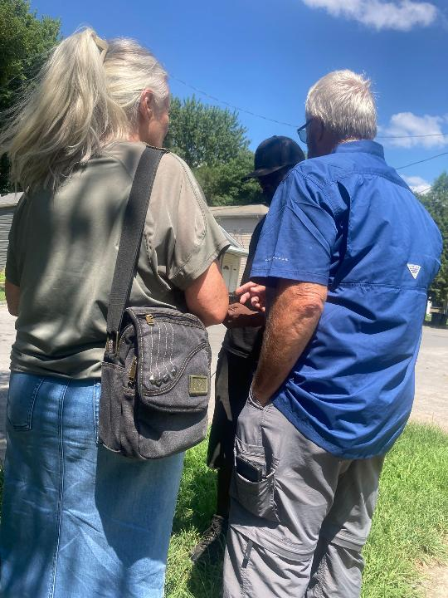
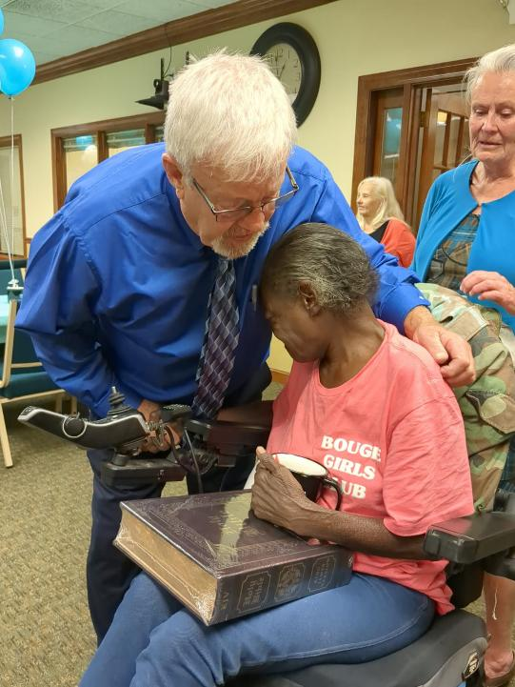

Slide 8
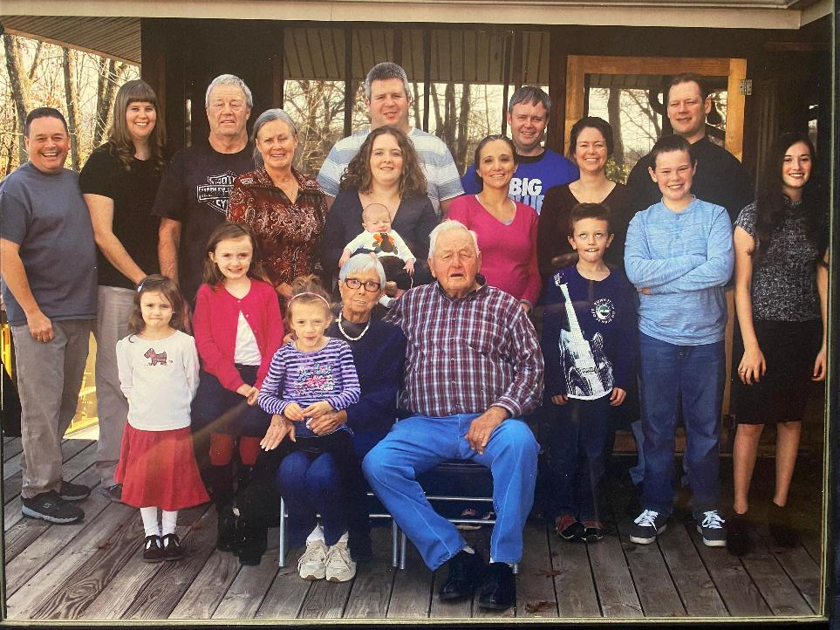

Slide 9
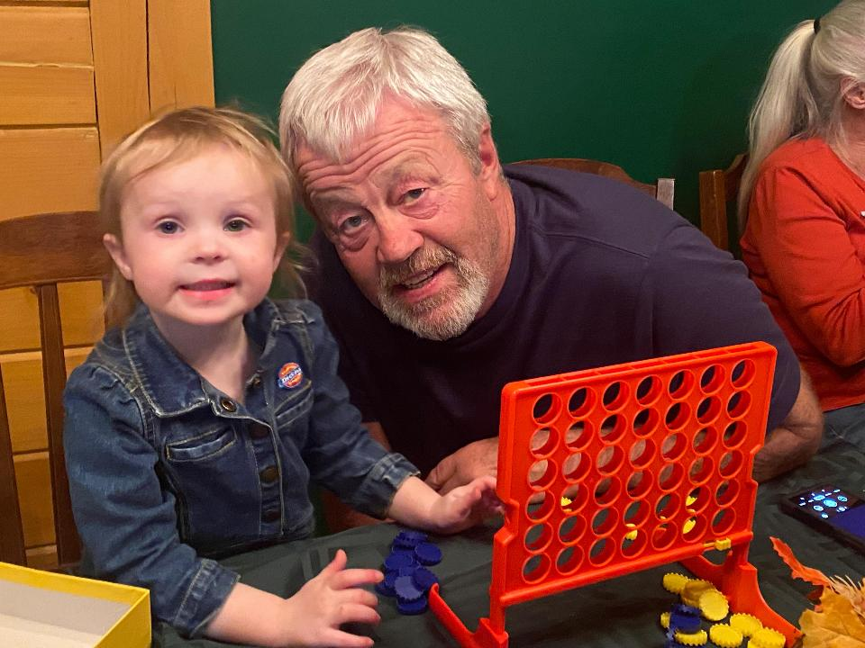

Slide 10
Proverbs 27:2 Let another man praise thee, and not thine own mouth; a stranger, and not thine own lips.

Slide 11
Romans 13:7 Render therefore to all their dues: tribute to whom tribute is due; custom to whom custom; fear to whom fear; honour to whom honour.

Slide 12
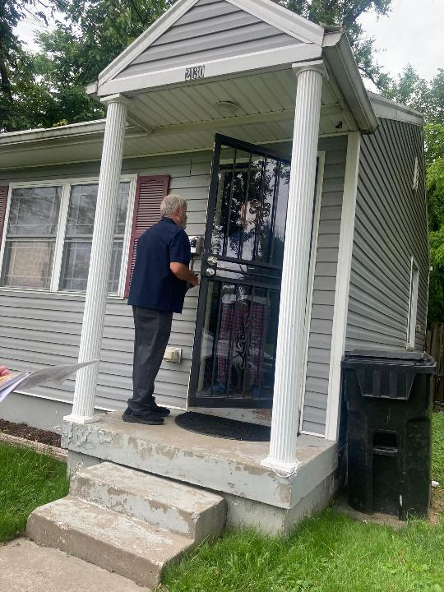
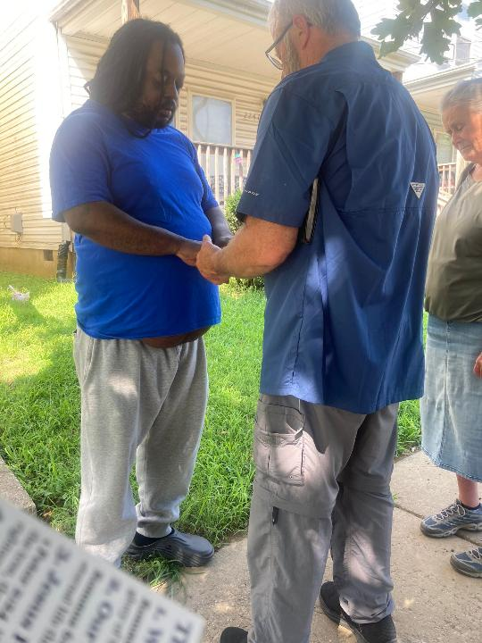

Slide 13
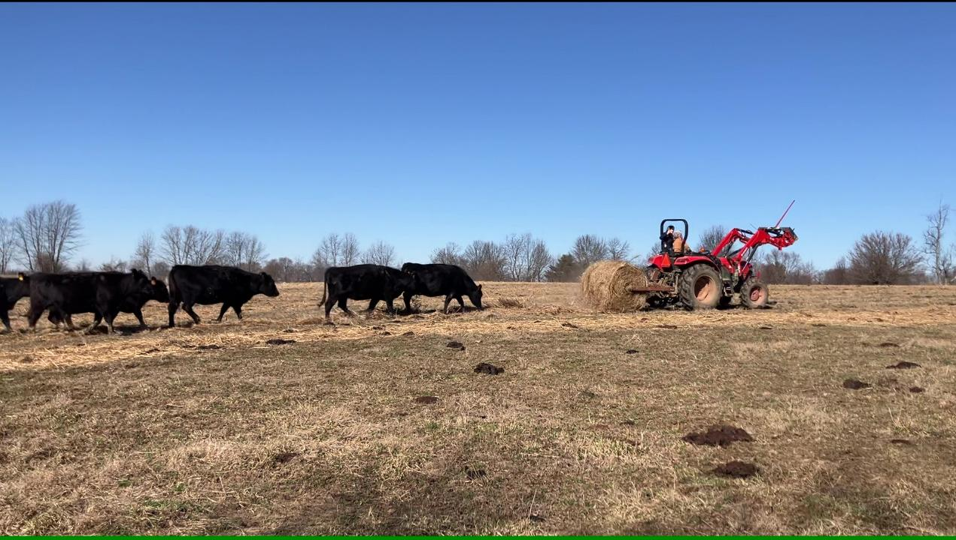

Slide 14
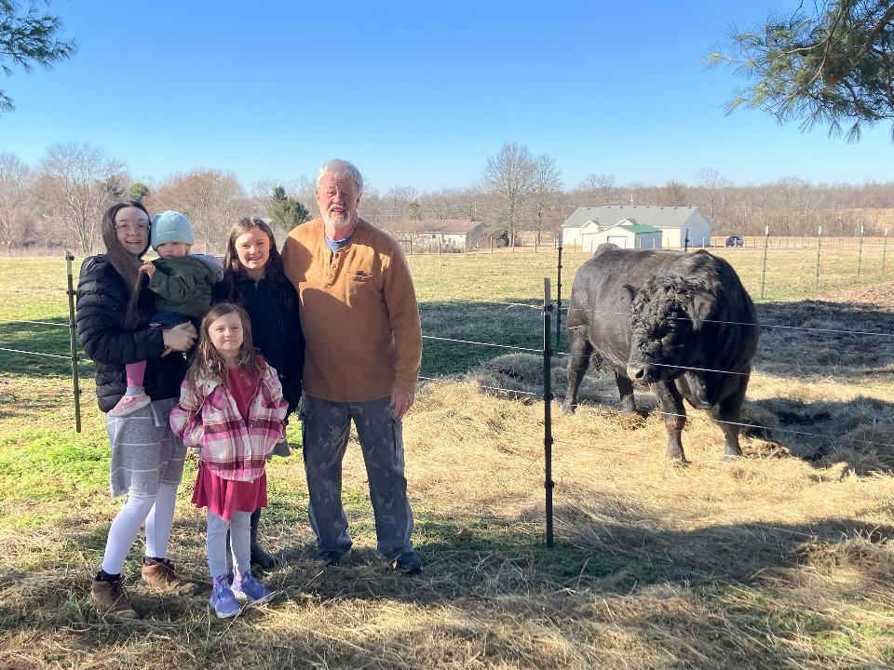

Slide 15
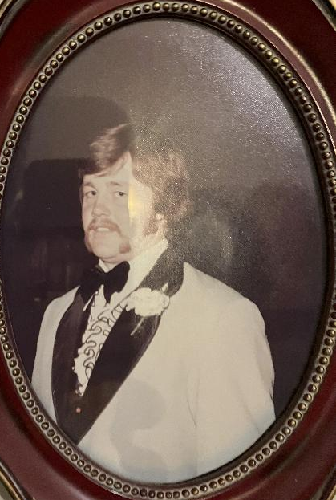
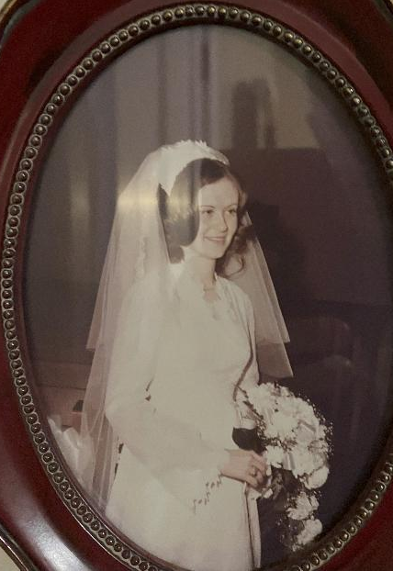

Slide 16
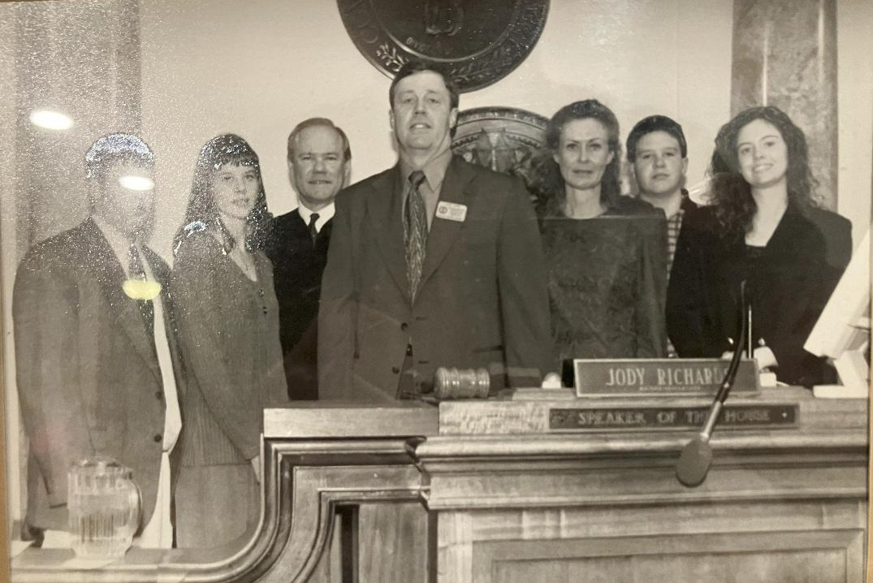

Slide 17
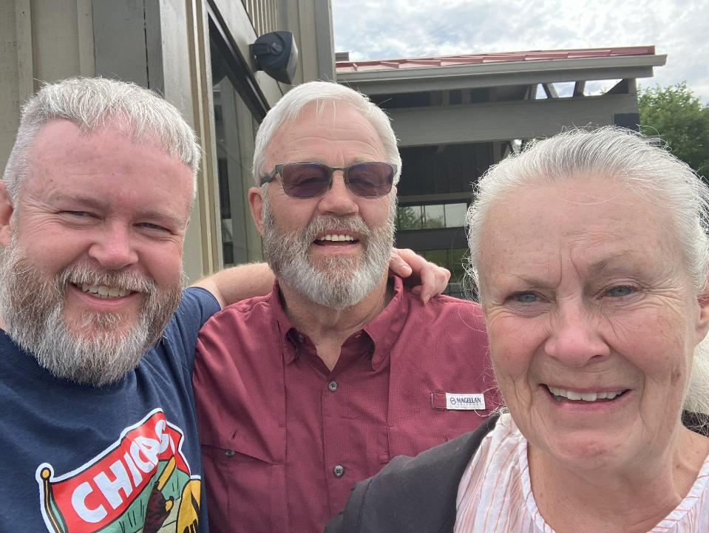

Slide 18
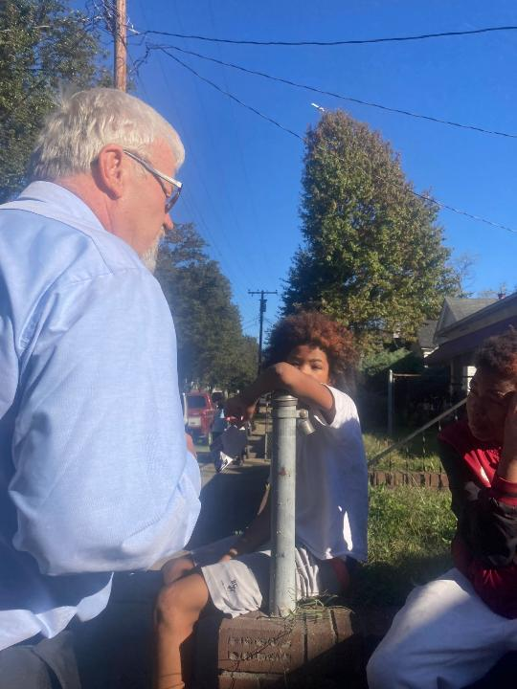
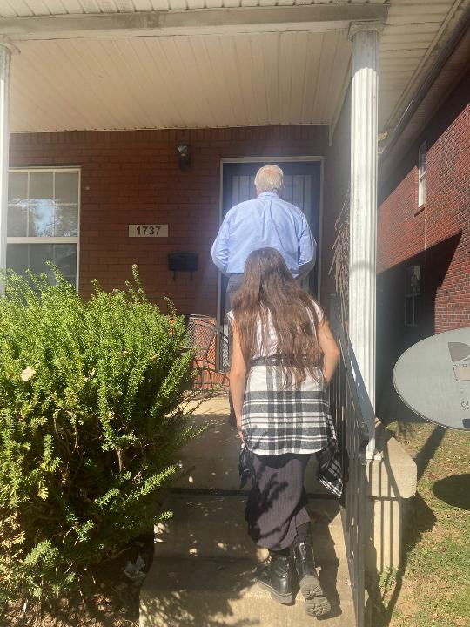

Slide 19
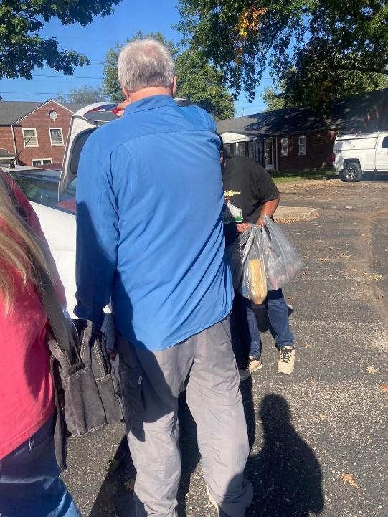
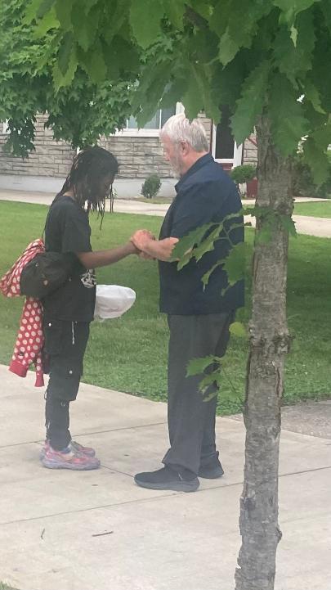

Slide 20
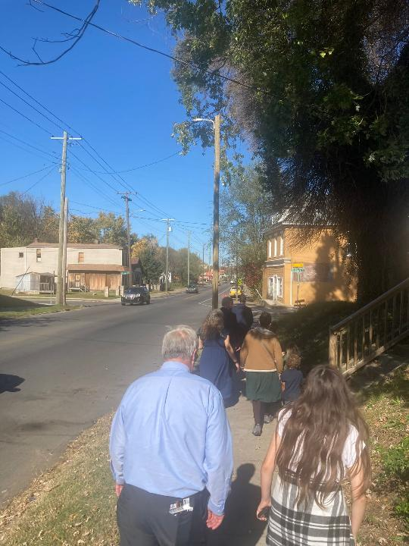
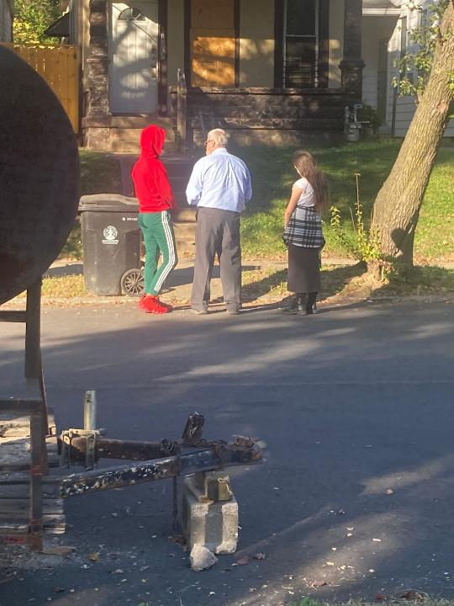

Slide 21
Ezekiel 22:30 And I sought for a man among them, that should make up the hedge, and stand in the gap before me for the land, that I should not destroy it: but I found none.

Slide 22
1 Timothy 3:8-10 Likewise must the deacons be grave, not doubletongued, not given to much wine, not greedy of filthy lucre; 9 Holding the mystery of the faith in a pure conscience. 10 And let these also first be proved; then let them use the office of a deacon, being found blameless.

Slide 23
1 Timothy 3:11-13 Even so must their wives be grave, not slanderers, sober, faithful in all things. 12 Let the deacons be the husbands of one wife, ruling their children and their own houses well. 13 For they that have used the office of a deacon well purchase to themselves a good degree, and great boldness in the faith which is in Christ Jesus.

Slide 24
Acts 6:6-7 Whom they set before the apostles: and when they had prayed, they laid their hands on them. 7 And the word of God increased; and the number of the disciples multiplied in Jerusalem greatly; and a great company of the priests were obedient to the faith.

Slide 25
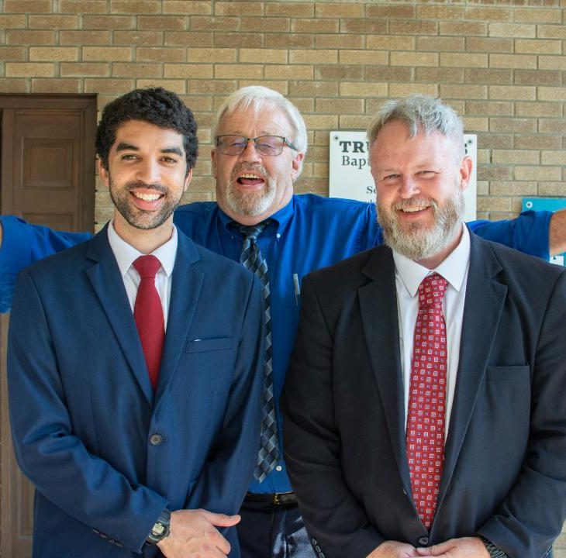

Slide 26
Romans 3:23 For all have sinned, and come short of the glory of God;

Slide 27
Romans 6:23a For the wages of sin is death;

Slide 28
Romans 5:8 But God commendeth his love toward us, in that, while we were yet sinners, Christ died for us.

Slide 29
1 John 4:14 And we have seen and do testify that the Father sent the Son to be "the Saviour" of the world.

Slide 30
Acts 16:30-31 And brought them out, and said, Sirs, what must I do to be saved? 31 And they said, Believe on the Lord Jesus Christ, and thou shalt be saved, and thy house.

Slide 31
John 6:47 Verily, verily, I say unto you, He that believeth on me hath everlasting life.

Slide 32
We Present To You:
Deacon Gary Tapp
True Words Baptist Church – 1377 S. 20th St. Louisville, KY – TrueWordsBaptist.org

Slide 33
Visit Us:
TrueWordsBaptist.org
True Words Baptist Church – 1377 S. 20th St. Louisville, KY – TrueWordsBaptist.org

