Slide 1
Sunday School
Matthew 7:15-23
Nathan Holmes
True Words Baptist Church – 1377 S. 20th St. Louisville, KY – TrueWordsBaptist.org

Slide 2
Matthew 7:15-23 Beware of false prophets, which come to you in sheep's clothing, but inwardly they are ravening wolves. 16 Ye shall know them by their fruits. Do men gather grapes of thorns, or figs of thistles? 17 Even so every good tree bringeth forth good fruit; but a corrupt tree bringeth forth evil fruit. 18 A good tree cannot bring forth evil fruit, neither can a corrupt tree bring forth good fruit. 19 Every tree that bringeth not forth good fruit is hewn down, and cast into the fire.

Slide 3
20 Wherefore by their fruits ye shall know them. 21 Not every one that saith unto me, Lord, Lord, shall enter into the kingdom of heaven; but he that doeth the will of my Father which is in heaven. 22 Many will say to me in that day, Lord, Lord, have we not prophesied in thy name? and in thy name have cast out devils? and in thy name done many wonderful works? 23 And then will I profess unto them, I never knew you: depart from me, ye that work iniquity.

Slide 4
Title of the Lesson
By Their Fruits Ye Shall Know Them
True Words Baptist Church – 1377 S. 20th St. Louisville, KY – TrueWordsBaptist.org

Slide 5
Matthew 7:13-14 Enter ye in at the strait gate: for wide is the gate, and broad is the way, that leadeth to destruction, and many there be which go in thereat: 14 Because strait is the gate, and narrow is the way, which leadeth unto life, and few there be that find it.

Slide 6
1 Peter 5:8 Be sober, be vigilant; because your adversary the devil, as a roaring lion, walketh about, seeking whom he may devour:

Slide 7
Luke 22:31 And the Lord said, Simon, Simon, behold, Satan hath desired to have you, that he may sift you as wheat:

Slide 8
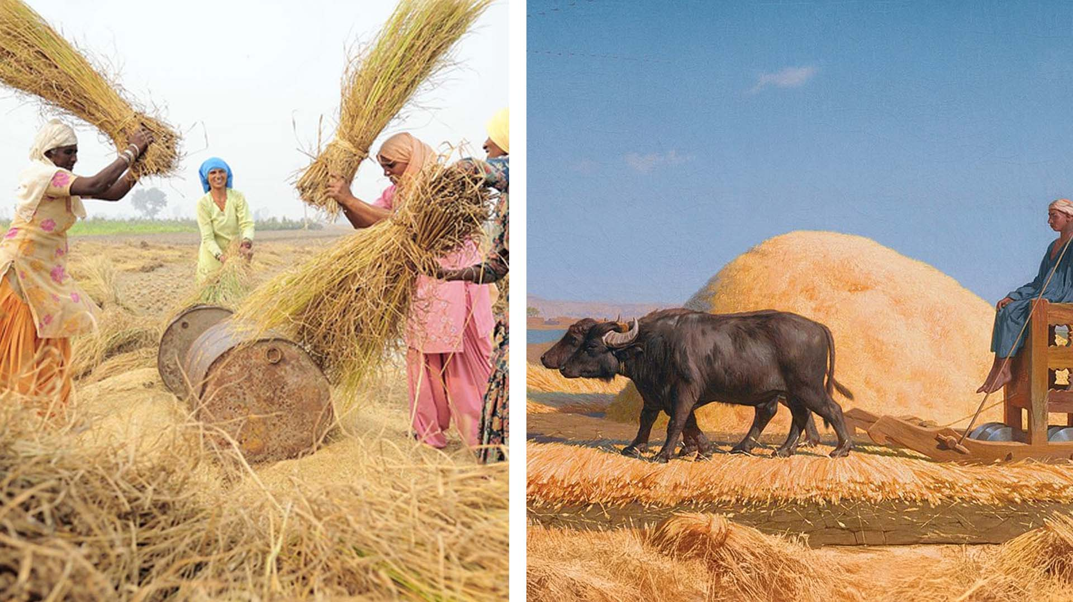

Slide 9
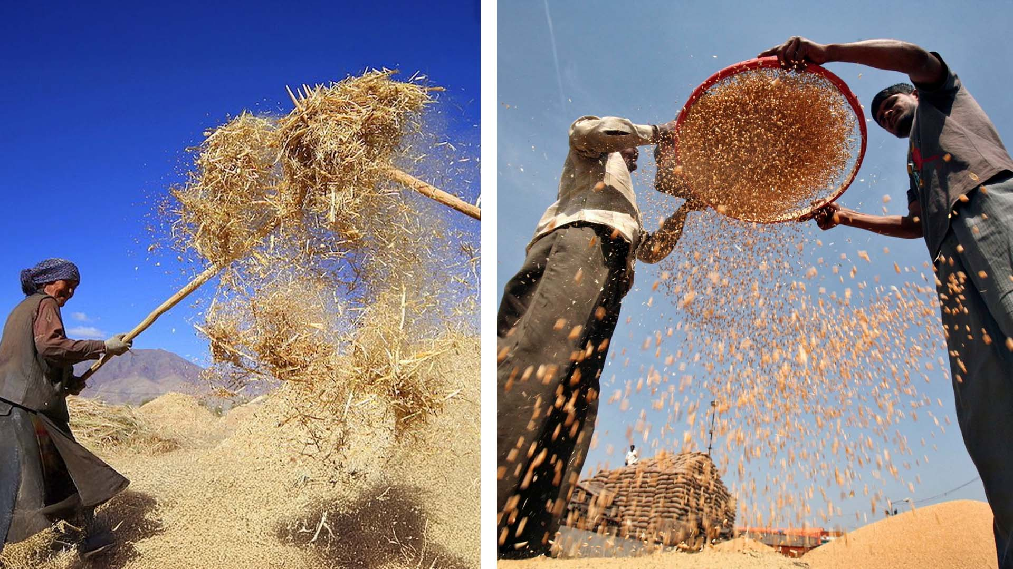

Slide 10
Matthew 7:15 Beware of false prophets, which come to you in sheep's clothing, but inwardly they are ravening wolves.

Slide 11
Deuteronomy 18:18-22 I will raise them up a Prophet from among their brethren, like unto thee, and will put my words in his mouth; and he shall speak unto them all that I shall command him. 19 And it shall come to pass, that whosoever will not hearken unto my words which he shall speak in my name, I will require it of him…

Slide 12
20 But the prophet, which shall presume to speak a word in my name, which I have not commanded him to speak, or that shall speak in the name of other gods, even that prophet shall die. 21 And if thou say in thine heart, How shall we know the word which the LORD hath not spoken? 22 When a prophet speaketh in the name of the LORD, if the thing follow not, nor come to pass, that is the thing which the LORD hath not spoken, but the prophet hath spoken it presumptuously: thou shalt not be afraid of him.

Slide 13
Jeremiah 14:14 Then the LORD said unto me, The prophets prophesy lies in my name: I sent them not, neither have I commanded them, neither spake unto them: they prophesy unto you a false vision and divination, and a thing of nought, and the deceit of their heart.

Slide 14
Deuteronomy 13:1-3 If there arise among you a prophet, or a dreamer of dreams, and giveth thee a sign or a wonder, 2 And the sign or the wonder come to pass, whereof he spake unto thee, saying, Let us go after other gods, which thou hast not known, and let us serve them; 3 Thou shalt not hearken unto the words of that prophet, or that dreamer of dreams…

Slide 15
Deuteronomy 13:5 And that prophet, or that dreamer of dreams, shall be put to death; because he hath spoken to turn you away from the LORD your God, which brought you out of the land of Egypt, and redeemed you out of the house of bondage, to thrust thee out of the way which the LORD thy God commanded thee to walk in. So shalt thou put the evil away from the midst of thee.

Slide 16
Matthew 7:15 Beware of false prophets, which come to you in sheep's clothing, but inwardly they are ravening wolves.

Slide 17
2 Corinthians 11:13-15 For such are false apostles, deceitful workers, transforming themselves into the apostles of Christ. 14 And no marvel; for Satan himself is transformed into an angel of light. 15 Therefore it is no great thing if his ministers also be transformed as the ministers of righteousness; whose end shall be according to their works.

Slide 18
Romans 16:18 For they that are such serve not our Lord Jesus Christ, but their own belly; and by good words and fair speeches deceive the hearts of the simple.

Slide 19
Jeremiah 23:16-17 Thus saith the LORD of hosts, Hearken not unto the words of the prophets that prophesy unto you: they make you vain: they speak a vision of their own heart, and not out of the mouth of the LORD. 17 They say still unto them that despise me, The LORD hath said, Ye shall have peace; and they say unto every one that walketh after the imagination of his own heart, No evil shall come upon you.

Slide 20
Joel Osteen says…
“You’re not defective. You’re not a mistake. You’re not faulty. You have been fearfully and wonderfully made. You are already good enough.”

Slide 21
Romans 3:12
“There is none that doeth good, no, not one.

Slide 22
Joel Osteen says…
“God wants us to prosper financially, to have plenty of money, to fulfill the destiny He has laid out for us.”

Slide 23
Philippians 1:29
For unto you it is given in the behalf of Christ, not only to believe on him, but also to suffer for his sake;

Slide 24
Joel Osteen says…
“If you believe in yourself, you can overcome anything.”

Slide 25
Jeremiah 17:5
Thus saith the LORD; Cursed be the man that trusteth in man, and maketh flesh his arm, and whose heart departeth from the LORD.

Slide 26
2 Peter 2:1-3 But there were false prophets also among the people, even as there shall be false teachers among you, who privily shall bring in damnable heresies, even denying the Lord that bought them, and bring upon themselves swift destruction. 2 And many shall follow their pernicious ways; by reason of whom the way of truth shall be evil spoken of.

Slide 27
3 And through covetousness shall they with feigned words make merchandise of you: whose judgment now of a long time lingereth not, and their damnation slumbereth not.

Slide 28
Acts 20:28-31 Take heed therefore unto yourselves, and to all the flock, over the which the Holy Ghost hath made you overseers, to feed the church of God, which he hath purchased with his own blood. 29 For I know this, that after my departing shall grievous wolves enter in among you, not sparing the flock. 30 Also of your own selves shall men arise, speaking perverse things, to draw away disciples after them.

Slide 29
31 Therefore watch, and remember, that by the space of three years I ceased not to warn every one night and day with tears.

Slide 30
Matthew 7:15-20 Beware of false prophets, which come to you in sheep's clothing, but inwardly they are ravening wolves.
16 Ye shall know them by their fruits. Do men gather grapes of thorns, or figs of thistles? 17 Even so every good tree bringeth forth good fruit; but a corrupt tree bringeth forth evil fruit. 18 A good tree cannot bring forth evil fruit, neither can a corrupt tree bring forth good fruit.

Slide 31
19 Every tree that bringeth not forth good fruit is hewn down, and cast into the fire. 20 Wherefore by their fruits ye shall know them.

Slide 32
Genesis 1:11-12 And God said, Let the earth bring forth grass, the herb yielding seed, and the fruit tree yielding fruit after his kind, whose seed is in itself, upon the earth: and it was so. 12 And the earth brought forth grass, and herb yielding seed after his kind, and the tree yielding fruit, whose seed was in itself, after his kind: and God saw that it was good.

Slide 33
Proverbs 11:30 The fruit of the righteous is a tree of life; and he that winneth souls is wise.

Slide 34
2 Peter 2:1-2 But there were false prophets also among the people, even as there shall be false teachers among you, who privily shall bring in damnable heresies, even denying the Lord that bought them, and bring upon themselves swift destruction…

Slide 35
Galatians 1:6-9 I marvel that ye are so soon removed from him that called you into the grace of Christ unto another gospel: 7 Which is not another; but there be some that trouble you, and would pervert the gospel of Christ. 8 But though we, or an angel from heaven, preach any other gospel unto you than that which we have preached unto you, let him be accursed.

Slide 36
9 As we said before, so say I now again, If any man preach any other gospel unto you than that ye have received, let him be accursed.

Slide 37
Matthew 7:20 Wherefore by their fruits ye shall know them.

Slide 38
Matthew 7:21 Not every one that saith unto me, Lord, Lord, shall enter into the kingdom of heaven; but he that doeth the will of my Father which is in heaven.

Slide 39
Matthew 7:22 Many will say to me in that day, Lord, Lord, have we not prophesied in thy name? and in thy name have cast out devils? and in thy name done many wonderful works?

Slide 40
Matthew 7:23 And then will I profess unto them, I never knew you: depart from me, ye that work iniquity.

Slide 41
2 Peter 1:19-21 We have also a more sure word of prophecy; whereunto ye do well that ye take heed, as unto a light that shineth in a dark place, until the day dawn, and the day star arise in your hearts: 20 Knowing this first, that no prophecy of the scripture is of any private interpretation. 21 For the prophecy came not in old time by the will of man: but holy men of God spake as they were moved by the Holy Ghost.

Slide 42
Isaiah 8:20 To the law and to the testimony: if they speak not according to this word, it is because there is no light in them.

Slide 43
Visit Us:
TrueWordsBaptist.org
True Words Baptist Church – 1377 S. 20th St. Louisville, KY – TrueWordsBaptist.org

