Slide 1

Thursday Bible Study
Jonah 1:17 - 2:10
Joshua Tapp
True Words Baptist Church – 1377 S. 20th St. Louisville, KY – TrueWordsBaptist.org

Slide 2
Jonah 1:17 Now the LORD had prepared a great fish to swallow up Jonah. And Jonah was in the belly of the fish three days and three nights.

Slide 3
Jonah 2:1-5 Then Jonah prayed unto the LORD his God out of the fish's belly, 2 And said, I cried by reason of mine affliction unto the LORD, and he heard me; out of the belly of hell cried I, and thou heardest my voice. 3 For thou hadst cast me into the deep, in the midst of the seas; and the floods compassed me about: all thy billows and thy waves passed over me. 4 Then I said, I am cast out of thy sight; yet I will look again toward thy holy temple. 5 The waters compassed me about, even to the soul: the depth closed me round about, the weeds were wrapped about my head.

Slide 4
Jonah 2:6-10 I went down to the bottoms of the mountains; the earth with her bars was about me for ever: yet hast thou brought up my life from corruption, O LORD my God. 7 When my soul fainted within me I remembered the LORD: and my prayer came in unto thee, into thine holy temple. 8 They that observe lying vanities forsake their own mercy. 9 But I will sacrifice unto thee with the voice of thanksgiving; I will pay that that I have vowed. Salvation is of the LORD. 10 And the LORD spake unto the fish, and it vomited out Jonah upon the dry land.

Slide 5
Title of the Bible Study
Jonah: The Sign of Jesus in Hell
True Words Baptist Church – 1377 S. 20th St. Louisville, KY – TrueWordsBaptist.org

Slide 6
Matthew 12:38-39 Then certain of the scribes and of the Pharisees answered, saying, Master, we would see a sign from thee. 39 But he answered and said unto them, An evil and adulterous generation seeketh after a sign; and there shall no sign be given to it, but the sign of the prophet Jonas:

Slide 7
Matthew 12:40 For as Jonas was three days and three nights in the whale's belly; so shall the Son of man be three days and three nights in the heart of the earth.

Slide 8
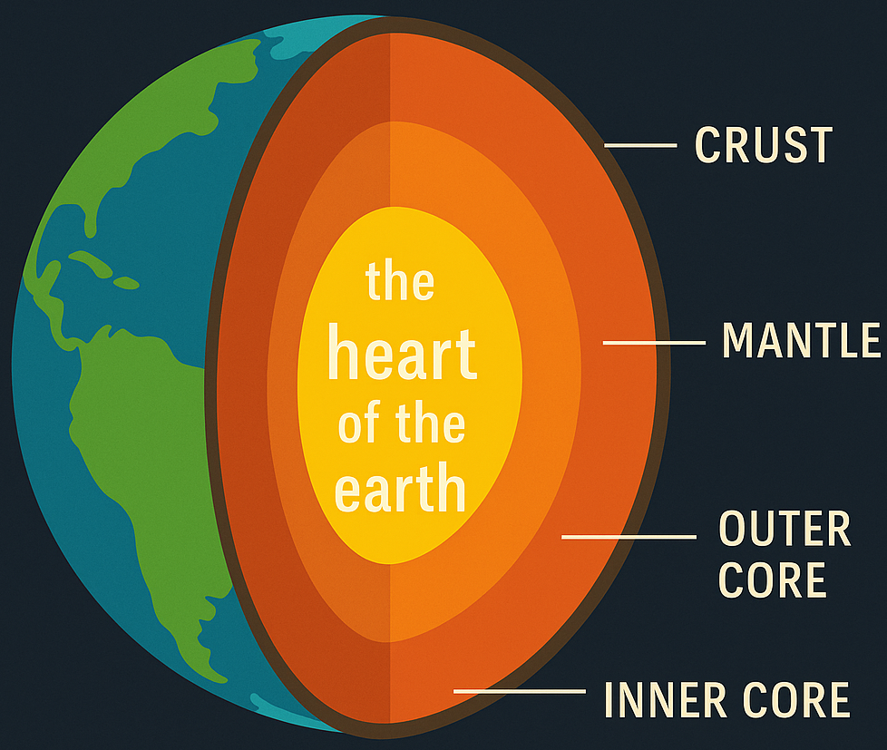

Slide 9
Jonah 1:15-17 So they took up Jonah, and cast him forth into the sea: and the sea ceased from her raging. 16 Then the men feared the LORD exceedingly, and offered a sacrifice unto the LORD, and made vows. 17 Now the LORD had prepared a great fish to swallow up Jonah. And Jonah was in the belly of the fish three days and three nights.

Slide 10
Jonah 2:1 Then Jonah prayed unto the LORD his God out of the fish's belly,

Slide 11
Jonah 2:2 And said, I cried by reason of mine affliction unto the LORD, and he heard me; out of the belly of hell cried I, and thou heardest my voice.

Slide 12
Jonah 2:3 For thou hadst cast me into the deep, in the midst of the seas; and the floods compassed me about: all thy billows and thy waves passed over me.

Slide 13
Jonah 2:4 Then I said, I am cast out of thy sight; yet I will look again toward thy holy temple.

Slide 14
Jonah 2:5 The waters compassed me about, even to the soul: the depth closed me round about, the weeds were wrapped about my head.

Slide 15
Jonah 2:6 I went down to the bottoms of the mountains; the earth with her bars was about me for ever: yet hast thou brought up my life from corruption, O LORD my God.

Slide 16
Jonah 2:7 When my soul fainted within me I remembered the LORD: and my prayer came in unto thee, into thine holy temple.

Slide 17
Jonah 2:8-9 They that observe lying vanities forsake their own mercy. 9 But I will sacrifice unto thee with the voice of thanksgiving; I will pay that that I have vowed. Salvation is of the LORD.

Slide 18
Jonah 2:10 And the LORD spake unto the fish, and it vomited out Jonah upon the dry land.

Slide 19
Visit Us:
TrueWordsBaptist.org
True Words Baptist Church – 1377 S. 20th St. Louisville, KY – TrueWordsBaptist.org

