Slide 1
Sunday School
Matthew 6:9-13
Nathan Holmes
True Words Baptist Church – 1377 S. 20th St. Louisville, KY – TrueWordsBaptist.org

Slide 2
Matthew 6:9-13 After this manner therefore pray ye: Our Father which art in heaven, Hallowed be thy name. 10 Thy kingdom come. Thy will be done in earth, as it is in heaven. 11 Give us this day our daily bread. 12 And forgive us our debts, as we forgive our debtors. 13 And lead us not into temptation, but deliver us from evil: For thine is the kingdom, and the power, and the glory, for ever. Amen.

Slide 3
Title of the Lesson
The Prayer That God Always Answers
True Words Baptist Church – 1377 S. 20th St. Louisville, KY – TrueWordsBaptist.org

Slide 4
Matthew 6:7 But when ye pray, use not vain repetitions, as the heathen do: for they think that they shall be heard for their much speaking.

Slide 5
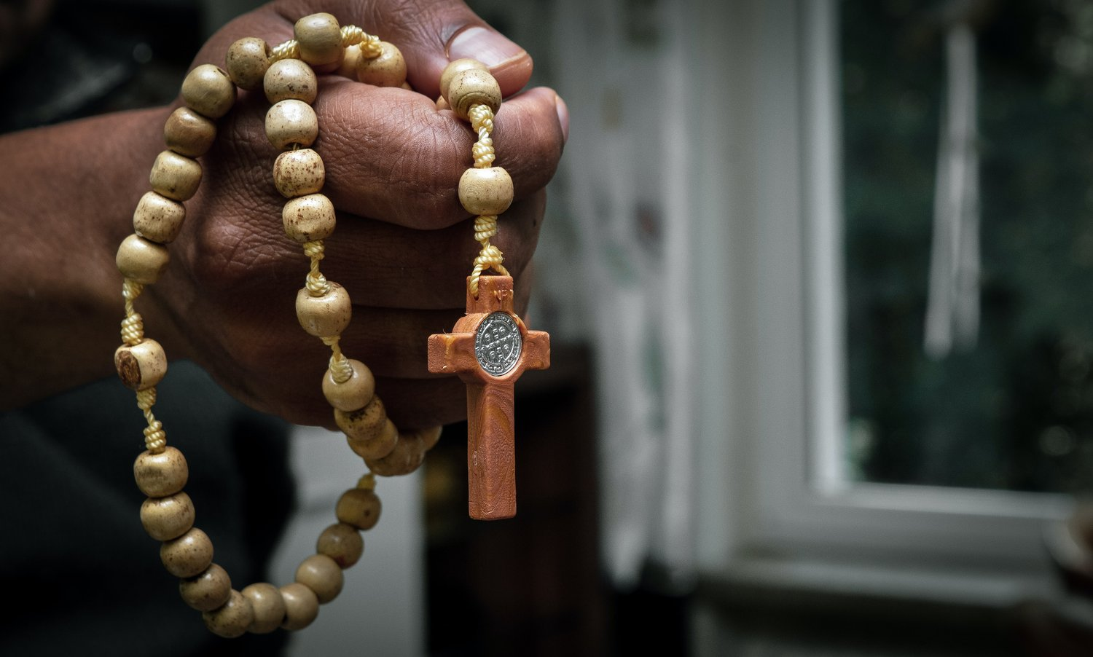

Slide 6
Matthew 6:7 But when ye pray, use not vain repetitions, as the heathen do: for they think that they shall be heard for their much speaking.

Slide 7
Matthew 6:8-9 Be not ye therefore like unto them: for your Father knoweth what things ye have need of, before ye ask him. 9 After this manner therefore pray ye...

Slide 8
Matthew 6:9-13 …Our Father which art in heaven, Hallowed be thy name. 10 Thy kingdom come. Thy will be done in earth, as it is in heaven. 11 Give us this day our daily bread. 12 And forgive us our debts, as we forgive our debtors. 13 And lead us not into temptation, but deliver us from evil: For thine is the kingdom, and the power, and the glory, for ever. Amen.

Slide 9
Luke 11:1 And it came to pass, that, as he was praying in a certain place, when he ceased, one of his disciples said unto him, Lord, teach us to pray, as John also taught his disciples.

Slide 10
Proverbs 28:9 He that turneth away his ear from hearing the law, even his prayer shall be abomination.

Slide 11
Isaiah 1:15 And when ye spread forth your hands, I will hide mine eyes from you: yea, when ye make many prayers, I will not hear: your hands are full of blood.

Slide 12
Isaiah 59:1-2 Behold, the LORD'S hand is not shortened, that it cannot save; neither his ear heavy, that it cannot hear: 2 But your iniquities have separated between you and your God, and your sins have hid his face from you, that he will not hear.

Slide 13
James 4:3 Ye ask, and receive not, because ye ask amiss, that ye may consume it upon your lusts.

Slide 14
1 Peter 3:12 For the eyes of the Lord are over the righteous, and his ears are open unto their prayers: but the face of the Lord is against them that do evil.

Slide 15
Galatians 6:7-8 Be not deceived; God is not mocked: for whatsoever a man soweth, that shall he also reap. 8 For he that soweth to his flesh shall of the flesh reap corruption; but he that soweth to the Spirit shall of the Spirit reap life everlasting.

Slide 16
Luke 9:51-56 And it came to pass, when the time was come that he should be received up, he stedfastly set his face to go to Jerusalem, 52 And sent messengers before his face: and they went, and entered into a village of the Samaritans, to make ready for him. 53 And they did not receive him, because his face was as though he would go to Jerusalem.

Slide 17
54 And when his disciples James and John saw this, they said, Lord, wilt thou that we command fire to come down from heaven, and consume them, even as Elias did? 55 But he turned, and rebuked them, and said, Ye know not what manner of spirit ye are of. 56 For the Son of man is not come to destroy men's lives, but to save them. And they went to another village.

Slide 18
Romans 12:17-21 Recompense to no man evil for evil. Provide things honest in the sight of all men. 18 If it be possible, as much as lieth in you, live peaceably with all men. 19 Dearly beloved, avenge not yourselves, but rather give place unto wrath: for it is written, Vengeance is mine; I will repay, saith the Lord.

Slide 19
Matthew 6:9-13 After this manner therefore pray ye: Our Father which art in heaven, Hallowed be thy name. 10 Thy kingdom come. Thy will be done in earth, as it is in heaven. 11 Give us this day our daily bread. 12 And forgive us our debts, as we forgive our debtors. 13 And lead us not into temptation, but deliver us from evil: For thine is the kingdom, and the power, and the glory, for ever. Amen.

Slide 20
Ephesians 5:15-18 See then that ye walk circumspectly, not as fools, but as wise, 16 Redeeming the time, because the days are evil. 17 Wherefore be ye not unwise, but understanding what the will of the Lord is. 18 And be not drunk with wine, wherein is excess; but be filled with the Spirit;

Slide 21
John 6:38-40 For I came down from heaven, not to do mine own will, but the will of him that sent me. 39 And this is the Father's will which hath sent me, that of all which he hath given me I should lose nothing, but should raise it up again at the last day. 40 And this is the will of him that sent me, that every one which seeth the Son, and believeth on him, may have everlasting life: and I will raise him up at the last day.

Slide 22
Deuteronomy 10:12-13 And now, Israel, what doth the LORD thy God require of thee, but to fear the LORD thy God, to walk in all his ways, and to love him, and to serve the LORD thy God with all thy heart and with all thy soul, 13 To keep the commandments of the LORD, and his statutes, which I command thee this day for thy good?

Slide 23
Mark 16:15 And he said unto them, Go ye into all the world, and preach the gospel to every creature.

Slide 24
1 Timothy 2:4 Who will have all men to be saved, and to come unto the knowledge of the truth.

Slide 25
2 Peter 3:9 The Lord is not slack concerning his promise, as some men count slackness; but is longsuffering to us-ward, not willing that any should perish, but that all should come to repentance.

Slide 26
John 15:7 If ye abide in me, and my words abide in you, ye shall ask what ye will, and it shall be done unto you.

Slide 27
Psalm 37:4-5 Delight thyself also in the LORD; and he shall give thee the desires of thine heart. 5 Commit thy way unto the LORD; trust also in him; and he shall bring it to pass.

Slide 28
1 Thessalonians 5:17
Pray without ceasing.

Slide 29
Psalm 55:17 Evening, and morning, and at noon, will I pray, and cry aloud: and he shall hear my voice.

Slide 30
1 John 5:13-15 These things have I written unto you that believe on the name of the Son of God; that ye may know that ye have eternal life, and that ye may believe on the name of the Son of God. 14 And this is the confidence that we have in him, that, if we ask any thing according to his will, he heareth us: 15 And if we know that he hear us, whatsoever we ask, we know that we have the petitions that we desired of him.

Slide 31
Visit Us:
TrueWordsBaptist.org
True Words Baptist Church – 1377 S. 20th St. Louisville, KY – TrueWordsBaptist.org

