Slide 1
Thursday Bible Study
Matthew 24:15-21
Joshua Tapp
True Words Baptist Church – 1377 S. 20th St. Louisville, KY – TrueWordsBaptist.org

Slide 2
Matthew 24:15-18 When ye therefore shall see the abomination of desolation, spoken of by Daniel the prophet, stand in the holy place, (whoso readeth, let him understand:) 16 Then let them which be in Judaea flee into the mountains: 17 Let him which is on the housetop not come down to take any thing out of his house: 18 Neither let him which is in the field return back to take his clothes.

Slide 3
Matthew 24:19-21 And woe unto them that are with child, and to them that give suck in those days! 20 But pray ye that your flight be not in the winter, neither on the sabbath day: 21 For then shall be great tribulation, such as was not since the beginning of the world to this time, no, nor ever shall be.

Slide 4
Title of the Bible Study
Abomination of
Desolation: What
the Bible Says
True Words Baptist Church – 1377 S. 20th St. Louisville, KY – TrueWordsBaptist.org

Slide 5
Matthew 24:15-18 When ye therefore shall see the abomination of desolation, spoken of by Daniel the prophet, stand in the holy place, (whoso readeth, let him understand:) 16 Then let them which be in Judaea flee into the mountains: 17 Let him which is on the housetop not come down to take any thing out of his house: 18 Neither let him which is in the field return back to take his clothes.

Slide 6
Matthew 24:19-21 And woe unto them that are with child, and to them that give suck in those days! 20 But pray ye that your flight be not in the winter, neither on the sabbath day: 21 For then shall be great tribulation, such as was not since the beginning of the world to this time, no, nor ever shall be.

Slide 8
Daniel 8:13 Then I heard one saint speaking, and another saint said unto that certain saint which spake, How long shall be the vision concerning the daily sacrifice, and the transgression of desolation, to give both the sanctuary and the host to be trodden under foot?

Slide 9
Daniel 9:27 And he shall confirm the covenant with many for one week: and in the midst of the week he shall cause the sacrifice and the oblation to cease, and for the overspreading of abominations he shall make it desolate, even until the consummation, and that determined shall be poured upon the desolate.

Slide 10
Daniel 11:31 And arms shall stand on his part, and they shall pollute the sanctuary of strength, and shall take away the daily sacrifice, and they shall place the abomination that maketh desolate.

Slide 11
Daniel 12:11 And from the time that the daily sacrifice shall be taken away, and the abomination that maketh desolate set up, there shall be a thousand two hundred and ninety days.

Slide 12
Matthew 24:15 When ye therefore shall see the abomination of desolation, spoken of by Daniel the prophet, stand in the holy place, (whoso readeth, let him understand:)

Slide 13
Mark 13:14 But when ye shall see the abomination of desolation, spoken of by Daniel the prophet, standing where it ought not, (let him that readeth understand,) then let them that be in Judaea flee to the mountains:

Slide 14
Luke 21:20 And when ye shall see Jerusalem compassed with armies, then know that the desolation thereof is nigh.

Slide 15
Deuteronomy 7:25–26 The graven images of their gods shall ye burn with fire: thou shalt not desire the silver or gold that is on them, nor take it unto thee, lest thou be snared therein: for it is an abomination to the LORD thy God. 26 Neither shalt thou bring an abomination into thine house, lest thou be a cursed thing like it: but thou shalt utterly detest it, and thou shalt utterly abhor it; for it is a cursed thing.

Slide 16
1 Kings 11:7 Then did Solomon build an high place for Chemosh, the abomination of Moab, in the hill that is before Jerusalem, and for Molech, the abomination of the children of Ammon.

Slide 17
Ezekiel 8:10 So I went in and saw; and behold every form of creeping things, and abominable beasts, and all the idols of the house of Israel, pourtrayed upon the wall round about.

Slide 18
Leviticus 18:22 Thou shalt not lie with mankind, as with womankind: it is abomination.

Slide 19
Leviticus 20:13 If a man also lie with mankind, as he lieth with a woman, both of them have committed an abomination: they shall surely be put to death; their blood shall be upon them.

Slide 20
Deuteronomy 17:1 Thou shalt not sacrifice unto the LORD thy God any bullock, or sheep, wherein is blemish, or any evilfavourdness: for that is an abomination unto the LORD thy God.

Slide 21
Proverbs 15:8 The sacrifice of the wicked is an abomination to the LORD: but the prayer of the upright is his delight.

Slide 22
Jeremiah 22:5 But if ye will not hear these words, I swear by myself, saith the LORD, that this house shall become a desolation.

Slide 23
Lamentations 1:13 From above hath he sent fire into my bones, and it prevaileth against them: he hath spread a net for my feet, he hath turned me back: he hath made me desolate and faint all the day.

Slide 24
Ezekiel 6:6 In all your dwellingplaces the cities shall be laid waste, and the high places shall be desolate; that your altars may be laid waste and made desolate, and your idols may be broken and cease, and your images may be cut down, and your works may be abolished.

Slide 25
Matthew 24:15 When ye therefore shall see the abomination of desolation, spoken of by Daniel the prophet, stand in the holy place, (whoso readeth, let him understand:)

Slide 26
Daniel 11:31 And arms shall stand on his part, and they shall pollute the sanctuary of strength, and shall take away the daily sacrifice, and they shall place the abomination that maketh desolate.

Slide 27
Daniel 12:11 And from the time that the daily sacrifice shall be taken away, and the abomination that maketh desolate set up, there shall be a thousand two hundred and ninety days.

Slide 28
2 Thessalonians 2:4 Who opposeth and exalteth himself above all that is called God, or that is worshipped; so that he as God sitteth in the temple of God, shewing himself that he is God.

Slide 29
2 Thessalonians 2:4 Who opposeth and exalteth himself above all that is called God, or that is worshipped; so that he as God sitteth in the temple of God, shewing himself that he is God.

Slide 30
Matthew 24:15 When ye therefore shall see the abomination of desolation, spoken of by Daniel the prophet, stand in the holy place, (whoso readeth, let him understand:)

Slide 31
Revelation 13:14-15 And deceiveth them that dwell on the earth by the means of those miracles which he had power to do in the sight of the beast; saying to them that dwell on the earth, that they should make an image to the beast, which had the wound by a sword, and did live. 15 And he had power to give life unto the image of the beast, that the image of the beast should both speak, and cause that as many as would not worship the image of the beast should be killed.

Slide 32
Daniel 11:31 And arms shall stand on his part, and they shall pollute the sanctuary of strength, and shall take away the daily sacrifice, and they shall place the abomination that maketh desolate.

Slide 33
Daniel 7:25 And he shall speak great words against the most High, and shall wear out the saints of the most High, and think to change times and laws: and they shall be given into his hand until a time and times and the dividing of time.

Slide 34
Leviticus 18:22 Thou shalt not lie with mankind, as with womankind: it is abomination.

Slide 35
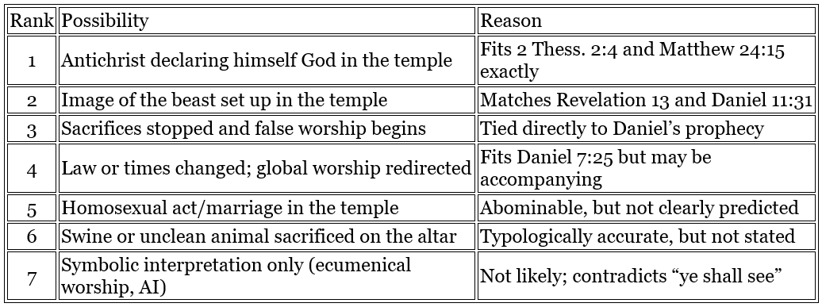

Slide 36
Visit Us:
TrueWordsBaptist.org
True Words Baptist Church – 1377 S. 20th St. Louisville, KY – TrueWordsBaptist.org

