Slide 1

Thursday Bible Study
Matthew 24:32-41
Joshua Tapp
True Words Baptist Church – 1377 S. 20th St. Louisville, KY – TrueWordsBaptist.org

Slide 2
Matthew 24:32-36 Now learn a parable of the fig tree; When his branch is yet tender, and putteth forth leaves, ye know that summer is nigh: 33 So likewise ye, when ye shall see all these things, know that it is near, even at the doors. 34 Verily I say unto you, This generation shall not pass, till all these things be fulfilled. 35 Heaven and earth shall pass away, but my words shall not pass away. 36 But of that day and hour knoweth no man, no, not the angels of heaven, but my Father only.

Slide 3
Matthew 24:37-41 But as the days of Noe were, so shall also the coming of the Son of man be. 38 For as in the days that were before the flood they were eating and drinking, marrying and giving in marriage, until the day that Noe entered into the ark, 39 And knew not until the flood came, and took them all away; so shall also the coming of the Son of man be. 40 Then shall two be in the field; the one shall be taken, and the other left. 41 Two women shall be grinding at the mill; the one shall be taken, and the other left.

Slide 4
Title of the Bible Study
The End According to Jesus: Matthew 24 Part 2
True Words Baptist Church – 1377 S. 20th St. Louisville, KY – TrueWordsBaptist.org

Slide 5
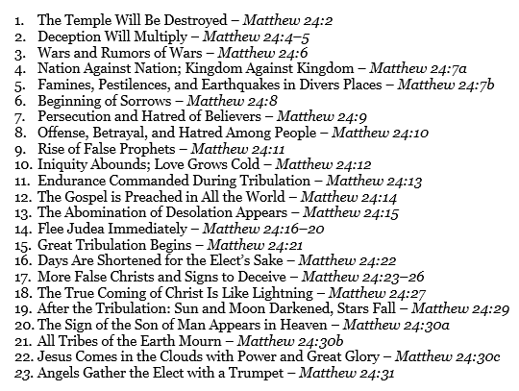

Slide 6
Matthew 24:32-35 Now learn a parable of the fig tree; When his branch is yet tender, and putteth forth leaves, ye know that summer is nigh: 33 So likewise ye, when ye shall see all these things, know that it is near, even at the doors. 34 Verily I say unto you, This generation shall not pass, till all these things be fulfilled. 35 Heaven and earth shall pass away, but my words shall not pass away.

Slide 7
Matthew 24:35 Heaven and earth shall pass away, but my words shall not pass away.

Slide 8
Matthew 24:36 But of that day and hour knoweth no man, no, not the angels of heaven, but my Father only.

Slide 9
Matthew 24:33 So likewise ye, when ye shall see all these things, know that it is near, even at the doors.

Slide 10
Matthew 24:31 And he shall send his angels with a great sound of a trumpet, and they shall gather together his elect from the four winds, from one end of heaven to the other.

Slide 11
Matthew 24:37–41 But as the days of Noe were, so shall also the coming of the Son of man be. 38 For as in the days that were before the flood they were eating and drinking, marrying and giving in marriage, until the day that Noe entered into the ark, 39 And knew not until the flood came, and took them all away; so shall also the coming of the Son of man be. 40 Then shall two be in the field; the one shall be taken, and the other left. 41 Two women shall be grinding at the mill; the one shall be taken, and the other left.

Slide 12
Revelation 6:17 For the great day of his wrath is come; and who shall be able to stand?

Slide 13
Matthew 24:25 Behold, I have told you before.

Slide 14
Matthew 24:40-41 Then shall two be in the field; the one shall be taken, and the other left. Two women shall be grinding at the mill; the one shall be taken, and the other left.

Slide 15
Visit Us:
TrueWordsBaptist.org
True Words Baptist Church – 1377 S. 20th St. Louisville, KY – TrueWordsBaptist.org

