Slide 1
Sunday School
Matthew 6:1-8
Nathan Holmes
True Words Baptist Church – 1377 S. 20th St. Louisville, KY – TrueWordsBaptist.org

Slide 2
Matthew 6:1-8 Take heed that ye do not your alms before men, to be seen of them: otherwise ye have no reward of your Father which is in heaven. 2 Therefore when thou doest thine alms, do not sound a trumpet before thee, as the hypocrites do in the synagogues and in the streets, that they may have glory of men. Verily I say unto you, They have their reward.

Slide 3
3 But when thou doest alms, let not thy left hand know what thy right hand doeth: 4 That thine alms may be in secret: and thy Father which seeth in secret himself shall reward thee openly. 5 And when thou prayest, thou shalt not be as the hypocrites are: for they love to pray standing in the synagogues and in the corners of the streets, that they may be seen of men. Verily I say unto you, They have their reward.

Slide 4
6 But thou, when thou prayest, enter into thy closet, and when thou hast shut thy door, pray to thy Father which is in secret; and thy Father which seeth in secret shall reward thee openly. 7 But when ye pray, use not vain repetitions, as the heathen do: for they think that they shall be heard for their much speaking. 8 Be not ye therefore like unto them: for your Father knoweth what things ye have need of, before ye ask him.

Slide 5
Title of the Lesson
They Have Their Reward
True Words Baptist Church – 1377 S. 20th St. Louisville, KY – TrueWordsBaptist.org

Slide 6
Acts 3:1-6 Now Peter and John went up together into the temple at the hour of prayer, being the ninth hour. 2 And a certain man lame from his mother's womb was carried, whom they laid daily at the gate of the temple which is called Beautiful, to ask alms of them that entered into the temple;

Slide 7
3 Who seeing Peter and John about to go into the temple asked an alms. 4 And Peter, fastening his eyes upon him with John, said, Look on us. 5 And he gave heed unto them, expecting to receive something of them. 6 Then Peter said, Silver and gold have I none; but such as I have give I thee: In the name of Jesus Christ of Nazareth rise up and walk.

Slide 8
Proverbs 28:27
He that giveth unto the poor shall not lack: but he that hideth his eyes shall have many a curse.

Slide 9
Matthew 6:1-2 Take heed that ye do not your alms before men, to be seen of them: otherwise ye have no reward of your Father which is in heaven. 2 Therefore when thou doest thine alms, do not sound a trumpet before thee, as the hypocrites do in the synagogues and in the streets, that they may have glory of men. Verily I say unto you, They have their reward.

Slide 10
1 John 2:15-16 Love not the world, neither the things that are in the world. If any man love the world, the love of the Father is not in him. 16 For all that is in the world, the lust of the flesh, and the lust of the eyes, and the pride of life, is not of the Father, but is of the world.

Slide 11
Proverbs 29:23
A man's pride shall bring him low: but honour shall uphold the humble in spirit.

Slide 12
Proverbs 16:5
Every one that is proud in heart is an abomination to the LORD: though hand join in hand, he shall not be unpunished.

Slide 13
Proverbs 16:18
Pride goeth before destruction, and an haughty spirit before a fall.

Slide 14
Psalm 12:3
The LORD shall cut off all flattering lips, and the tongue that speaketh proud things:

Slide 15
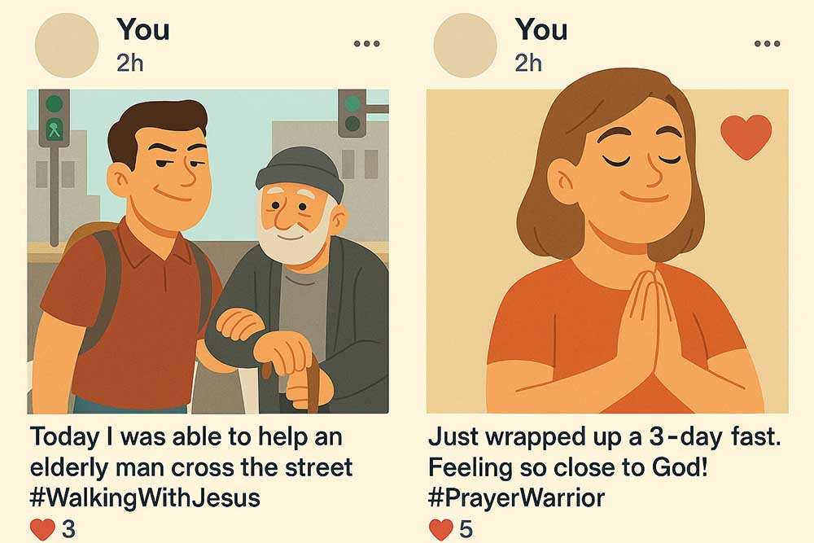

Slide 16
Matthew 6:16-18 Moreover when ye fast, be not, as the hypocrites, of a sad countenance: for they disfigure their faces, that they may appear unto men to fast. Verily I say unto you, They have their reward. 17 But thou, when thou fastest, anoint thine head, and wash thy face;

Slide 17
18 That thou appear not unto men to fast, but unto thy Father which is in secret: and thy Father, which seeth in secret, shall reward thee openly.

Slide 18
Galatians 1:10
For do I now persuade men, or God? or do I seek to please men? for if I yet pleased men, I should not be the servant of Christ.

Slide 19
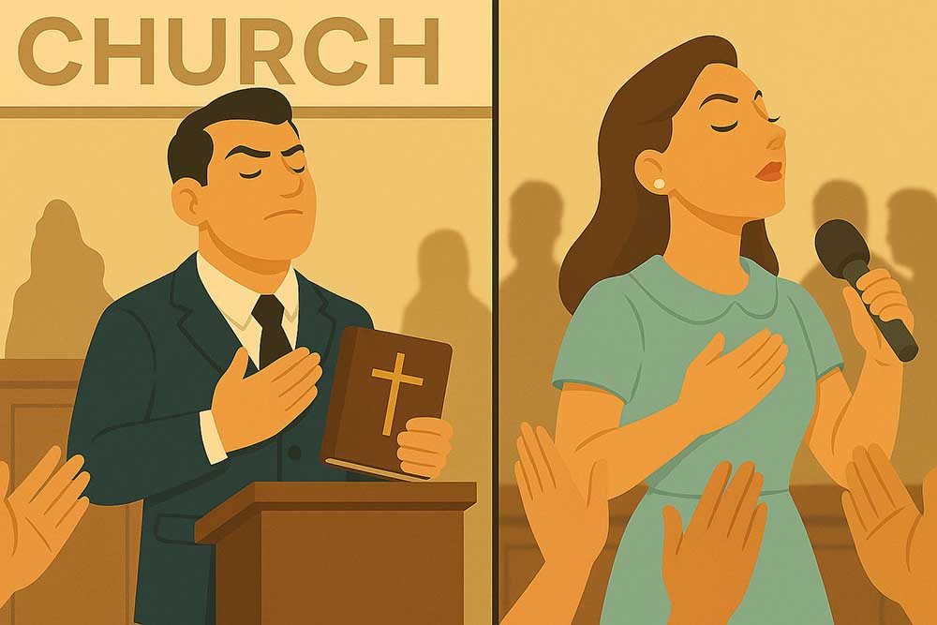

Slide 20
Matthew 6:5
And when thou prayest, thou shalt not be as the hypocrites are: for they love to pray standing in the synagogues and in the corners of the streets, that they may be seen of men. Verily I say unto you, They have their reward.

Slide 21
Matthew 6:7
But when ye pray, use not vain repetitions, as the heathen do: for they think that they shall be heard for their much speaking.

Slide 23
Jeremiah 9:23-24 Thus saith the LORD, Let not the wise man glory in his wisdom, neither let the mighty man glory in his might, let not the rich man glory in his riches:

Slide 24
24 But let him that glorieth glory in this, that he understandeth and knoweth me, that I am the LORD which exercise lovingkindness, judgment, and righteousness, in the earth: for in these things I delight, saith the LORD.

Slide 25
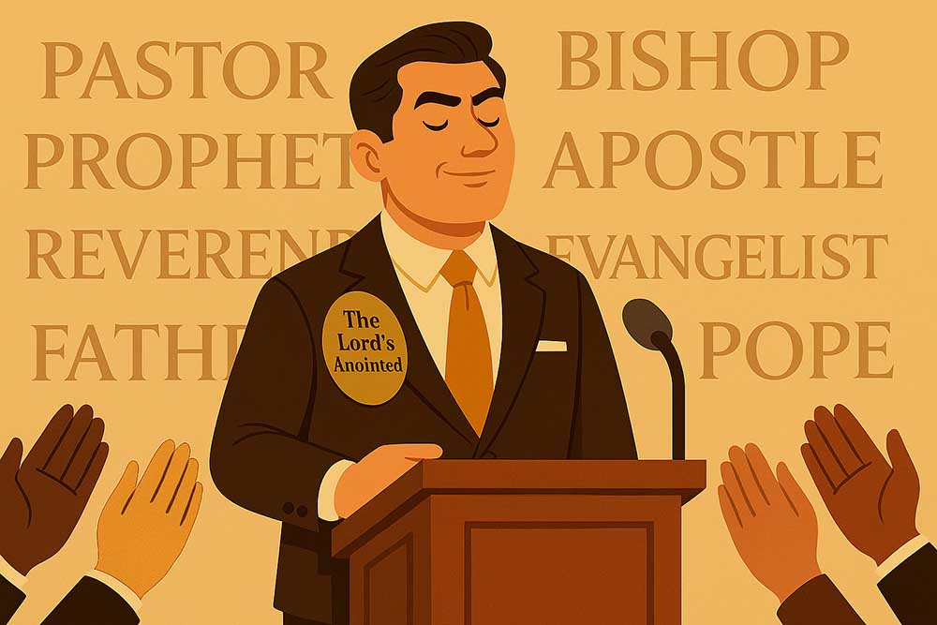

Slide 26
Matthew 23:1-2;5-12
Then spake Jesus to the multitude, and to his disciples, 2 Saying, The scribes and the Pharisees sit in Moses' seat…
5 But all their works they do for to be seen of men: they make broad their phylacteries, and enlarge the borders of their garments,

Slide 27
6 And love the uppermost rooms at feasts, and the chief seats in the synagogues, 7 And greetings in the markets, and to be called of men, Rabbi, Rabbi. 8 But be not ye called Rabbi: for one is your Master, even Christ; and all ye are brethren.

Slide 28
9 And call no man your father upon the earth: for one is your Father, which is in heaven. 10 Neither be ye called masters: for one is your Master, even Christ. 11 But he that is greatest among you shall be your servant. 12 And whosoever shall exalt himself shall be abased; and he that shall humble himself shall be exalted.

Slide 29
Luke 16:14-15
And the Pharisees also, who were covetous, heard all these things: and they derided him. 15 And he said unto them, Ye are they which justify yourselves before men; but God knoweth your hearts: for that which is highly esteemed among men is abomination in the sight of God.

Slide 30
Philippians 2:4-11
Look not every man on his own things, but every man also on the things of others. 5 Let this mind be in you, which was also in Christ Jesus: 6 Who, being in the form of God, thought it not robbery to be equal with God:

Slide 31
7 But made himself of no reputation, and took upon him the form of a servant, and was made in the likeness of men: 8 And being found in fashion as a man, he humbled himself, and became obedient unto death, even the death of the cross.

Slide 32
9 Wherefore God also hath highly exalted him, and given him a name which is above every name: 10 That at the name of Jesus every knee should bow, of things in heaven, and things in earth, and things under the earth; 11 And that every tongue should confess that Jesus Christ is Lord, to the glory of God the Father.

Slide 33
John 12:42-43 Nevertheless among the chief rulers also many believed on him; but because of the Pharisees they did not confess him, lest they should be put out of the synagogue: 43 For they loved the praise of men more than the praise of God.

Slide 34
Matthew 6:2-4 Therefore when thou doest thine alms, do not sound a trumpet before thee, as the hypocrites do in the synagogues and in the streets, that they may have glory of men. Verily I say unto you, They have their reward. 3 But when thou doest alms, let not thy left hand know what thy right hand doeth: 4 That thine alms may be in secret: and thy Father which seeth in secret himself shall reward thee openly.

Slide 35
Matthew 6:6
But thou, when thou prayest, enter into thy closet, and when thou hast shut thy door, pray to thy Father which is in secret; and thy Father which seeth in secret shall reward thee openly.

Slide 36
Revelation 22:12
And, behold, I come quickly; and my reward is with me, to give every man according as his work shall be.

Slide 37
2 John 8
Look to yourselves, that we lose not those things which we have wrought, but that we receive a full reward.

Slide 38
Acts 12:21-23 And upon a set day Herod, arrayed in royal apparel, sat upon his throne, and made an oration unto them. 22 And the people gave a shout, saying, It is the voice of a god, and not of a man. 23 And immediately the angel of the Lord smote him, because he gave not God the glory: and he was eaten of worms, and gave up the ghost.

Slide 39
1 Corinthians 1:27-31 But God hath chosen the foolish things of the world to confound the wise; and God hath chosen the weak things of the world to confound the things which are mighty; 28 And base things of the world, and things which are despised, hath God chosen, yea, and things which are not, to bring to nought things that are:

Slide 40
29 That no flesh should glory in his presence. 30 But of him are ye in Christ Jesus, who of God is made unto us wisdom, and righteousness, and sanctification, and redemption: 31 That, according as it is written, He that glorieth, let him glory in the Lord.

Slide 41
Colossians 3:22-24
Servants, obey in all things your masters according to the flesh; not with eyeservice, as menpleasers; but in singleness of heart, fearing God: 23 And whatsoever ye do, do it heartily, as to the Lord, and not unto men; 24 Knowing that of the Lord ye shall receive the reward of the inheritance: for ye serve the Lord Christ.

Slide 42
1 Peter 5:4
And when the chief Shepherd shall appear, ye shall receive a crown of glory that fadeth not away.

Slide 43
Luke 22:26-27 But ye shall not be so: but he that is greatest among you, let him be as the younger; and he that is chief, as he that doth serve. 27 For whether is greater, he that sitteth at meat, or he that serveth? is not he that sitteth at meat? but I am among you as he that serveth.

Slide 44
Proverbs 22:6
Train up a child in the way he should go: and when he is old, he will not depart from it.

Slide 45
Philippians 2:5-8 Let this mind be in you, which was also in Christ Jesus: 6 Who, being in the form of God, thought it not robbery to be equal with God: 7 But made himself of no reputation, and took upon him the form of a servant, and was made in the likeness of men: 8 And being found in fashion as a man, he humbled himself, and became obedient unto death, even the death of the cross.

Slide 46
Visit Us:
TrueWordsBaptist.org
True Words Baptist Church – 1377 S. 20th St. Louisville, KY – TrueWordsBaptist.org

