Slide 1
Thursday Bible Study
Leviticus 23:15-22
Joshua Tapp
True Words Baptist Church – 1377 S. 20th St. Louisville, KY – TrueWordsBaptist.org

Slide 2
Leviticus 23:15-17 And ye shall count unto you from the morrow after the sabbath, from the day that ye brought the sheaf of the wave offering; seven sabbaths shall be complete: 16 Even unto the morrow after the seventh sabbath shall ye number fifty days; and ye shall offer a new meat offering unto the LORD. 17 Ye shall bring out of your habitations two wave loaves of two tenth deals: they shall be of fine flour; they shall be baken with leaven; they are the firstfruits unto the LORD.

Slide 3
Leviticus 23:18-20 And ye shall offer with the bread seven lambs without blemish of the first year, and one young bullock, and two rams: they shall be for a burnt offering unto the LORD, with their meat offering, and their drink offerings, even an offering made by fire, of sweet savour unto the LORD. 19 Then ye shall sacrifice one kid of the goats for a sin offering, and two lambs of the first year for a sacrifice of peace offerings. 20 And the priest shall wave them with the bread of the firstfruits for a wave offering before the LORD, with the two lambs: they shall be holy to the LORD for the priest.

Slide 4
Leviticus 23:21-22 And ye shall proclaim on the selfsame day, that it may be an holy convocation unto you: ye shall do no servile work therein: it shall be a statute for ever in all your dwellings throughout your generations. 22 And when ye reap the harvest of your land, thou shalt not make clean riddance of the corners of thy field when thou reapest, neither shalt thou gather any gleaning of thy harvest: thou shalt leave them unto the poor, and to the stranger: I am the LORD your God.

Slide 5
Title of the Bible Study
The Feast of Weeks:
The Power of Pentecost
True Words Baptist Church – 1377 S. 20th St. Louisville, KY – TrueWordsBaptist.org

Slide 6
1. Passover
2. Feast of Unleavened Bread
3. Firstfruits
4. Feast of Weeks
5. Blowing of the Trumpets
6. Day of Atonement
7. Feast of Tabernacles

Slide 7
Exodus 23:14-16 Three times thou shalt keep a feast unto me in the year. 15 Thou shalt keep the feast of unleavened bread: (thou shalt eat unleavened bread seven days, as I commanded thee, in the time appointed of the month Abib; for in it thou camest out from Egypt: and none shall appear before me empty:) 16 And the feast of harvest, the firstfruits of thy labours, which thou hast sown in the field: and the feast of ingathering, which is in the end of the year, when thou hast gathered in thy labours out of the field.

Slide 9
Exodus 23:16 And the feast of harvest, the firstfruits of thy labours, which thou hast sown in the field: and the feast of ingathering, which is in the end of the year, when thou hast gathered in thy labours out of the field.

Slide 10
Exodus 34:22-23 And thou shalt observe the feast of weeks, of the firstfruits of wheat harvest, and the feast of ingathering at the year's end. 23 Thrice in the year shall all your men children appear before the Lord GOD, the God of Israel.

Slide 11
Ruth 1:22 So Naomi returned, and Ruth the Moabitess, her daughter in law, with her, which returned out of the country of Moab: and they came to Beth-lehem in the beginning of barley harvest.

Slide 12
Ruth 2:23 So she kept fast by the maidens of Boaz to glean unto the end of barley harvest and of wheat harvest; and dwelt with her mother in law.

Slide 13
Leviticus 23:15-16 And ye shall count unto you from the morrow after the sabbath, from the day that ye brought the sheaf of the wave offering; seven sabbaths shall be complete: 16 Even unto the morrow after the seventh sabbath shall ye number fifty days; and ye shall offer a new meat offering unto the LORD.

Slide 14
Leviticus 23:16 Even unto the morrow after the seventh sabbath shall ye number fifty days; and ye shall offer a new meat offering unto the LORD.

Slide 15
Leviticus 23:17 Ye shall bring out of your habitations two wave loaves of two tenth deals: they shall be of fine flour; they shall be baken with leaven; they are the firstfruits unto the LORD.

Slide 16
Matthew 13:33 Another parable spake he unto them; The kingdom of heaven is like unto leaven, which a woman took, and hid in three measures of meal, till the whole was leavened.

Slide 17
Leviticus 23:18 And ye shall offer with the bread seven lambs without blemish of the first year, and one young bullock, and two rams: they shall be for a burnt offering unto the LORD, with their meat offering, and their drink offerings, even an offering made by fire, of sweet savour unto the LORD.

Slide 18
Leviticus 23:19 Then ye shall sacrifice one kid of the goats for a sin offering, and two lambs of the first year for a sacrifice of peace offerings.

Slide 19
Leviticus 23:20 And the priest shall wave them with the bread of the firstfruits for a wave offering before the LORD, with the two lambs: they shall be holy to the LORD for the priest.

Slide 20
Leviticus 23:21-22 And ye shall proclaim on the selfsame day, that it may be an holy convocation unto you: ye shall do no servile work therein: it shall be a statute for ever in all your dwellings throughout your generations. 22 And when ye reap the harvest of your land, thou shalt not make clean riddance of the corners of thy field when thou reapest, neither shalt thou gather any gleaning of thy harvest: thou shalt leave them unto the poor, and to the stranger: I am the LORD your God.

Slide 21
Mark 12:41-44 And Jesus sat over against the treasury, and beheld how the people cast money into the treasury: and many that were rich cast in much. 42 And there came a certain poor widow, and she threw in two mites, which make a farthing. 43 And he called unto him his disciples, and saith unto them, Verily I say unto you, That this poor widow hath cast more in, than all they which have cast into the treasury: 44 For all they did cast in of their abundance; but she of her want did cast in all that she had, even all her living.

Slide 22
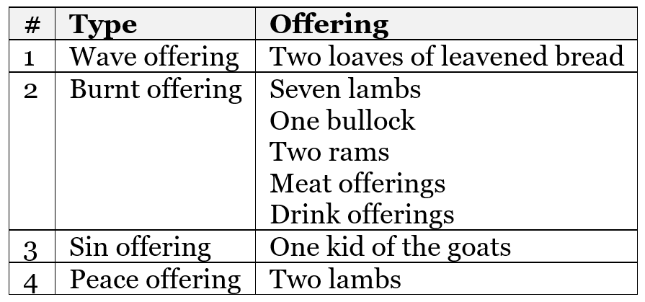

Slide 23
Deuteronomy 16:9-10 Seven weeks shalt thou number unto thee: begin to number the seven weeks from such time as thou beginnest to put the sickle to the corn. 10 And thou shalt keep the feast of weeks unto the LORD thy God with a tribute of a freewill offering of thine hand, which thou shalt give unto the LORD thy God, according as the LORD thy God hath blessed thee:

Slide 24
Deuteronomy 16:11-12 And thou shalt rejoice before the LORD thy God, thou, and thy son, and thy daughter, and thy manservant, and thy maidservant, and the Levite that is within thy gates, and the stranger, and the fatherless, and the widow, that are among you, in the place which the LORD thy God hath chosen to place his name there. 12 And thou shalt remember that thou wast a bondman in Egypt: and thou shalt observe and do these statutes.

Slide 25
Visit Us:
TrueWordsBaptist.org
True Words Baptist Church – 1377 S. 20th St. Louisville, KY – TrueWordsBaptist.org

