Slide 1
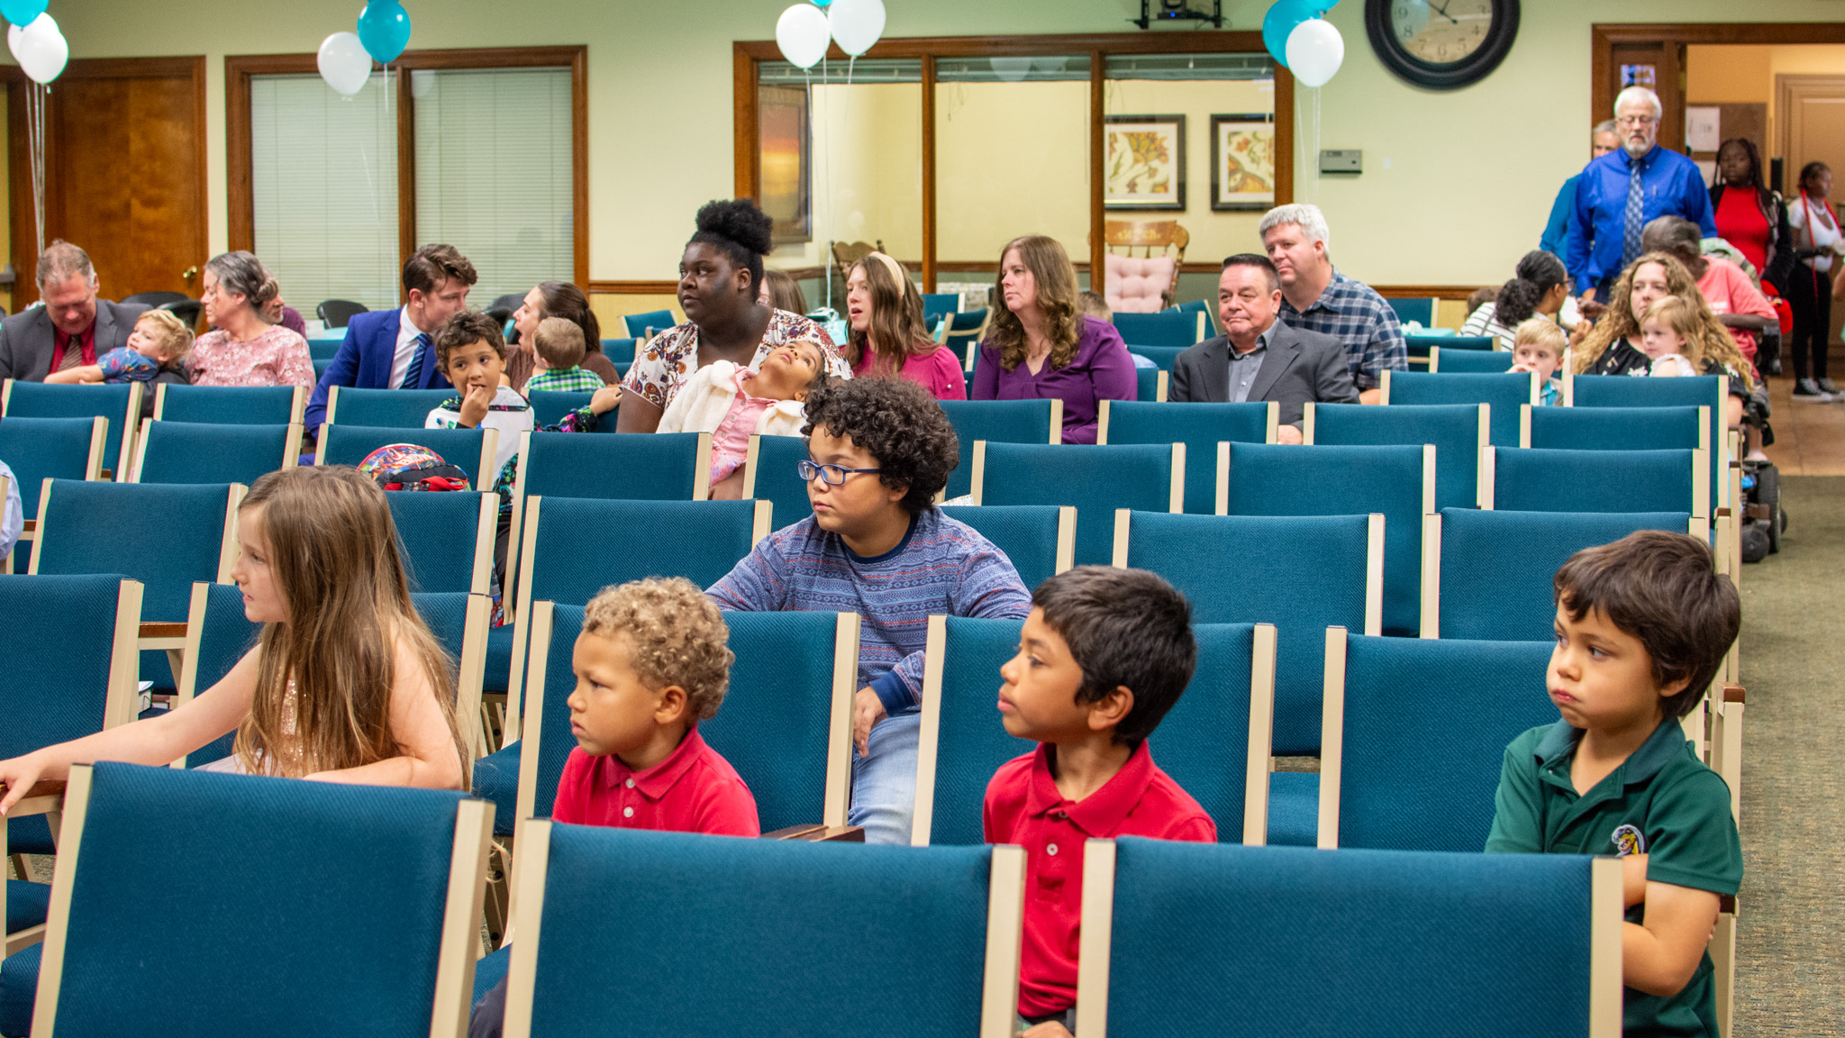
Welcome To
True Words
Baptist Church
True Words Baptist Church – 1377 S. 20th St. Louisville, KY – TrueWordsBaptist.org

Slide 2
2/20/25
Welcome To
Thursday Night Service
Joshua Tapp
True Words Baptist Church – 1377 S. 20th St. Louisville, KY – TrueWordsBaptist.org

Slide 3
Opening Prayer
True Words Baptist Church – 1377 S. 20th St. Louisville, KY – TrueWordsBaptist.org

Slide 4
Song 1
Near The Cross
#10
Nathan Holmes
- Please Stand For Singing -
True Words Baptist Church – 1377 S. 20th St. Louisville, KY – TrueWordsBaptist.org

Slide 5
Announcements
Joshua Tapp
True Words Baptist Church – 1377 S. 20th St. Louisville, KY – TrueWordsBaptist.org

Slide 6
Thursday
February 20, 2025
2/20/25
True Words Baptist Church – 1377 S. 20th St. Louisville, KY – TrueWordsBaptist.org

Slide 7
Today’s Schedule
Soul Winning: | Prior to Service
Thursday PM Service: | 7:00 PM – 8:00 PM
True Words Baptist Church – 1377 S. 20th St. Louisville, KY – TrueWordsBaptist.org

Slide 8
Our Church Services:
Sunday School 10 am
Sunday Worship 11 am
Sunday Evening 6 pm
Thursday Bible Study 7 pm

Slide 9
Visit Our Website:
TrueWordsBaptist.org
Sunday School Lessons, Sermons, Bible Studies, Daily Bible Reading, and More
True Words Baptist Church – 1377 S. 20th St. Louisville, KY – TrueWordsBaptist.org

Slide 10
Soul Winning & Baptisms
Date | Day of Week | Soul Winners | Salvations | Baptisms
2/16/2025 | Sunday | 0 | 0 | 0
2/17/2025 | Monday | 0 | 0 | 0
2/18/2025 | Tuesday | 3 | 7 | 0
2/19/2025 | Wednesday | 0 | 0 | 0
2/20/2025 | Thursday
2/21/2025 | Friday
2/22/2025 | Saturday
This Week Totals:
February 2025: |  | 65 | 72 | 4
From 10/13/24: |  | 465 | 459 | 21
True Words Baptist Church – 1377 S. 20th St. Louisville, KY – TrueWordsBaptist.org

Slide 11
Attendance
Week Of | Sunday School | Sunday AM | Sunday PM | Thursday PM
1/5/2025 | N/A | N/A | N/A | 17
1/12/2025 | 47 | 45 | 25 | 29
1/19/2025 | 35 | 47 | 31 | 26
1/26/2025 | 32 | 45 | 13 | 25
Jan-2025 | 114 | 137 | 69 | 97
Week Of | Sunday School | Sunday AM | Sunday PM | Thursday PM
2/2/2025 | 45 | 51 | 16 | 25
2/9/2025 | 47 | 57 | 17 | 31
2/16/2025 | N/A | N/A | N/A
2/23/2025
Feb-2025 | 92/46 | 108/54 | 33/17 | 56/28
Month | Sunday School | Sunday AM | Sunday PM | Thursday PM
October 2024 | 40.00 | 50.33 | 24.00 | 19.00
Novermber 2024 | 33.75 | 37.25 | 17.25 | 21.50
December 2024 | 44.20 | 49.80 | 20.40 | 21.00
January 2025 | 38.00 | 45.67 | 23.00 | 24.25
True Words Baptist Church – 1377 S. 20th St. Louisville, KY – TrueWordsBaptist.org

Slide 12
Soul Winning Schedule
Day | Time | Lead
Sunday | 3:00 pm to 5:00 pm | Joshua Tapp
Monday | Posted in Group | Nathan Holmes
Tuesday | Posted in Group | Joshua Tapp
Wednesday* | Posted in Group | Pamela Tapp
Thursday | Posted in Group | Nathan Holmes
Friday | Posted in Group | Joshua Tapp
Saturday | Posted in Group | Joshua Tapp
* Wednesday is Ladies only.
** Saturday is for visitation to the saved and soul winning.
True Words Baptist Church – 1377 S. 20th St. Louisville, KY – TrueWordsBaptist.org

Slide 13
Existing
Prayer
Requests
True Words Baptist Church – 1377 S. 20th St. Louisville, KY – TrueWordsBaptist.org

Slide 14
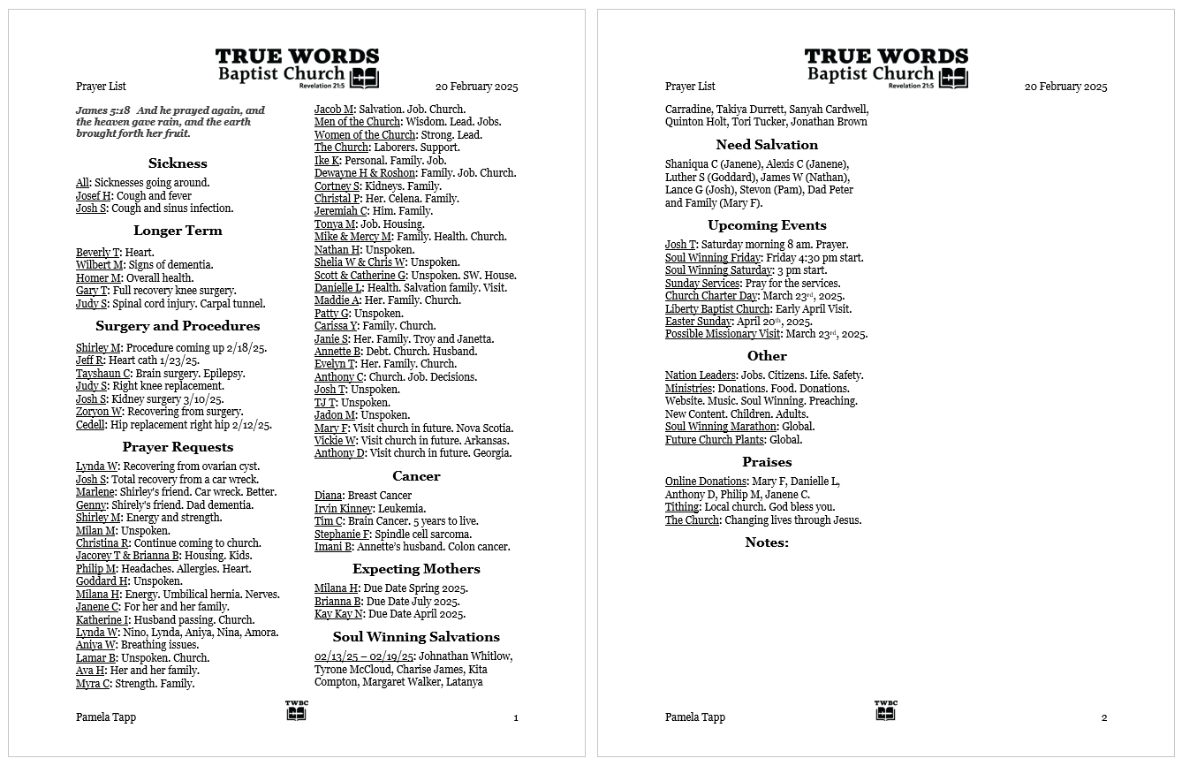

Slide 15
New
Prayer
Requests
True Words Baptist Church – 1377 S. 20th St. Louisville, KY – TrueWordsBaptist.org

Slide 16
Prayer
True Words Baptist Church – 1377 S. 20th St. Louisville, KY – TrueWordsBaptist.org

Slide 17
Special Music by Emma Tapp
When He Cometh
#82
True Words Baptist Church – 1377 S. 20th St. Louisville, KY – TrueWordsBaptist.org

Slide 18
Soul Winning
Testimony
True Words Baptist Church – 1377 S. 20th St. Louisville, KY – TrueWordsBaptist.org

Slide 19
Thursday Bible Study
Leviticus 23:4-44
Joshua Tapp
True Words Baptist Church – 1377 S. 20th St. Louisville, KY – TrueWordsBaptist.org

Slide 20
Bible Reading
Exodus 34:18-27
True Words Baptist Church – 1377 S. 20th St. Louisville, KY – TrueWordsBaptist.org

Slide 21
Exodus 34:18-21 The feast of unleavened bread shalt thou keep. Seven days thou shalt eat unleavened bread, as I commanded thee, in the time of the month Abib: for in the month Abib thou camest out from Egypt. 19 All that openeth the matrix is mine; and every firstling among thy cattle, whether ox or sheep, that is male. 20 But the firstling of an ass thou shalt redeem with a lamb: and if thou redeem him not, then shalt thou break his neck. All the firstborn of thy sons thou shalt redeem. And none shall appear before me empty. 21 Six days thou shalt work, but on the seventh day thou shalt rest: in earing time and in harvest thou shalt rest.

Slide 22
Exodus 34:22-25 And thou shalt observe the feast of weeks, of the firstfruits of wheat harvest, and the feast of ingathering at the year's end. 23 Thrice in the year shall all your men children appear before the Lord GOD, the God of Israel. 24 For I will cast out the nations before thee, and enlarge thy borders: neither shall any man desire thy land, when thou shalt go up to appear before the LORD thy God thrice in the year. 25 Thou shalt not offer the blood of my sacrifice with leaven; neither shall the sacrifice of the feast of the passover be left unto the morning.

Slide 23
Exodus 34:26-27 The first of the firstfruits of thy land thou shalt bring unto the house of the LORD thy God. Thou shalt not seethe a kid in his mother's milk. 27 And the LORD said unto Moses, Write thou these words: for after the tenor of these words I have made a covenant with thee and with Israel.

Slide 24
Title of the Bible Study
The Seven Feasts of the Lord: God's Plan Revealed
True Words Baptist Church – 1377 S. 20th St. Louisville, KY – TrueWordsBaptist.org

Slide 25
1. Passover
2. Feast of Unleavened Bread
3. Firstfruits
4. Feast of Weeks
5. Blowing of the Trumpets
6. Day of Atonement
7. Feast of Tabernacles

Slide 26
1. Passover, Feast of Unleavened Bread, Firstfruits
2. Feast of Weeks
3. Blowing of the Trumpets, Day of Atonement, Feast of Tabernacles

Slide 27
Leviticus 23:5 In the fourteenth day of the first month at even is the LORD'S passover.

Slide 28
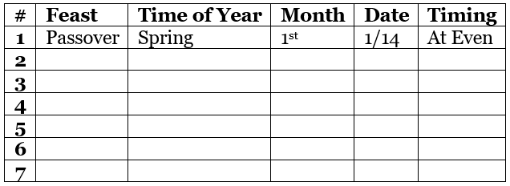

Slide 29
Leviticus 23:5-7 In the fourteenth day of the first month at even is the LORD'S passover. 6 And on the fifteenth day of the same month is the feast of unleavened bread unto the LORD: seven days ye must eat unleavened bread. 7 In the first day ye shall have an holy convocation: ye shall do no servile work therein.

Slide 30
Exodus 12:18 In the first month, on the fourteenth day of the month at even, ye shall eat unleavened bread, until the one and twentieth day of the month at even.

Slide 31
Ezekiel 45:21 In the first month, in the fourteenth day of the month, ye shall have the passover, a feast of seven days; unleavened bread shall be eaten.

Slide 33
Leviticus 23:10-11 Speak unto the children of Israel, and say unto them, When ye be come into the land which I give unto you, and shall reap the harvest thereof, then ye shall bring a sheaf of the firstfruits of your harvest unto the priest: 11 And he shall wave the sheaf before the LORD, to be accepted for you: on the morrow after the sabbath the priest shall wave it.

Slide 35
Leviticus 23:15-16 And ye shall count unto you from the morrow after the sabbath, from the day that ye brought the sheaf of the wave offering; seven sabbaths shall be complete: 16 Even unto the morrow after the seventh sabbath shall ye number fifty days; and ye shall offer a new meat offering unto the LORD.

Slide 37
Matthew 13:24-27 Another parable put he forth unto them, saying, The kingdom of heaven is likened unto a man which sowed good seed in his field: 25 But while men slept, his enemy came and sowed tares among the wheat, and went his way. 26 But when the blade was sprung up, and brought forth fruit, then appeared the tares also. 27 So the servants of the householder came and said unto him, Sir, didst not thou sow good seed in thy field? from whence then hath it tares?

Slide 38
Matthew 13:28-30 He said unto them, An enemy hath done this. The servants said unto him, Wilt thou then that we go and gather them up? 29 But he said, Nay; lest while ye gather up the tares, ye root up also the wheat with them. 30 Let both grow together until the harvest: and in the time of harvest I will say to the reapers, Gather ye together first the tares, and bind them in bundles to burn them: but gather the wheat into my barn.

Slide 39
Leviticus 23:23-25 And the LORD spake unto Moses, saying, 24 Speak unto the children of Israel, saying, In the seventh month, in the first day of the month, shall ye have a sabbath, a memorial of blowing of trumpets, an holy convocation. 25 Ye shall do no servile work therein: but ye shall offer an offering made by fire unto the LORD.

Slide 41
Numbers 10:9 And if ye go to war in your land against the enemy that oppresseth you, then ye shall blow an alarm with the trumpets; and ye shall be remembered before the LORD your God, and ye shall be saved from your enemies.

Slide 42
Leviticus 23:27-28 Also on the tenth day of this seventh month there shall be a day of atonement: it shall be an holy convocation unto you; and ye shall afflict your souls, and offer an offering made by fire unto the LORD. 28 And ye shall do no work in that same day: for it is a day of atonement, to make an atonement for you before the LORD your God.

Slide 43
Leviticus 23:32 It shall be unto you a sabbath of rest, and ye shall afflict your souls: in the ninth day of the month at even, from even unto even, shall ye celebrate your sabbath.

Slide 45
Leviticus 23:34 Speak unto the children of Israel, saying, The fifteenth day of this seventh month shall be the feast of tabernacles for seven days unto the LORD.

Slide 46
Leviticus 23:39 Also in the fifteenth day of the seventh month, when ye have gathered in the fruit of the land, ye shall keep a feast unto the LORD seven days: on the first day shall be a sabbath, and on the eighth day shall be a sabbath.

Slide 48
Closing Prayer
Joshua Tapp
True Words Baptist Church – 1377 S. 20th St. Louisville, KY – TrueWordsBaptist.org

Slide 49
Song 2
Tis So Sweet To Trust in Jesus
#127
Nathan Holmes
- Please Stand For Singing -
True Words Baptist Church – 1377 S. 20th St. Louisville, KY – TrueWordsBaptist.org

