Slide 1
Thursday Bible Study
Ezekiel 43:18-27
Joshua Tapp
True Words Baptist Church – 1377 S. 20th St. Louisville, KY – TrueWordsBaptist.org

Slide 2
Title of the Bible Study
The Sprinkling
of Blood
True Words Baptist Church – 1377 S. 20th St. Louisville, KY – TrueWordsBaptist.org

Slide 3
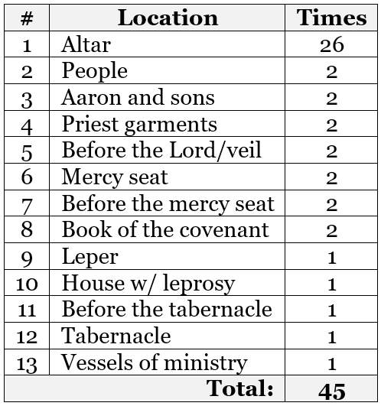

Slide 4
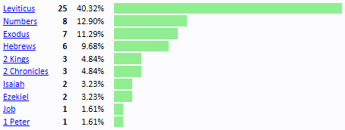

Slide 5
Exodus 24:6-8 And Moses took half of the blood, and put it in basons; and half of the blood he sprinkled on the altar. 7 And he took the book of the covenant, and read in the audience of the people: and they said, All that the LORD hath said will we do, and be obedient. 8 And Moses took the blood, and sprinkled it on the people, and said, Behold the blood of the covenant, which the LORD hath made with you concerning all these words.

Slide 6
Hebrews 9:11-12 But Christ being come an high priest of good things to come, by a greater and more perfect tabernacle, not made with hands, that is to say, not of this building; 12 Neither by the blood of goats and calves, but by his own blood he entered in once into the holy place, having obtained eternal redemption for us.

Slide 7
Hebrews 9:14 How much more shall the blood of Christ, who through the eternal Spirit offered himself without spot to God, purge your conscience from dead works to serve the living God?

Slide 8
Hebrews 9:18-20 Whereupon neither the first testament was dedicated without blood. 19 For when Moses had spoken every precept to all the people according to the law, he took the blood of calves and of goats, with water, and scarlet wool, and hyssop, and sprinkled both the book, and all the people, 20 Saying, This is the blood of the testament which God hath enjoined unto you.

Slide 9
Hebrews 9:21-22 Moreover he sprinkled with blood both the tabernacle, and all the vessels of the ministry. 22 And almost all things are by the law purged with blood; and without shedding of blood is no remission.

Slide 10
Hebrews 9:23-24 It was therefore necessary that the patterns of things in the heavens should be purified with these; but the heavenly things themselves with better sacrifices than these. 24 For Christ is not entered into the holy places made with hands, which are the figures of the true; but into heaven itself, now to appear in the presence of God for us:

Slide 11
Hebrews 9:25-26 Nor yet that he should offer himself often, as the high priest entereth into the holy place every year with blood of others; 26 For then must he often have suffered since the foundation of the world: but now once in the end of the world hath he appeared to put away sin by the sacrifice of himself.

Slide 12
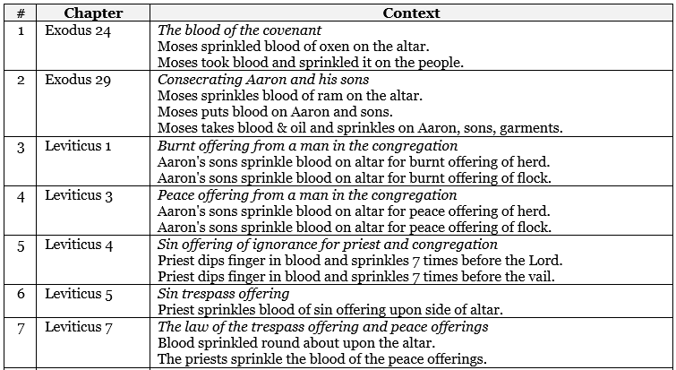

Slide 13
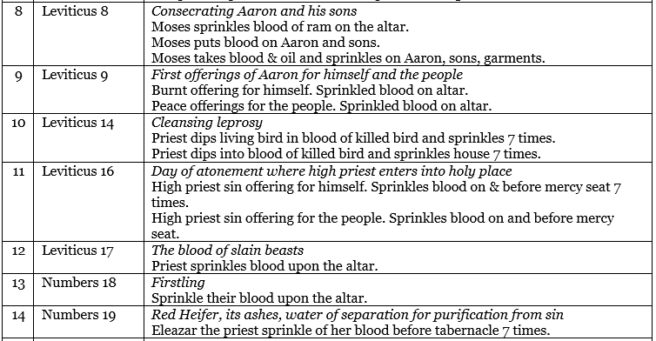

Slide 14
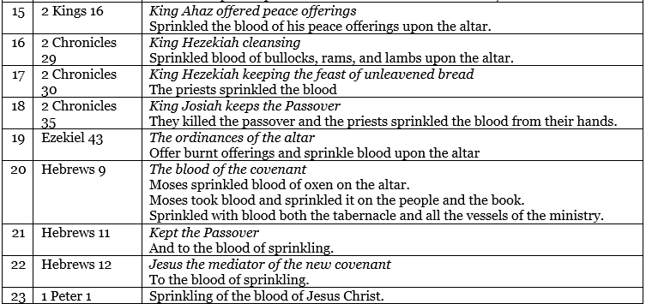

Slide 16
Leviticus 16:15-16 Then shall he kill the goat of the sin offering, that is for the people, and bring his blood within the vail, and do with that blood as he did with the blood of the bullock, and sprinkle it upon the mercy seat, and before the mercy seat: 16 And he shall make an atonement for the holy place, because of the uncleanness of the children of Israel, and because of their transgressions in all their sins: and so shall he do for the tabernacle of the congregation, that remaineth among them in the midst of their uncleanness.

Slide 17
Leviticus 16:18-19 And he shall go out unto the altar that is before the LORD, and make an atonement for it; and shall take of the blood of the bullock, and of the blood of the goat, and put it upon the horns of the altar round about. 19 And he shall sprinkle of the blood upon it with his finger seven times, and cleanse it, and hallow it from the uncleanness of the children of Israel.

Slide 18
Leviticus 16:20 And when he hath made an end of reconciling the holy place, and the tabernacle of the congregation, and the altar, he shall bring the live goat:

Slide 19
Ezekiel 43:20 And thou shalt take of the blood thereof, and put it on the four horns of it, and on the four corners of the settle, and upon the border round about: thus shalt thou cleanse and purge it.

Slide 20
Ezekiel 43:22-23 And on the second day thou shalt offer a kid of the goats without blemish for a sin offering; and they shall cleanse the altar, as they did cleanse it with the bullock. 23 When thou hast made an end of cleansing it, thou shalt offer a young bullock without blemish, and a ram out of the flock without blemish.

Slide 21
Ezekiel 43:26 Seven days shall they purge the altar and purify it; and they shall consecrate themselves.

Slide 22
Revelation 6:9 And when he had opened the fifth seal, I saw under the altar the souls of them that were slain for the word of God, and for the testimony which they held:

Slide 23
Revelation 9:13 And the sixth angel sounded, and I heard a voice from the four horns of the golden altar which is before God,

Slide 24
Hebrews 10:22 Let us draw near with a true heart in full assurance of faith, having our hearts sprinkled from an evil conscience, and our bodies washed with pure water.

Slide 25
Hebrews 11:28 Through faith he kept the passover, and the sprinkling of blood, lest he that destroyed the firstborn should touch them.

Slide 26
Visit Us:
TrueWordsBaptist.org
True Words Baptist Church – 1377 S. 20th St. Louisville, KY – TrueWordsBaptist.org

