Slide 1
Thursday Bible Study
Mark 16:9-20
Joshua Tapp
True Words Baptist Church – 1377 S. 20th St. Louisville, KY – TrueWordsBaptist.org

Slide 2
Title of the Bible Study
Resurrection Timeline: The Appearances
of Jesus
True Words Baptist Church – 1377 S. 20th St. Louisville, KY – TrueWordsBaptist.org

Slide 3
Matthew 28:5-7 And the angel answered and said unto the women, Fear not ye: for I know that ye seek Jesus, which was crucified. 6 He is not here: for he is risen, as he said. Come, see the place where the Lord lay. 7 And go quickly, and tell his disciples that he is risen from the dead; and, behold, he goeth before you into Galilee; there shall ye see him: lo, I have told you.

Slide 4
Matthew 28:8-10 And they departed quickly from the sepulchre with fear and great joy; and did run to bring his disciples word. 9 And as they went to tell his disciples, behold, Jesus met them, saying, All hail. And they came and held him by the feet, and worshipped him. 10 Then said Jesus unto them, Be not afraid: go tell my brethren that they go into Galilee, and there shall they see me.

Slide 5
Matthew 28:16-18 Then the eleven disciples went away into Galilee, into a mountain where Jesus had appointed them. 17 And when they saw him, they worshipped him: but some doubted. 18 And Jesus came and spake unto them, saying, All power is given unto me in heaven and in earth.

Slide 6
Mark 16:9 Now when Jesus was risen early the first day of the week, he appeared first to Mary Magdalene, out of whom he had cast seven devils.

Slide 7
Mark 16:12 After that he appeared in another form unto two of them, as they walked, and went into the country.

Slide 8
Mark 16:14 Afterward he appeared unto the eleven as they sat at meat, and upbraided them with their unbelief and hardness of heart, because they believed not them which had seen him after he was risen.

Slide 9
Luke 24:13-15 And, behold, two of them went that same day to a village called Emmaus, which was from Jerusalem about threescore furlongs. 14 And they talked together of all these things which had happened. 15 And it came to pass, that, while they communed together and reasoned, Jesus himself drew near, and went with them.

Slide 10
Luke 24:18 And the one of them, whose name was Cleopas, answering said unto him, Art thou only a stranger in Jerusalem, and hast not known the things which are come to pass there in these days?

Slide 11
Luke 24:29-31 But they constrained him, saying, Abide with us: for it is toward evening, and the day is far spent. And he went in to tarry with them. 30 And it came to pass, as he sat at meat with them, he took bread, and blessed it, and brake, and gave to them. 31 And their eyes were opened, and they knew him; and he vanished out of their sight.

Slide 12
Luke 24:33-34 And they rose up the same hour, and returned to Jerusalem, and found the eleven gathered together, and them that were with them, 34 Saying, The Lord is risen indeed, and hath appeared to Simon.

Slide 13
Luke 24:36-38 And as they thus spake, Jesus himself stood in the midst of them, and saith unto them, Peace be unto you. 37 But they were terrified and affrighted, and supposed that they had seen a spirit. 38 And he said unto them, Why are ye troubled? and why do thoughts arise in your hearts?

Slide 14
Luke 24:39-41 Behold my hands and my feet, that it is I myself: handle me, and see; for a spirit hath not flesh and bones, as ye see me have. 40 And when he had thus spoken, he shewed them his hands and his feet. 41 And while they yet believed not for joy, and wondered, he said unto them, Have ye here any meat?

Slide 16
John 20:16 Jesus saith unto her, Mary. She turned herself, and saith unto him, Rabboni; which is to say, Master.

Slide 17
John 20:19 Then the same day at evening, being the first day of the week, when the doors were shut where the disciples were assembled for fear of the Jews, came Jesus and stood in the midst, and saith unto them, Peace be unto you.

Slide 18
John 20:24-26 But Thomas, one of the twelve, called Didymus, was not with them when Jesus came. 25 The other disciples therefore said unto him, We have seen the Lord. But he said unto them, Except I shall see in his hands the print of the nails, and put my finger into the print of the nails, and thrust my hand into his side, I will not believe. 26 And after eight days again his disciples were within, and Thomas with them: then came Jesus, the doors being shut, and stood in the midst, and said, Peace be unto you.

Slide 19
John 21:1-2 After these things Jesus shewed himself again to the disciples at the sea of Tiberias; and on this wise shewed he himself. 2 There were together Simon Peter, and Thomas called Didymus, and Nathanael of Cana in Galilee, and the sons of Zebedee, and two other of his disciples.

Slide 20
John 21:13-14 Jesus then cometh, and taketh bread, and giveth them, and fish likewise. 14 This is now the third time that Jesus shewed himself to his disciples, after that he was risen from the dead.

Slide 22
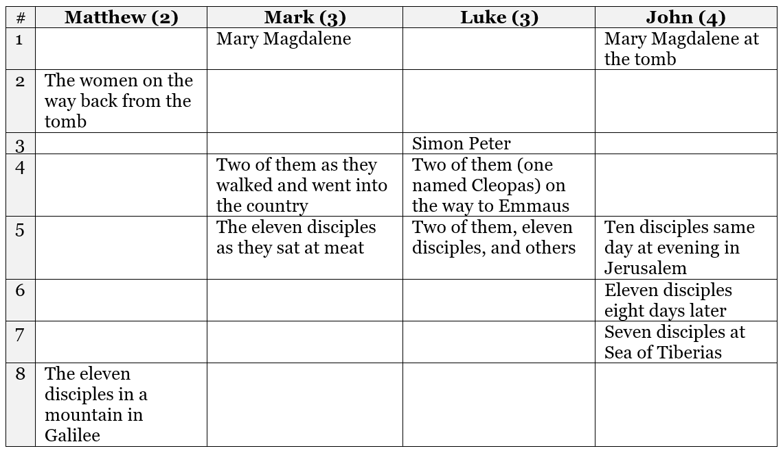

Slide 23
1 Corinthians 15:4-8 And that he was buried, and that he rose again the third day according to the scriptures: 5 And that he was seen of Cephas, then of the twelve: 6 After that, he was seen of above five hundred brethren at once; of whom the greater part remain unto this present, but some are fallen asleep. 7 After that, he was seen of James; then of all the apostles. 8 And last of all he was seen of me also, as of one born out of due time.

Slide 24
Visit Us:
TrueWordsBaptist.org
True Words Baptist Church – 1377 S. 20th St. Louisville, KY – TrueWordsBaptist.org

