Slide 1

Sunday Evening
1 Corinthians 6:12-20
Joshua Tapp
True Words Baptist Church – 1377 S. 20th St. Louisville, KY – TrueWordsBaptist.org

Slide 2
Title of the Sermon
The Laws of Thy God: Flee Fornication
True Words Baptist Church – 1377 S. 20th St. Louisville, KY – TrueWordsBaptist.org

Slide 3
1 Corinthians 6:18 Flee fornication. Every sin that a man doeth is without the body; but he that committeth fornication sinneth against his own body.

Slide 4
Isaiah 55:6-7 Seek ye the LORD while he may be found, call ye upon him while he is near: 7 Let the wicked forsake his way, and the unrighteous man his thoughts: and let him return unto the LORD, and he will have mercy upon him; and to our God, for he will abundantly pardon.

Slide 5
Isaiah 55:8-9 For my thoughts are not your thoughts, neither are your ways my ways, saith the LORD. 9 For as the heavens are higher than the earth, so are my ways higher than your ways, and my thoughts than your thoughts.

Slide 6
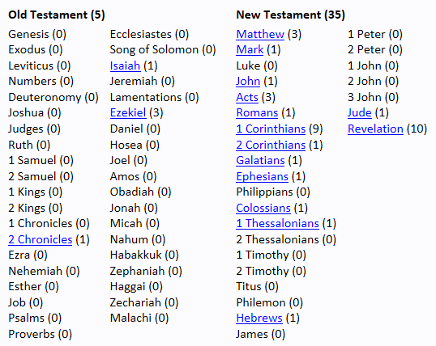
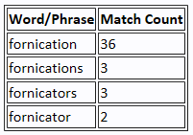

Slide 7
2 Chronicles 21:4-6 Now when Jehoram was risen up to the kingdom of his father, he strengthened himself, and slew all his brethren with the sword, and divers also of the princes of Israel. 5 Jehoram was thirty and two years old when he began to reign, and he reigned eight years in Jerusalem. 6 And he walked in the way of the kings of Israel, like as did the house of Ahab: for he had the daughter of Ahab to wife: and he wrought that which was evil in the eyes of the LORD.

Slide 8
2 Chronicles 21:11 Moreover he made high places in the mountains of Judah, and caused the inhabitants of Jerusalem to commit fornication, and compelled Judah thereto.

Slide 9
2 Chronicles 21:12-13 And there came a writing to him from Elijah the prophet, saying, Thus saith the LORD God of David thy father, Because thou hast not walked in the ways of Jehoshaphat thy father, nor in the ways of Asa king of Judah, 13 But hast walked in the way of the kings of Israel, and hast made Judah and the inhabitants of Jerusalem to go a whoring, like to the whoredoms of the house of Ahab, and also hast slain thy brethren of thy father's house, which were better than thyself:

Slide 10
Genesis 38:24 And it came to pass about three months after, that it was told Judah, saying, Tamar thy daughter in law hath played the harlot; and also, behold, she is with child by whoredom. And Judah said, Bring her forth, and let her be burnt.

Slide 11
2 Chronicles 21:14-16 Behold, with a great plague will the LORD smite thy people, and thy children, and thy wives, and all thy goods: 15 And thou shalt have great sickness by disease of thy bowels, until thy bowels fall out by reason of the sickness day by day. 16 Moreover the LORD stirred up against Jehoram the spirit of the Philistines, and of the Arabians, that were near the Ethiopians:

Slide 12
2 Chronicles 21:17-18 And they came up into Judah, and brake into it, and carried away all the substance that was found in the king's house, and his sons also, and his wives; so that there was never a son left him, save Jehoahaz, the youngest of his sons. 18 And after all this the LORD smote him in his bowels with an incurable disease.

Slide 13
2 Chronicles 21:19 And it came to pass, that in process of time, after the end of two years, his bowels fell out by reason of his sickness: so he died of sore diseases. And his people made no burning for him, like the burning of his fathers.

Slide 14
1 Corinthians 6:12-13 All things are lawful unto me, but all things are not expedient: all things are lawful for me, but I will not be brought under the power of any. 13 Meats for the belly, and the belly for meats: but God shall destroy both it and them. Now the body is not for fornication, but for the Lord; and the Lord for the body.

Slide 15
1 Corinthians 6:14-16 And God hath both raised up the Lord, and will also raise up us by his own power. 15 Know ye not that your bodies are the members of Christ? shall I then take the members of Christ, and make them the members of an harlot? God forbid. 16 What? know ye not that he which is joined to an harlot is one body? for two, saith he, shall be one flesh.

Slide 16
1 Corinthians 6:17-20 But he that is joined unto the Lord is one spirit. 18 Flee fornication. Every sin that a man doeth is without the body; but he that committeth fornication sinneth against his own body. 19 What? know ye not that your body is the temple of the Holy Ghost which is in you, which ye have of God, and ye are not your own? 20 For ye are bought with a price: therefore glorify God in your body, and in your spirit, which are God's.

Slide 17
1 Corinthians 7:1-3 Now concerning the things whereof ye wrote unto me: It is good for a man not to touch a woman. 2 Nevertheless, to avoid fornication, let every man have his own wife, and let every woman have her own husband. 3 Let the husband render unto the wife due benevolence: and likewise also the wife unto the husband.

Slide 18
1 Corinthians 7:9 But if they cannot contain, let them marry: for it is better to marry than to burn.

Slide 19
1 Corinthians 10:6-8 Now these things were our examples, to the intent we should not lust after evil things, as they also lusted. 7 Neither be ye idolaters, as were some of them; as it is written, The people sat down to eat and drink, and rose up to play. 8 Neither let us commit fornication, as some of them committed, and fell in one day three and twenty thousand.

Slide 20
Numbers 25:1-5 And Israel abode in Shittim, and the people began to commit whoredom with the daughters of Moab. 2 And they called the people unto the sacrifices of their gods: and the people did eat, and bowed down to their gods. 3 And Israel joined himself unto Baal-peor: and the anger of the LORD was kindled against Israel. 4 And the LORD said unto Moses, Take all the heads of the people, and hang them up before the LORD against the sun, that the fierce anger of the LORD may be turned away from Israel. 5 And Moses said unto the judges of Israel, Slay ye every one his men that were joined unto Baal-peor.

Slide 21
Revelation 2:20-21 Notwithstanding I have a few things against thee, because thou sufferest that woman Jezebel, which calleth herself a prophetess, to teach and to seduce my servants to commit fornication, and to eat things sacrificed unto idols. 21 And I gave her space to repent of her fornication; and she repented not.

Slide 22
Revelation 2:22 Behold, I will cast her into a bed, and them that commit adultery with her into great tribulation, except they repent of their deeds.

Slide 23
Revelation 2:23 And I will kill her children with death; and all the churches shall know that I am he which searcheth the reins and hearts: and I will give unto every one of you according to your works.

Slide 24
Visit Us:
TrueWordsBaptist.org
True Words Baptist Church – 1377 S. 20th St. Louisville, KY – TrueWordsBaptist.org

