Slide 1
Sunday School
Matthew 2
Joshua Tapp
True Words Baptist Church – 1377 S. 20th St. Louisville, KY – TrueWordsBaptist.org

Slide 2
Title of the Lesson:
The Birth of
Jesus Christ
True Words Baptist Church – 1377 S. 20th St. Louisville, KY – TrueWordsBaptist.org

Slide 3
Matthew 2:1-2 Now when Jesus was born in Bethlehem of Judaea in the days of Herod the king, behold, there came wise men from the east to Jerusalem, 2 Saying, Where is he that is born King of the Jews? for we have seen his star in the east, and are come to worship him.

Slide 4
Luke 2:1-4 And it came to pass in those days, that there went out a decree from Caesar Augustus, that all the world should be taxed. 2 (And this taxing was first made when Cyrenius was governor of Syria.) 3 And all went to be taxed, every one into his own city. 4 And Joseph also went up from Galilee, out of the city of Nazareth, into Judaea, unto the city of David, which is called Bethlehem; (because he was of the house and lineage of David:)

Slide 5
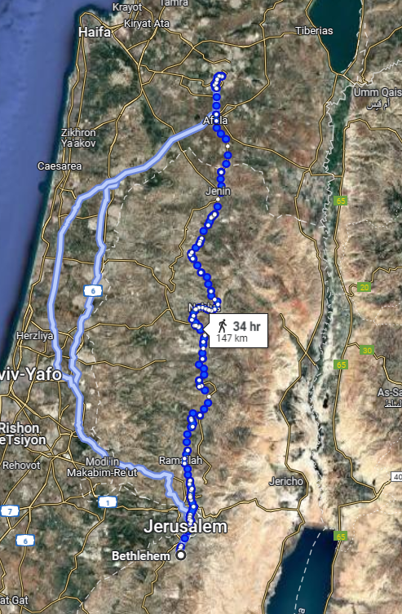

Slide 6
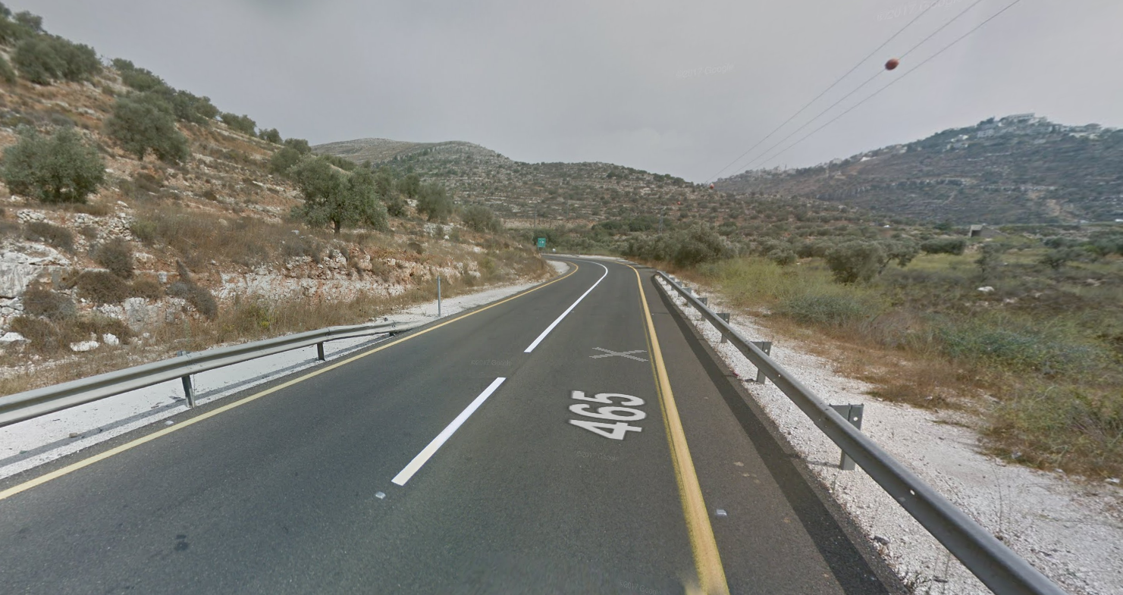

Slide 7
Luke 2:5-7 To be taxed with Mary his espoused wife, being great with child. 6 And so it was, that, while they were there, the days were accomplished that she should be delivered. 7 And she brought forth her firstborn son, and wrapped him in swaddling clothes, and laid him in a manger; because there was no room for them in the inn.

Slide 8
Micah 5:2 But thou, Beth-lehem Ephratah, though thou be little among the thousands of Judah, yet out of thee shall he come forth unto me that is to be ruler in Israel; whose goings forth have been from of old, from everlasting.

Slide 9
Luke 2:7 And she brought forth her firstborn son, and wrapped him in swaddling clothes, and laid him in a manger; because there was no room for them in the inn.

Slide 10
Matthew 2:1-2 Now when Jesus was born in Bethlehem of Judaea in the days of Herod the king, behold, there came wise men from the east to Jerusalem, 2 Saying, Where is he that is born King of the Jews? for we have seen his star in the east, and are come to worship him.

Slide 11
Philippians 2:5-8 Let this mind be in you, which was also in Christ Jesus: 6 Who, being in the form of God, thought it not robbery to be equal with God: 7 But made himself of no reputation, and took upon him the form of a servant, and was made in the likeness of men: 8 And being found in fashion as a man, he humbled himself, and became obedient unto death, even the death of the cross.

Slide 12
Matthew 11:29 Take my yoke upon you, and learn of me; for I am meek and lowly in heart: and ye shall find rest unto your souls.

Slide 13
1 Peter 2:21-23 For even hereunto were ye called: because Christ also suffered for us, leaving us an example, that ye should follow his steps: 22 Who did no sin, neither was guile found in his mouth: 23 Who, when he was reviled, reviled not again; when he suffered, he threatened not; but committed himself to him that judgeth righteously:

Slide 14
Matthew 23:5-8 But all their works they do for to be seen of men: they make broad their phylacteries, and enlarge the borders of their garments, 6 And love the uppermost rooms at feasts, and the chief seats in the synagogues, 7 And greetings in the markets, and to be called of men, Rabbi, Rabbi. 8 But be not ye called Rabbi: for one is your Master, even Christ; and all ye are brethren.

Slide 15
Genesis 3:19 In the sweat of thy face shalt thou eat bread, till thou return unto the ground; for out of it wast thou taken: for dust thou art, and unto dust shalt thou return.

Slide 16
Genesis 18:27 And Abraham answered and said, Behold now, I have taken upon me to speak unto the Lord, which am but dust and ashes:

Slide 17
Visit Us:
TrueWordsBaptist.org
True Words Baptist Church – 1377 S. 20th St. Louisville, KY – TrueWordsBaptist.org

