Slide 1
Thursday Bible Study
John 12
Joshua Tapp
True Words Baptist Church – 1377 S. 20th St. Louisville, KY – TrueWordsBaptist.org

Slide 2
Title of the Bible Study:
The Passover Lamb & Palm Sunday
True Words Baptist Church – 1377 S. 20th St. Louisville, KY – TrueWordsBaptist.org

Slide 3
Exodus 12:3 Speak ye unto all the congregation of Israel, saying, In the tenth day of this month they shall take to them every man a lamb, according to the house of their fathers, a lamb for an house:

Slide 4
Exodus 12:5-6 Your lamb shall be without blemish, a male of the first year: ye shall take it out from the sheep, or from the goats: 6 And ye shall keep it up until the fourteenth day of the same month: and the whole assembly of the congregation of Israel shall kill it in the evening.

Slide 5
John 11:55-57 And the Jews' passover was nigh at hand: and many went out of the country up to Jerusalem before the passover, to purify themselves. 56 Then sought they for Jesus, and spake among themselves, as they stood in the temple, What think ye, that he will not come to the feast? 57 Now both the chief priests and the Pharisees had given a commandment, that, if any man knew where he were, he should shew it, that they might take him.

Slide 6
John 12:1-2 Then Jesus six days before the passover came to Bethany, where Lazarus was which had been dead, whom he raised from the dead. 2 There they made him a supper; and Martha served: but Lazarus was one of them that sat at the table with him.

Slide 8
John 12:12-13 On the next day much people that were come to the feast, when they heard that Jesus was coming to Jerusalem, 13 Took branches of palm trees, and went forth to meet him, and cried, Hosanna: Blessed is the King of Israel that cometh in the name of the Lord.

Slide 9
Exodus 12:3 Speak ye unto all the congregation of Israel, saying, In the tenth day of this month they shall take to them every man a lamb, according to the house of their fathers, a lamb for an house:

Slide 10
John 12:12-15 On the next day much people that were come to the feast, when they heard that Jesus was coming to Jerusalem, 13 Took branches of palm trees, and went forth to meet him, and cried, Hosanna: Blessed is the King of Israel that cometh in the name of the Lord. 14 And Jesus, when he had found a young ass, sat thereon; as it is written, 15 Fear not, daughter of Sion: behold, thy King cometh, sitting on an ass's colt.

Slide 13
Matthew 28:1 In the end of the sabbath, as it began to dawn toward the first day of the week, came Mary Magdalene and the other Mary to see the sepulchre.

Slide 14
Matthew 28:5-6 And the angel answered and said unto the women, Fear not ye: for I know that ye seek Jesus, which was crucified. 6 He is not here: for he is risen, as he said. Come, see the place where the Lord lay.

Slide 16
Matthew 12:40 For as Jonas was three days and three nights in the whale's belly; so shall the Son of man be three days and three nights in the heart of the earth.

Slide 17
Matthew 16:21 From that time forth began Jesus to shew unto his disciples, how that he must go unto Jerusalem, and suffer many things of the elders and chief priests and scribes, and be killed, and be raised again the third day.

Slide 18
Matthew 17:23 And they shall kill him, and the third day he shall be raised again. And they were exceeding sorry.

Slide 19
Matthew 20:19 And shall deliver him to the Gentiles to mock, and to scourge, and to crucify him: and the third day he shall rise again.

Slide 20
Mark 15:37 And Jesus cried with a loud voice, and gave up the ghost.

Slide 21
Matthew 12:40 For as Jonas was three days and three nights in the whale's belly; so shall the Son of man be three days and three nights in the heart of the earth.

Slide 22
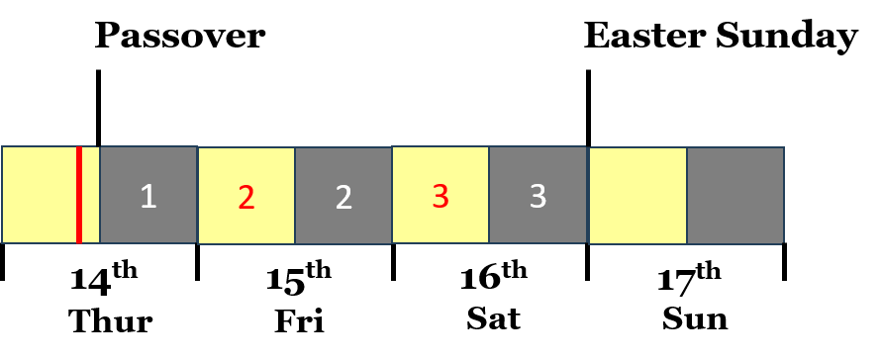

Slide 23
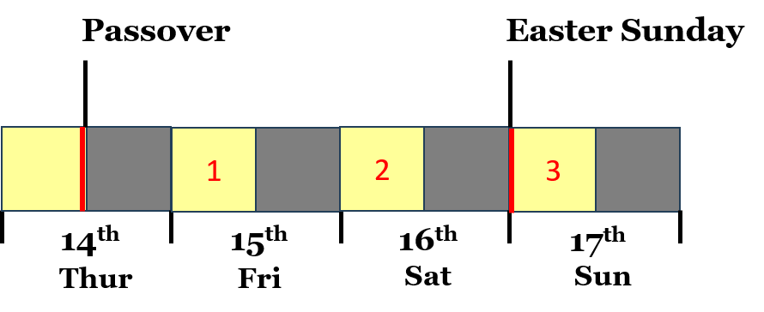

Slide 25
Exodus 12:3 Speak ye unto all the congregation of Israel, saying, In the tenth day of this month they shall take to them every man a lamb, according to the house of their fathers, a lamb for an house:

Slide 26
Exodus 12:6 And ye shall keep it up until the fourteenth day of the same month: and the whole assembly of the congregation of Israel shall kill it in the evening.

Slide 27
Visit Us:
TrueWordsBaptist.org
True Words Baptist Church – 1377 S. 20th St. Louisville, KY – TrueWordsBaptist.org

