Slide 1
Sunday Evening
Exodus 21
Joshua Tapp
True Words Baptist Church – 1377 S. 20th St. Louisville, KY – TrueWordsBaptist.org

Slide 2
Title of the Sermon
The Laws of Thy God:
The Death Penalty
True Words Baptist Church – 1377 S. 20th St. Louisville, KY – TrueWordsBaptist.org

Slide 3
Psalm 119:97-100 O how love I thy law! it is my meditation all the day. 98 Thou through thy commandments hast made me wiser than mine enemies: for they are ever with me. 99 I have more understanding than all my teachers: for thy testimonies are my meditation. 100 I understand more than the ancients, because I keep thy precepts.

Slide 4
Genesis 9:6 Whoso sheddeth man's blood, by man shall his blood be shed: for in the image of God made he man.

Slide 5
Exodus 21:12 He that smiteth a man, so that he die, shall be surely put to death.

Slide 6
Exodus 21:14 But if a man come presumptuously upon his neighbour, to slay him with guile; thou shalt take him from mine altar, that he may die.

Slide 7
Exodus 21:22-23 If men strive, and hurt a woman with child, so that her fruit depart from her, and yet no mischief follow: he shall be surely punished, according as the woman's husband will lay upon him; and he shall pay as the judges determine. 23 And if any mischief follow, then thou shalt give life for life,

Slide 8
Exodus 21:15 And he that smiteth his father, or his mother, shall be surely put to death.

Slide 9
Exodus 21:16 And he that stealeth a man, and selleth him, or if he be found in his hand, he shall surely be put to death.

Slide 10
Deuteronomy 24:7 If a man be found stealing any of his brethren of the children of Israel, and maketh merchandise of him, or selleth him; then that thief shall die; and thou shalt put evil away from among you.

Slide 11
Exodus 22:19 Whosoever lieth with a beast shall surely be put to death.

Slide 12
Deuteronomy 22:25 But if a man find a betrothed damsel in the field, and the man force her, and lie with her: then the man only that lay with her shall die:

Slide 13
Leviticus 20:10 And the man that committeth adultery with another man's wife, even he that committeth adultery with his neighbour's wife, the adulterer and the adulteress shall surely be put to death.

Slide 14
Leviticus 20:11-12 And the man that lieth with his father's wife hath uncovered his father's nakedness: both of them shall surely be put to death; their blood shall be upon them. 12 And if a man lie with his daughter in law, both of them shall surely be put to death: they have wrought confusion; their blood shall be upon them.

Slide 15
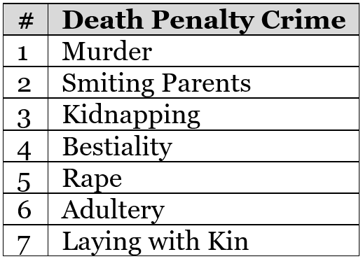

Slide 16
Leviticus 20:13 If a man also lie with mankind, as he lieth with a woman, both of them have committed an abomination: they shall surely be put to death; their blood shall be upon them.

Slide 17
Romans 1:32 Who knowing the judgment of God, that they which commit such things are worthy of death, not only do the same, but have pleasure in them that do them.

Slide 18
Deuteronomy 22:20-21 But if this thing be true, and the tokens of virginity be not found for the damsel: 21 Then they shall bring out the damsel to the door of her father's house, and the men of her city shall stone her with stones that she die: because she hath wrought folly in Israel, to play the whore in her father's house: so shalt thou put evil away from among you.

Slide 19
Exodus 22:18 Thou shalt not suffer a witch to live.

Slide 20
Leviticus 20:27 A man also or woman that hath a familiar spirit, or that is a wizard, shall surely be put to death: they shall stone them with stones: their blood shall be upon them.

Slide 21
Leviticus 20:2 Again, thou shalt say to the children of Israel, Whosoever he be of the children of Israel, or of the strangers that sojourn in Israel, that giveth any of his seed unto Molech; he shall surely be put to death: the people of the land shall stone him with stones.

Slide 22
Deuteronomy 17:3-5 And hath gone and served other gods, and worshipped them, either the sun, or moon, or any of the host of heaven, which I have not commanded; 4 And it be told thee, and thou hast heard of it, and inquired diligently, and, behold, it be true, and the thing certain, that such abomination is wrought in Israel: 5 Then shalt thou bring forth that man or that woman, which have committed that wicked thing, unto thy gates, even that man or that woman, and shalt stone them with stones, till they die.

Slide 23
Deuteronomy 18:20 But the prophet, which shall presume to speak a word in my name, which I have not commanded him to speak, or that shall speak in the name of other gods, even that prophet shall die.

Slide 24
Leviticus 24:16 And he that blasphemeth the name of the LORD, he shall surely be put to death, and all the congregation shall certainly stone him: as well the stranger, as he that is born in the land, when he blasphemeth the name of the LORD, shall be put to death.

Slide 25
Exodus 21:17 And he that curseth his father, or his mother, shall surely be put to death.

Slide 26
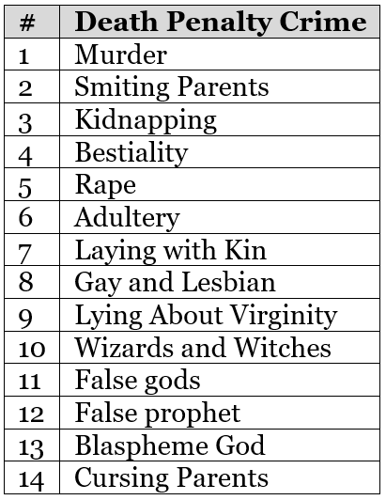

Slide 27
Deuteronomy 21:20-21 And they shall say unto the elders of his city, This our son is stubborn and rebellious, he will not obey our voice; he is a glutton, and a drunkard. 21 And all the men of his city shall stone him with stones, that he die: so shalt thou put evil away from among you; and all Israel shall hear, and fear.

Slide 28
Deuteronomy 19:18-19 And the judges shall make diligent inquisition: and, behold, if the witness be a false witness, and hath testified falsely against his brother; 19 Then shall ye do unto him, as he had thought to have done unto his brother: so shalt thou put the evil away from among you.

Slide 29
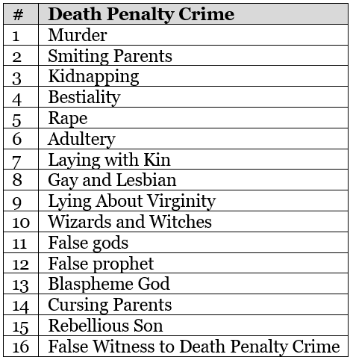

Slide 30
Deuteronomy 17:11-12 According to the sentence of the law which they shall teach thee, and according to the judgment which they shall tell thee, thou shalt do: thou shalt not decline from the sentence which they shall shew thee, to the right hand, nor to the left. 12 And the man that will do presumptuously, and will not hearken unto the priest that standeth to minister there before the LORD thy God, or unto the judge, even that man shall die: and thou shalt put away the evil from Israel.

Slide 31
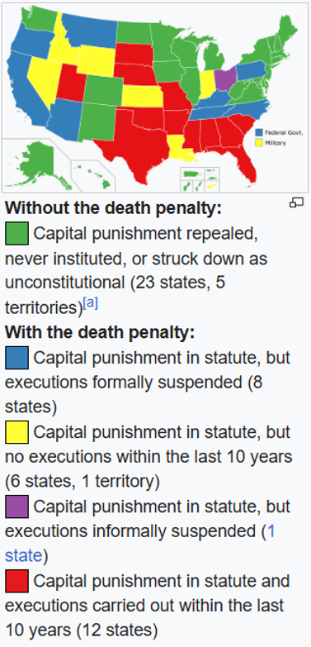

Slide 32
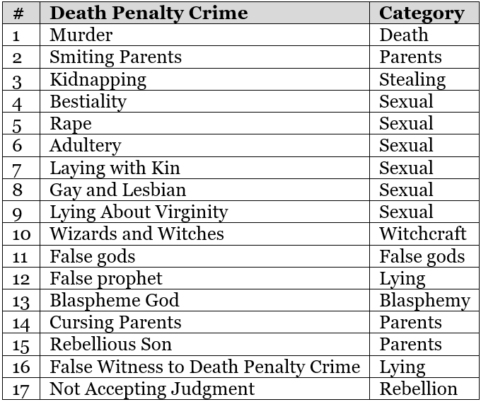

Slide 33
Visit Us:
TrueWordsBaptist.org
True Words Baptist Church – 1377 S. 20th St. Louisville, KY – TrueWordsBaptist.org

