Slide 1
Thursday Bible Study
Exodus 12
Joshua Tapp
True Words Baptist Church – 1377 S. 20th St. Louisville, KY – TrueWordsBaptist.org

Slide 2
Title of the Bible Study:
Instruction of the
Lord's Passover
True Words Baptist Church – 1377 S. 20th St. Louisville, KY – TrueWordsBaptist.org

Slide 3
Exodus 12:1-3 And the LORD spake unto Moses and Aaron in the land of Egypt, saying, 2 This month shall be unto you the beginning of months: it shall be the first month of the year to you. 3 Speak ye unto all the congregation of Israel, saying, In the tenth day of this month they shall take to them every man a lamb, according to the house of their fathers, a lamb for an house:

Slide 4
Exodus 12:5-6 Your lamb shall be without blemish, a male of the first year: ye shall take it out from the sheep, or from the goats: 6 And ye shall keep it up until the fourteenth day of the same month: and the whole assembly of the congregation of Israel shall kill it in the evening.

Slide 5
Exodus 12:7 And they shall take of the blood, and strike it on the two side posts and on the upper door post of the houses, wherein they shall eat it.

Slide 6
Exodus 12:8 And they shall eat the flesh in that night, roast with fire, and unleavened bread; and with bitter herbs they shall eat it.

Slide 7
Exodus 12:9-10 Eat not of it raw, nor sodden at all with water, but roast with fire; his head with his legs, and with the purtenance thereof. 10 And ye shall let nothing of it remain until the morning; and that which remaineth of it until the morning ye shall burn with fire.

Slide 8
Exodus 12:11 And thus shall ye eat it; with your loins girded, your shoes on your feet, and your staff in your hand; and ye shall eat it in haste: it is the LORD'S passover.

Slide 9
Exodus 12:12 For I will pass through the land of Egypt this night, and will smite all the firstborn in the land of Egypt, both man and beast; and against all the gods of Egypt I will execute judgment: I am the LORD.

Slide 10
Deuteronomy 32:39 See now that I, even I, am he, and there is no god with me: I kill, and I make alive; I wound, and I heal: neither is there any that can deliver out of my hand.

Slide 11
Exodus 12:13 And the blood shall be to you for a token upon the houses where ye are: and when I see the blood, I will pass over you, and the plague shall not be upon you to destroy you, when I smite the land of Egypt.

Slide 12
Exodus 12:14 And this day shall be unto you for a memorial; and ye shall keep it a feast to the LORD throughout your generations; ye shall keep it a feast by an ordinance for ever.

Slide 13
Exodus 12:15 Seven days shall ye eat unleavened bread; even the first day ye shall put away leaven out of your houses: for whosoever eateth leavened bread from the first day until the seventh day, that soul shall be cut off from Israel.

Slide 14
Ezekiel 45:21 In the first month, in the fourteenth day of the month, ye shall have the passover, a feast of seven days; unleavened bread shall be eaten.

Slide 15
Exodus 12:8 And they shall eat the flesh in that night, roast with fire, and unleavened bread; and with bitter herbs they shall eat it.

Slide 16
Matthew 26:17 Now the first day of the feast of unleavened bread the disciples came to Jesus, saying unto him, Where wilt thou that we prepare for thee to eat the passover?

Slide 17
Luke 22:1 Now the feast of unleavened bread drew nigh, which is called the Passover.

Slide 18
John 2:23 Now when he was in Jerusalem at the passover, in the feast day, many believed in his name, when they saw the miracles which he did.

Slide 19
Exodus 12:16 And in the first day there shall be an holy convocation, and in the seventh day there shall be an holy convocation to you; no manner of work shall be done in them, save that which every man must eat, that only may be done of you.

Slide 20
Exodus 12:17 And ye shall observe the feast of unleavened bread; for in this selfsame day have I brought your armies out of the land of Egypt: therefore shall ye observe this day in your generations by an ordinance for ever.

Slide 21
Exodus 12:18 In the first month, on the fourteenth day of the month at even, ye shall eat unleavened bread, until the one and twentieth day of the month at even.

Slide 22
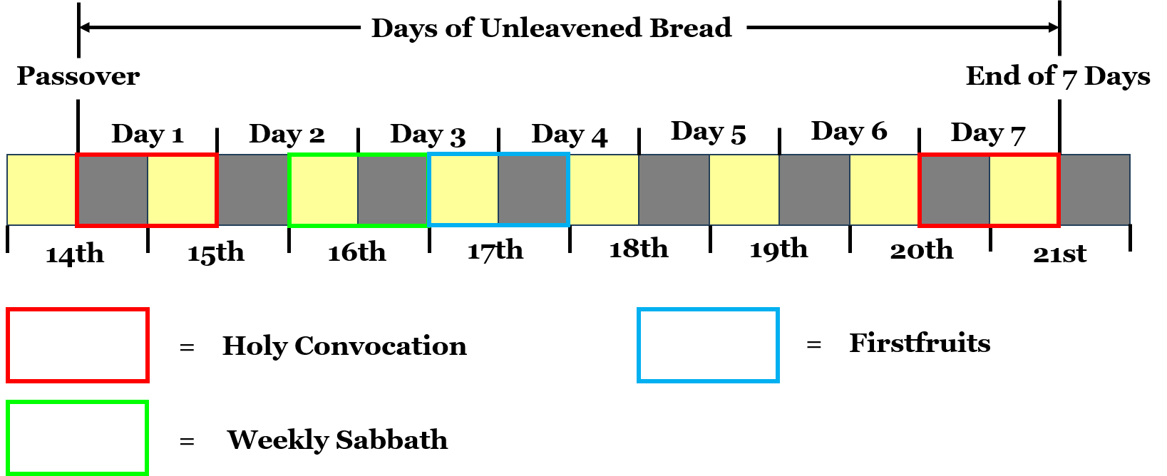

Slide 23
Exodus 12:19-20 Seven days shall there be no leaven found in your houses: for whosoever eateth that which is leavened, even that soul shall be cut off from the congregation of Israel, whether he be a stranger, or born in the land. 20 Ye shall eat nothing leavened; in all your habitations shall ye eat unleavened bread.

Slide 24
Visit Us:
TrueWordsBaptist.org
True Words Baptist Church – 1377 S. 20th St. Louisville, KY – TrueWordsBaptist.org

