Slide 1
Sunday School
Matthew 1
Joshua Tapp
True Words Baptist Church – 1377 S. 20th St. Louisville, KY – TrueWordsBaptist.org

Slide 2
Title of the Lesson:
Carried Away
To Babylon
True Words Baptist Church – 1377 S. 20th St. Louisville, KY – TrueWordsBaptist.org

Slide 3
Matthew 1:9 And Ozias begat Joatham; and Joatham begat Achaz; and Achaz begat Ezekias;

Slide 4
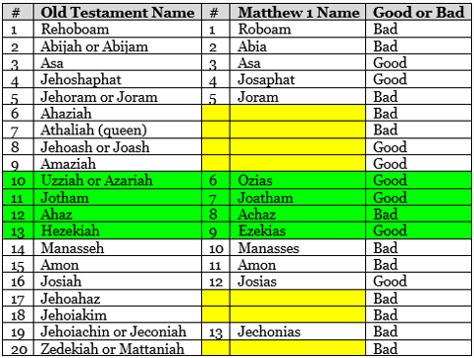

Slide 5
2 Kings 18:1-3 Now it came to pass in the third year of Hoshea son of Elah king of Israel, that Hezekiah the son of Ahaz king of Judah began to reign. 2 Twenty and five years old was he when he began to reign; and he reigned twenty and nine years in Jerusalem. His mother's name also was Abi, the daughter of Zachariah. 3 And he did that which was right in the sight of the LORD, according to all that David his father did.

Slide 6
2 Kings 18:4-6 He removed the high places, and brake the images, and cut down the groves, and brake in pieces the brasen serpent that Moses had made: for unto those days the children of Israel did burn incense to it: and he called it Nehushtan. 5 He trusted in the LORD God of Israel; so that after him was none like him among all the kings of Judah, nor any that were before him. 6 For he clave to the LORD, and departed not from following him, but kept his commandments, which the LORD commanded Moses.

Slide 7
2 Kings 20:1 In those days was Hezekiah sick unto death. And the prophet Isaiah the son of Amoz came to him, and said unto him, Thus saith the LORD, Set thine house in order; for thou shalt die, and not live.

Slide 8
2 Kings 20:2-3 Then he turned his face to the wall, and prayed unto the LORD, saying, 3 I beseech thee, O LORD, remember now how I have walked before thee in truth and with a perfect heart, and have done that which is good in thy sight. And Hezekiah wept sore.

Slide 9
Matthew 1:10 And Ezekias begat Manasses; and Manasses begat Amon; and Amon begat Josias;

Slide 10
2 Kings 21:1-2 Manasseh was twelve years old when he began to reign, and reigned fifty and five years in Jerusalem. And his mother's name was Hephzi-bah. 2 And he did that which was evil in the sight of the LORD, after the abominations of the heathen, whom the LORD cast out before the children of Israel.

Slide 11
2 Kings 21:3 For he built up again the high places which Hezekiah his father had destroyed; and he reared up altars for Baal, and made a grove, as did Ahab king of Israel; and worshipped all the host of heaven, and served them.

Slide 12
Jeremiah 25:4-6 And the LORD hath sent unto you all his servants the prophets, rising early and sending them; but ye have not hearkened, nor inclined your ear to hear. 5 They said, Turn ye again now every one from his evil way, and from the evil of your doings, and dwell in the land that the LORD hath given unto you and to your fathers for ever and ever: 6 And go not after other gods to serve them, and to worship them, and provoke me not to anger with the works of your hands; and I will do you no hurt.

Slide 13
2 Kings 21:9 But they hearkened not: and Manasseh seduced them to do more evil than did the nations whom the LORD destroyed before the children of Israel.

Slide 14
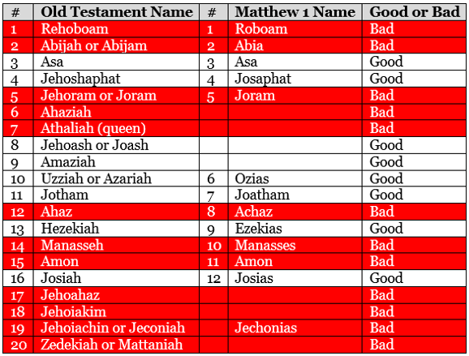

Slide 15
Matthew 1:11 And Josias begat Jechonias and his brethren, about the time they were carried away to Babylon:

Slide 16
2 Kings 24:8-9 Jehoiachin was eighteen years old when he began to reign, and he reigned in Jerusalem three months. And his mother's name was Nehushta, the daughter of Elnathan of Jerusalem. 9 And he did that which was evil in the sight of the LORD, according to all that his father had done.

Slide 17
2 Kings 24:10-11 At that time the servants of Nebuchadnezzar king of Babylon came up against Jerusalem, and the city was besieged. 11 And Nebuchadnezzar king of Babylon came against the city, and his servants did besiege it.

Slide 18
2 Kings 24:14 And he carried away all Jerusalem, and all the princes, and all the mighty men of valour, even ten thousand captives, and all the craftsmen and smiths: none remained, save the poorest sort of the people of the land.

Slide 19
2 Kings 24:15 And he carried away Jehoiachin to Babylon, and the king's mother, and the king's wives, and his officers, and the mighty of the land, those carried he into captivity from Jerusalem to Babylon.

Slide 20
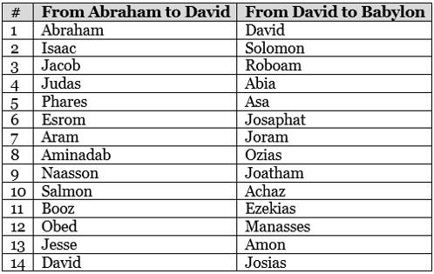

Slide 21
Visit Us:
TrueWordsBaptist.org
True Words Baptist Church – 1377 S. 20th St. Louisville, KY – TrueWordsBaptist.org

