Slide 1
Thursday Bible Study
Leviticus 23
Joshua Tapp
True Words Baptist Church – 1377 S. 20th St. Louisville, KY – TrueWordsBaptist.org

Slide 2
Title of the Bible Study:
The Three Spring Time Feasts of the Lord
Joshua Tapp
True Words Baptist Church – 1377 S. 20th St. Louisville, KY – TrueWordsBaptist.org

Slide 3
Leviticus 23:3 Six days shall work be done: but the seventh day is the sabbath of rest, an holy convocation; ye shall do no work therein: it is the sabbath of the LORD in all your dwellings.

Slide 4
Leviticus 23:4 These are the feasts of the LORD, even holy convocations, which ye shall proclaim in their seasons.

Slide 5
Leviticus 23:5 In the fourteenth day of the first month at even is the LORD'S passover.

Slide 6
Leviticus 23:5-8 In the fourteenth day of the first month at even is the LORD'S passover. 6 And on the fifteenth day of the same month is the feast of unleavened bread unto the LORD: seven days ye must eat unleavened bread. 7 In the first day ye shall have an holy convocation: ye shall do no servile work therein. 8 But ye shall offer an offering made by fire unto the LORD seven days: in the seventh day is an holy convocation: ye shall do no servile work therein.

Slide 7
Exodus 12:13-14 And the blood shall be to you for a token upon the houses where ye are: and when I see the blood, I will pass over you, and the plague shall not be upon you to destroy you, when I smite the land of Egypt. 14 And this day shall be unto you for a memorial; and ye shall keep it a feast to the LORD throughout your generations; ye shall keep it a feast by an ordinance for ever.

Slide 8
Exodus 12:15-16 Seven days shall ye eat unleavened bread; even the first day ye shall put away leaven out of your houses: for whosoever eateth leavened bread from the first day until the seventh day, that soul shall be cut off from Israel. 16 And in the first day there shall be an holy convocation, and in the seventh day there shall be an holy convocation to you; no manner of work shall be done in them, save that which every man must eat, that only may be done of you.

Slide 9
Exodus 12:17-18 And ye shall observe the feast of unleavened bread; for in this selfsame day have I brought your armies out of the land of Egypt: therefore shall ye observe this day in your generations by an ordinance for ever. 18 In the first month, on the fourteenth day of the month at even, ye shall eat unleavened bread, until the one and twentieth day of the month at even.

Slide 11
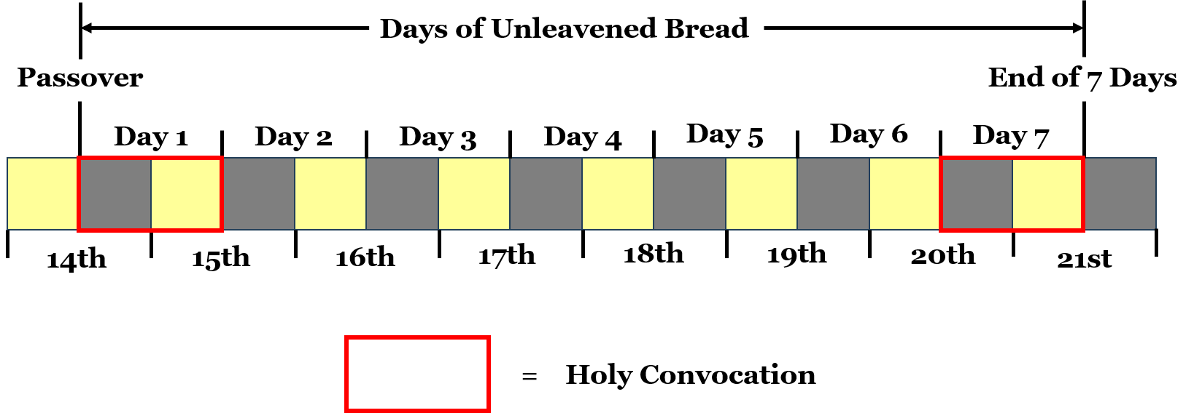

Slide 12
Leviticus 23:9-11 And the LORD spake unto Moses, saying, 10 Speak unto the children of Israel, and say unto them, When ye be come into the land which I give unto you, and shall reap the harvest thereof, then ye shall bring a sheaf of the firstfruits of your harvest unto the priest: 11 And he shall wave the sheaf before the LORD, to be accepted for you: on the morrow after the sabbath the priest shall wave it.

Slide 13
Matthew 28:1 In the end of the sabbath, as it began to dawn toward the first day of the week, came Mary Magdalene and the other Mary to see the sepulchre.

Slide 15
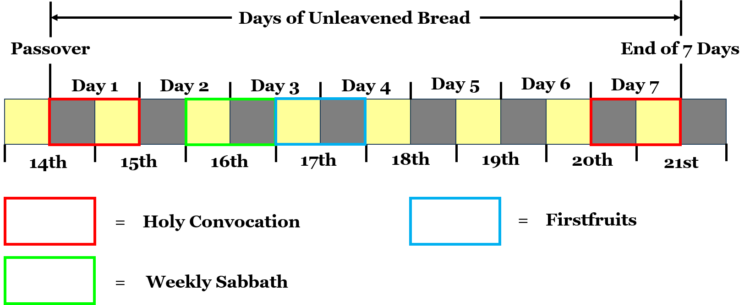

Slide 16
Visit Us:
TrueWordsBaptist.org
True Words Baptist Church – 1377 S. 20th St. Louisville, KY – TrueWordsBaptist.org

