Slide 1
Sunday School
Matthew 2
Joshua Tapp
True Words Baptist Church – 1377 S. 20th St. Louisville, KY – TrueWordsBaptist.org

Slide 2
Title of the Lesson
Jesus of Nazareth
True Words Baptist Church – 1377 S. 20th St. Louisville, KY – TrueWordsBaptist.org

Slide 3
Luke 2:4-5 And Joseph also went up from Galilee, out of the city of Nazareth, into Judaea, unto the city of David, which is called Bethlehem; (because he was of the house and lineage of David:) 5 To be taxed with Mary his espoused wife, being great with child.

Slide 4
Matthew 2:5-6 And they said unto him, In Bethlehem of Judaea: for thus it is written by the prophet, 6 And thou Bethlehem, in the land of Juda, art not the least among the princes of Juda: for out of thee shall come a Governor, that shall rule my people Israel.

Slide 5
Matthew 2:19-20 But when Herod was dead, behold, an angel of the Lord appeareth in a dream to Joseph in Egypt, 20 Saying, Arise, and take the young child and his mother, and go into the land of Israel: for they are dead which sought the young child's life.

Slide 6
Matthew 2:21-23 And he arose, and took the young child and his mother, and came into the land of Israel. 22 But when he heard that Archelaus did reign in Judaea in the room of his father Herod, he was afraid to go thither: notwithstanding, being warned of God in a dream, he turned aside into the parts of Galilee: 23 And he came and dwelt in a city called Nazareth: that it might be fulfilled which was spoken by the prophets, He shall be called a Nazarene.

Slide 7
Luke 2:21-22 And when eight days were accomplished for the circumcising of the child, his name was called JESUS, which was so named of the angel before he was conceived in the womb. 22 And when the days of her purification according to the law of Moses were accomplished, they brought him to Jerusalem, to present him to the Lord;

Slide 8
Leviticus 12:1-2 And the LORD spake unto Moses, saying, 2 Speak unto the children of Israel, saying, If a woman have conceived seed, and born a man child: then she shall be unclean seven days; according to the days of the separation for her infirmity shall she be unclean.

Slide 9
Leviticus 12:3-4 And in the eighth day the flesh of his foreskin shall be circumcised. 4 And she shall then continue in the blood of her purifying three and thirty days; she shall touch no hallowed thing, nor come into the sanctuary, until the days of her purifying be fulfilled.

Slide 10
Matthew 2:23 And he came and dwelt in a city called Nazareth: that it might be fulfilled which was spoken by the prophets, He shall be called a Nazarene.

Slide 11
John 7:37-39 In the last day, that great day of the feast, Jesus stood and cried, saying, If any man thirst, let him come unto me, and drink. 38 He that believeth on me, as the scripture hath said, out of his belly shall flow rivers of living water. 39 (But this spake he of the Spirit, which they that believe on him should receive: for the Holy Ghost was not yet given; because that Jesus was not yet glorified.)

Slide 12
John 7:40-43 Many of the people therefore, when they heard this saying, said, Of a truth this is the Prophet. 41 Others said, This is the Christ. But some said, Shall Christ come out of Galilee? 42 Hath not the scripture said, That Christ cometh of the seed of David, and out of the town of Bethlehem, where David was? 43 So there was a division among the people because of him.

Slide 13
John 7:1 After these things Jesus walked in Galilee: for he would not walk in Jewry, because the Jews sought to kill him.

Slide 14
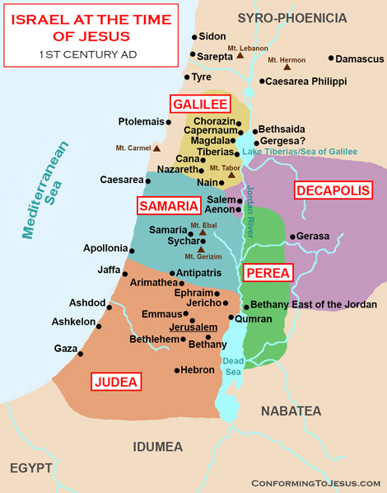

Slide 15
John 7:45-48 Then came the officers to the chief priests and Pharisees; and they said unto them, Why have ye not brought him? 46 The officers answered, Never man spake like this man. 47 Then answered them the Pharisees, Are ye also deceived? 48 Have any of the rulers or of the Pharisees believed on him?

Slide 16
John 7:49 But this people who knoweth not the law are cursed.

Slide 17
John 7:50-52 Nicodemus saith unto them, (he that came to Jesus by night, being one of them,) 51 Doth our law judge any man, before it hear him, and know what he doeth? 52 They answered and said unto him, Art thou also of Galilee? Search, and look: for out of Galilee ariseth no prophet.

Slide 18
John 1:45-46 Philip findeth Nathanael, and saith unto him, We have found him, of whom Moses in the law, and the prophets, did write, Jesus of Nazareth, the son of Joseph. 46 And Nathanael said unto him, Can there any good thing come out of Nazareth? Philip saith unto him, Come and see.

Slide 19
Matthew 2:23 And he came and dwelt in a city called Nazareth: that it might be fulfilled which was spoken by the prophets, He shall be called a Nazarene.

Slide 20
Psalm 22:6-8 But I am a worm, and no man; a reproach of men, and despised of the people. 7 All they that see me laugh me to scorn: they shoot out the lip, they shake the head, saying, 8 He trusted on the LORD that he would deliver him: let him deliver him, seeing he delighted in him.

Slide 21
Isaiah 53:3 He is despised and rejected of men; a man of sorrows, and acquainted with grief: and we hid as it were our faces from him; he was despised, and we esteemed him not.

Slide 22
Isaiah 49:7 Thus saith the LORD, the Redeemer of Israel, and his Holy One, to him whom man despiseth, to him whom the nation abhorreth, to a servant of rulers, Kings shall see and arise, princes also shall worship, because of the LORD that is faithful, and the Holy One of Israel, and he shall choose thee.

Slide 23
Isaiah 50:6 I gave my back to the smiters, and my cheeks to them that plucked off the hair: I hid not my face from shame and spitting.

Slide 24
Revelation 1:5-6 And from Jesus Christ, who is the faithful witness, and the first begotten of the dead, and the prince of the kings of the earth. Unto him that loved us, and washed us from our sins in his own blood, 6 And hath made us kings and priests unto God and his Father; to him be glory and dominion for ever and ever. Amen.

Slide 25
Revelation 5:10 And hast made us unto our God kings and priests: and we shall reign on the earth.

Slide 26
Visit Us:
TrueWordsBaptist.org
True Words Baptist Church – 1377 S. 20th St. Louisville, KY – TrueWordsBaptist.org

