Slide 1
Sunday School
Matthew 1
Joshua Tapp
True Words Baptist Church – 1377 S. 20th St. Louisville, KY – TrueWordsBaptist.org

Slide 2
Title of the Lesson:
The Kings In The Generation of
Jesus Christ
True Words Baptist Church – 1377 S. 20th St. Louisville, KY – TrueWordsBaptist.org

Slide 3
Matthew 1:6-7 And Jesse begat David the king; and David the king begat Solomon of her that had been the wife of Urias; 7 And Solomon begat Roboam; and Roboam begat Abia; and Abia begat Asa;

Slide 4
1 Timothy 3:16 And without controversy great is the mystery of godliness: God was manifest in the flesh, justified in the Spirit, seen of angels, preached unto the Gentiles, believed on in the world, received up into glory.

Slide 5
Matthew 1:7 And Solomon begat Roboam; and Roboam begat Abia; and Abia begat Asa;

Slide 6
1 Kings 11:1-2 But king Solomon loved many strange women, together with the daughter of Pharaoh, women of the Moabites, Ammonites, Edomites, Zidonians, and Hittites; 2 Of the nations concerning which the LORD said unto the children of Israel, Ye shall not go in to them, neither shall they come in unto you: for surely they will turn away your heart after their gods: Solomon clave unto these in love.

Slide 7
1 Kings 11:3-4 And he had seven hundred wives, princesses, and three hundred concubines: and his wives turned away his heart. 4 For it came to pass, when Solomon was old, that his wives turned away his heart after other gods: and his heart was not perfect with the LORD his God, as was the heart of David his father.

Slide 8
1 Kings 11:5-6 For Solomon went after Ashtoreth the goddess of the Zidonians, and after Milcom the abomination of the Ammonites. 6 And Solomon did evil in the sight of the LORD, and went not fully after the LORD, as did David his father.

Slide 9
1 Kings 11:7-8 Then did Solomon build an high place for Chemosh, the abomination of Moab, in the hill that is before Jerusalem, and for Molech, the abomination of the children of Ammon. 8 And likewise did he for all his strange wives, which burnt incense and sacrificed unto their gods.

Slide 10
1 Kings 11:9-10 And the LORD was angry with Solomon, because his heart was turned from the LORD God of Israel, which had appeared unto him twice, 10 And had commanded him concerning this thing, that he should not go after other gods: but he kept not that which the LORD commanded.

Slide 11
1 Kings 11:11 Wherefore the LORD said unto Solomon, Forasmuch as this is done of thee, and thou hast not kept my covenant and my statutes, which I have commanded thee, I will surely rend the kingdom from thee, and will give it to thy servant.

Slide 12
1 Kings 11:12-13 Notwithstanding in thy days I will not do it for David thy father's sake: but I will rend it out of the hand of thy son. 13 Howbeit I will not rend away all the kingdom; but will give one tribe to thy son for David my servant's sake, and for Jerusalem's sake which I have chosen.

Slide 13
Matthew 1:7 And Solomon begat Roboam; and Roboam begat Abia; and Abia begat Asa;

Slide 14
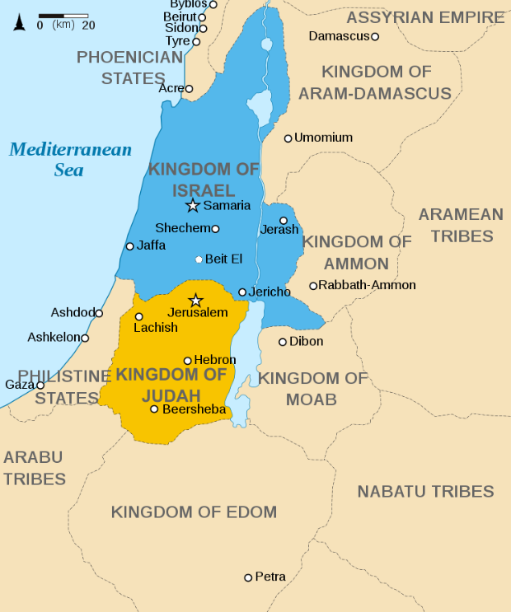

Slide 15
Matthew 1:7 And Solomon begat Roboam; and Roboam begat Abia; and Abia begat Asa;

Slide 16
1 Kings 15:11-12 And Asa did that which was right in the eyes of the LORD, as did David his father. 12 And he took away the sodomites out of the land, and removed all the idols that his fathers had made.

Slide 17
1 Kings 15:13 And also Maachah his mother, even her he removed from being queen, because she had made an idol in a grove; and Asa destroyed her idol, and burnt it by the brook Kidron.

Slide 18
Matthew 1:8 And Asa begat Josaphat; and Josaphat begat Joram; and Joram begat Ozias;

Slide 19
Visit Us:
TrueWordsBaptist.org
True Words Baptist Church – 1377 S. 20th St. Louisville, KY – TrueWordsBaptist.org

