Slide 1
Thursday Bible Study
Genesis 1
Joshua Tapp
True Words Baptist Church – 1377 S. 20th St. Louisville, KY – TrueWordsBaptist.org

Slide 2
Title of the Bible Study:
The First Day
Joshua Tapp
True Words Baptist Church – 1377 S. 20th St. Louisville, KY – TrueWordsBaptist.org

Slide 3
Genesis 1:1-2 In the beginning God created the heaven and the earth. 2 And the earth was without form, and void; and darkness was upon the face of the deep. And the Spirit of God moved upon the face of the waters.

Slide 4
1 John 1:5 This then is the message which we have heard of him, and declare unto you, that God is light, and in him is no darkness at all.

Slide 5
Psalm 27:1 The LORD is my light and my salvation; whom shall I fear? the LORD is the strength of my life; of whom shall I be afraid?

Slide 6
Psalm 36:9 For with thee is the fountain of life: in thy light shall we see light.

Slide 7
Psalm 84:11 For the LORD God is a sun and shield: the LORD will give grace and glory: no good thing will he withhold from them that walk uprightly.

Slide 8
Isaiah 60:19 The sun shall be no more thy light by day; neither for brightness shall the moon give light unto thee: but the LORD shall be unto thee an everlasting light, and thy God thy glory.

Slide 9
John 1:4 In him was life; and the life was the light of men.

Slide 10
John 1:9 That was the true Light, which lighteth every man that cometh into the world.

Slide 11
John 8:12 Then spake Jesus again unto them, saying, I am the light of the world: he that followeth me shall not walk in darkness, but shall have the light of life.

Slide 12
Revelation 21:23 And the city had no need of the sun, neither of the moon, to shine in it: for the glory of God did lighten it, and the Lamb is the light thereof.

Slide 13
Revelation 22:5 And there shall be no night there; and they need no candle, neither light of the sun; for the Lord God giveth them light: and they shall reign for ever and ever.

Slide 14
Genesis 1:1-2 In the beginning God created the heaven and the earth. 2 And the earth was without form, and void; and darkness was upon the face of the deep. And the Spirit of God moved upon the face of the waters.

Slide 15
Genesis 1:3-4 And God said, Let there be light: and there was light. 4 And God saw the light, that it was good: and God divided the light from the darkness.

Slide 16
Genesis 1:5 And God called the light Day, and the darkness he called Night. And the evening and the morning were the first day.

Slide 17
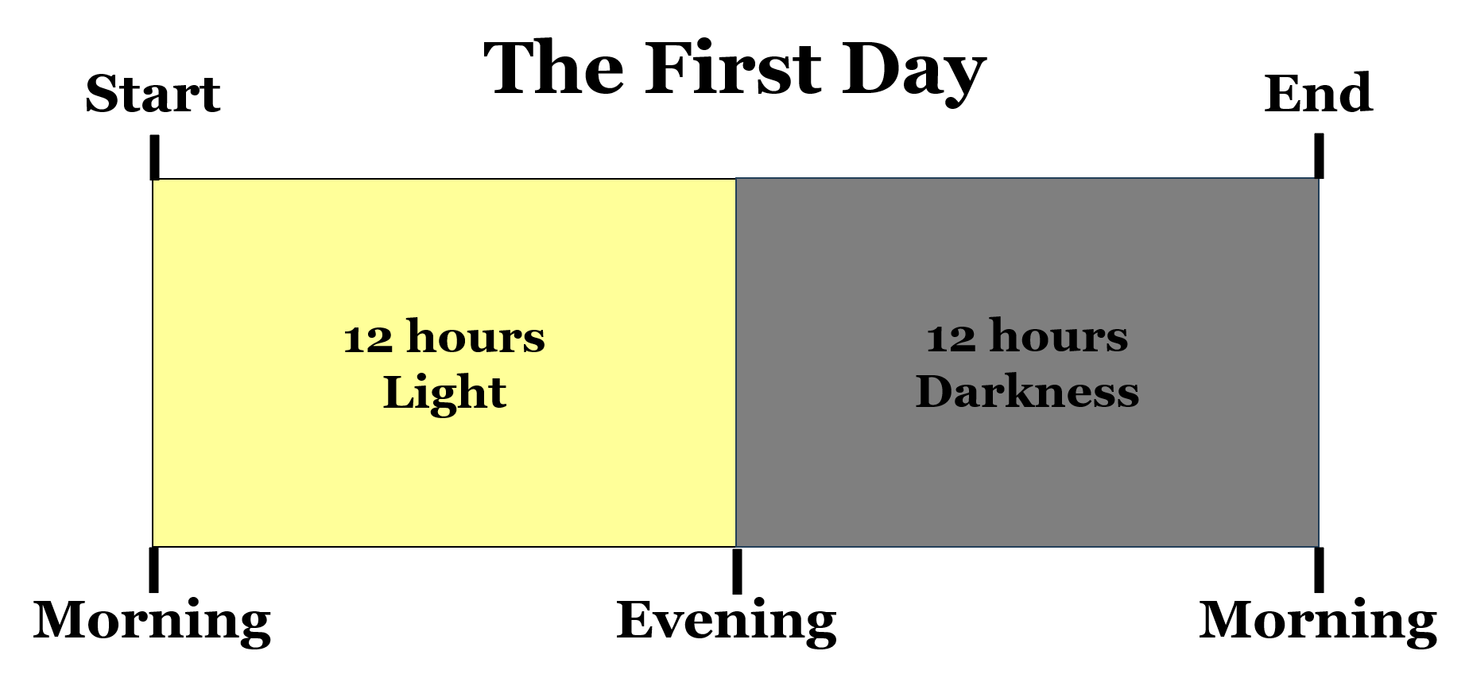

Slide 18
Genesis 1:5 And God called the light Day, and the darkness he called Night. And the evening and the morning were the first day.

Slide 19
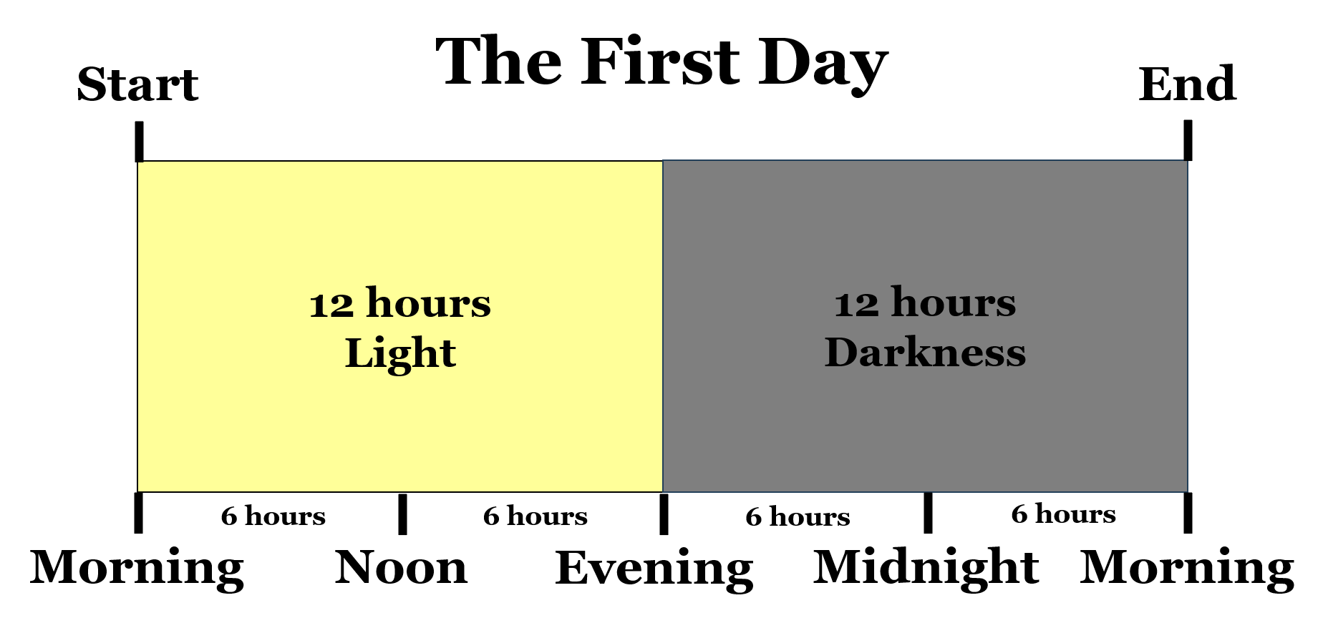

Slide 20
Genesis 1:31 And God saw every thing that he had made, and, behold, it was very good. And the evening and the morning were the sixth day.

Slide 21
Daniel 8:26 And the vision of the evening and the morning which was told is true: wherefore shut thou up the vision; for it shall be for many days.

Slide 22
Genesis 1:5 And God called the light Day, and the darkness he called Night. And the evening and the morning were the first day.

Slide 23
John 11:9-10 Jesus answered, Are there not twelve hours in the day? If any man walk in the day, he stumbleth not, because he seeth the light of this world. 10 But if a man walk in the night, he stumbleth, because there is no light in him.

Slide 24
John 9:4 I must work the works of him that sent me, while it is day: the night cometh, when no man can work.

Slide 25
John 12:35 Then Jesus said unto them, Yet a little while is the light with you. Walk while ye have the light, lest darkness come upon you: for he that walketh in darkness knoweth not whither he goeth.

Slide 26
Genesis 2:1-3 Thus the heavens and the earth were finished, and all the host of them. 2 And on the seventh day God ended his work which he had made; and he rested on the seventh day from all his work which he had made. 3 And God blessed the seventh day, and sanctified it: because that in it he had rested from all his work which God created and made.

Slide 27
Visit Us:
TrueWordsBaptist.org
True Words Baptist Church – 1377 S. 20th St. Louisville, KY – TrueWordsBaptist.org

