Slide 1
Thursday Bible Study
Matthew 28
Joshua Tapp
True Words Baptist Church – 1377 S. 20th St. Louisville, KY – TrueWordsBaptist.org

Slide 2
Title of the Bible Study:
Day vs. Night
Joshua Tapp
True Words Baptist Church – 1377 S. 20th St. Louisville, KY – TrueWordsBaptist.org

Slide 3
Matthew 28:1 In the end of the sabbath, as it began to dawn toward the first day of the week, came Mary Magdalene and the other Mary to see the sepulchre.

Slide 4
Genesis 2:2-3 And on the seventh day God ended his work which he had made; and he rested on the seventh day from all his work which he had made. 3 And God blessed the seventh day, and sanctified it: because that in it he had rested from all his work which God created and made.

Slide 5
Exodus 16:22-23 And it came to pass, that on the sixth day they gathered twice as much bread, two omers for one man: and all the rulers of the congregation came and told Moses. 23 And he said unto them, This is that which the LORD hath said, To morrow is the rest of the holy sabbath unto the LORD: bake that which ye will bake to day, and seethe that ye will seethe; and that which remaineth over lay up for you to be kept until the morning.

Slide 6
Matthew 28:1 In the end of the sabbath, as it began to dawn toward the first day of the week, came Mary Magdalene and the other Mary to see the sepulchre.

Slide 7
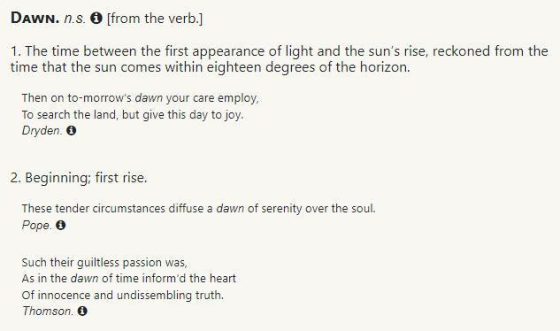

Slide 8
Malachi 4:2 But unto you that fear my name shall the Sun of righteousness arise with healing in his wings; and ye shall go forth, and grow up as calves of the stall.

Slide 9
Jewish Day vs. Biblical Day
Saturday
Sunday
Morning
Evening
Morning
Evening
Morning
Evening
Morning
Friday
Saturday
Sunday

Slide 10
Biblical Day vs. Night
Morning
Evening
Morning
Evening
Morning
Evening
Morning
Friday
Saturday
Sunday

Slide 11
Matthew 11:28-30 Come unto me, all ye that labour and are heavy laden, and I will give you rest. 29 Take my yoke upon you, and learn of me; for I am meek and lowly in heart: and ye shall find rest unto your souls. 30 For my yoke is easy, and my burden is light.

Slide 12
Exodus 20:8-10 Remember the sabbath day, to keep it holy. 9 Six days shalt thou labour, and do all thy work: 10 But the seventh day is the sabbath of the LORD thy God: in it thou shalt not do any work, thou, nor thy son, nor thy daughter, thy manservant, nor thy maidservant, nor thy cattle, nor thy stranger that is within thy gates:

Slide 13
Exodus 20:11 For in six days the LORD made heaven and earth, the sea, and all that in them is, and rested the seventh day: wherefore the LORD blessed the sabbath day, and hallowed it.

Slide 14
Exodus 16:23-24 And he said unto them, This is that which the LORD hath said, To morrow is the rest of the holy sabbath unto the LORD: bake that which ye will bake to day, and seethe that ye will seethe; and that which remaineth over lay up for you to be kept until the morning. 24 And they laid it up till the morning, as Moses bade: and it did not stink, neither was there any worm therein.

Slide 15
Exodus 16:24-26 And they laid it up till the morning, as Moses bade: and it did not stink, neither was there any worm therein. 25 And Moses said, Eat that to day; for to day is a sabbath unto the LORD: to day ye shall not find it in the field. 26 Six days ye shall gather it; but on the seventh day, which is the sabbath, in it there shall be none.

Slide 16
1 Thessalonians 5:4-5 But ye, brethren, are not in darkness, that that day should overtake you as a thief. 5 Ye are all the children of light, and the children of the day: we are not of the night, nor of darkness.

Slide 17
Visit Us:
TrueWordsBaptist.org
True Words Baptist Church – 1377 S. 20th St. Louisville, KY – TrueWordsBaptist.org

